Slide 1
An Outline of Today’s Work Monday 1 February 2021
Subject | Subject/Website | Topic | Activity/ Instruction
Maths | White Rose Year 3 Spring Block Multiplication and Division | Multiply 2-digit by 1-digit - no exchange -activity | White Rose Teaching Video Related worksheets in today’s folder )
 | Twinkle Go! | Times Tables | Use your login to access the games. PINCODE: VD0158
English | National Curriculum Word | ‘early’ | Worksheet is in the today’s folder
 | High Frequency Spelling Words | Weekly 5! | 5 High Frequency Words to learn for the week. Sheet in the folder
 | Comprehension The Twits | The Glass Eye The Frog | Question sheet and Text in the folder
RE | Islam | Why is the Mosque a Special place for Muslims? | Video links to watch PPT Twinkle Go resources Activity sheet
Worship | Rev Julie |  | A link can be found in the Whole School Folder

Slide 2
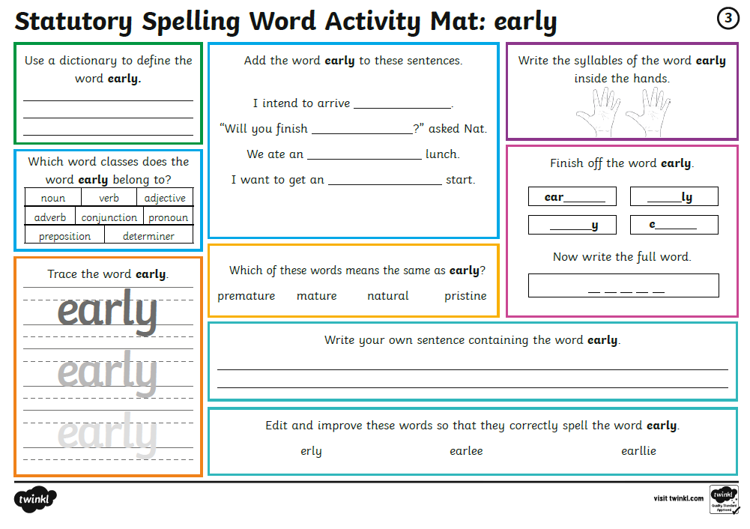

Slide 3
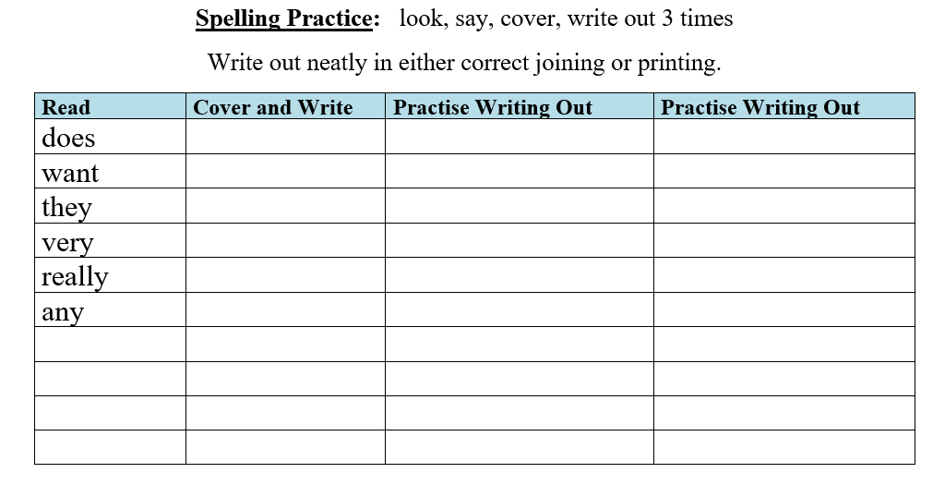
SPELLING
Every Monday I will be setting 5 High Frequency Spelling Words for you to learn to spell.
They are separate to the National Curriculum words, are words that we use often and MUST know how to spell.
I will include some in our weekly dictation and they will be part of our quiz on a Friday.
There is a ‘Look, Cover, Write’ check sheet to help you learn theses words.
Interactive Spelling Game
National Curriculum Words and Words with Spelling Patterns
http://www.ictgames.com/mobilePage/lcwc/index.html

Slide 4
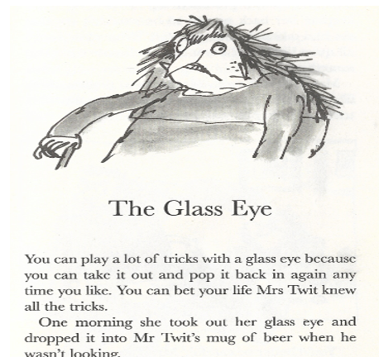

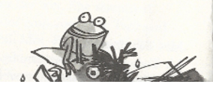
Comprehension
Ask an adult to discuss the questions with you if you are not feeling confident.
You must use paper or an exercise book to answer the questions.
You will find the question sheet in the folder.

Slide 5
Super Work!
Have a short break and then start on the Math’s Tasks.

Slide 6

Maths :
Multiply 2-digits by 1-digit (no exchange) activity
Follow this link to the White Rose website to watch the video clip and pause to complete the activities. Have paper, a pencil and rubber ready to jot down your answers.
https://whiterosemaths.com/homelearning/year-3/week-1-number-multiplication-division/
Although there are no White Rose sheets you will find related worksheets in the math’s folder on the Kingsland Website.

Slide 7



Times Tables Rock
https://play.ttrockstars.com/auth/school/student/78867
11 Times Table
https://www.twinkl.co.uk/go
Use your login details to access the games.
PINCODE: VD0158
https://www.youtube.com/watch?v=p9AxbcO4Kp4

Slide 8
Have a lunch break!

Slide 9

Why is The Mosque important to Muslims?
Below are a selection of video clips to watch as well as a PPT in the folder before you complete the activity sheet.
Kaisan visits a London Mosque
https://www.bbc.co.uk/teach/class-clips-video/religious-education-ks2-my-life-my-religion-east-london-mosque/zmctvk7
Kaisan demonstrates ‘Wudu’ –washing ritual
https://www.bbc.co.uk/teach/class-clips-video/religious-education-ks2-my-life-my-religion-washing-ritual-wudu/zvmrwty
If you login in to Twinkle Go, you will find: Looking around a Mosque ( potos)
Places of Worship PPT (photos)
Places Of Worship ( inside a Mosque)
Islam ( interactive PPT)
Twinkle Go-PIN:
ZV2730

Slide 10
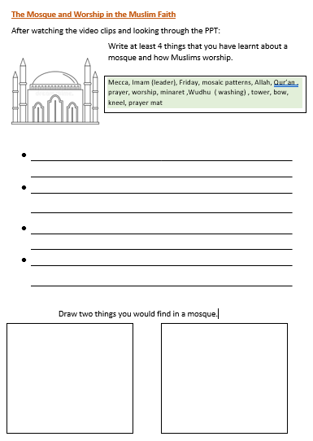
Complete the activity sheet.
write in full sentences
use neat handwriting
use detail and colour
in your drawings

Slide 11

Follow the link for Today’s Worship
In the Whole School Folder

Slide 12
Have a super day, give of your best and please send me an e mail this afternoon with examples of your work.
teacher@kingslandengland.hereford.sch.uk
In the subject line could you have :
Year 3 and name of your child
Please only send one email a day with either attachments or a photo of work completed.

