Slide 1
An Outline of Today’s Work Friday 29th January 2021
Subject | Subject/Website | Topic | Activity/ Instruction
English | Handwriting | Upper- and Lower-case Letters | Letters to trace and write Lined handwriting Paper
 | Written Task | How to write instructions | PPT Recipe Worksheet
Maths | White Rose Year 3 Spring Block Multiplication and Division | Related Calculations | Watch the White Rose video and pause to complete the activities In the Math’s Folder you will find a related White Rose sheet and extension sheets.
French |  |  | See work set by Mr Powell in our Year 3 folder
PE |  |  | See work set by Mr Powell and Miss Price in our Year 3 folder
Worship | ‘Big Joe’ |  | Links are emailed or can be found in the ‘Whole School ‘folder.

Slide 2
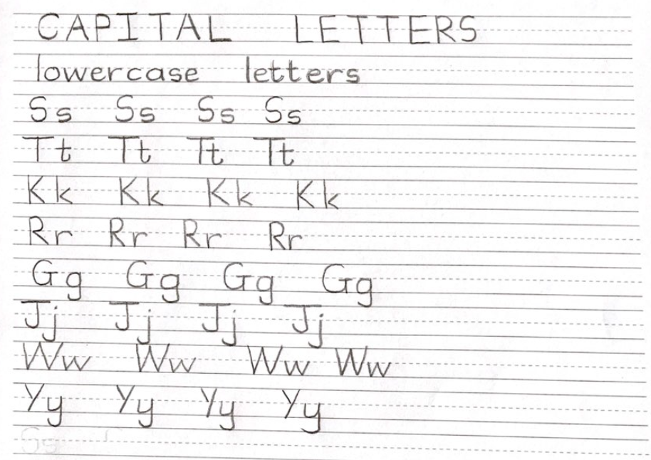

Slide 3

Handwriting Lines

Slide 4
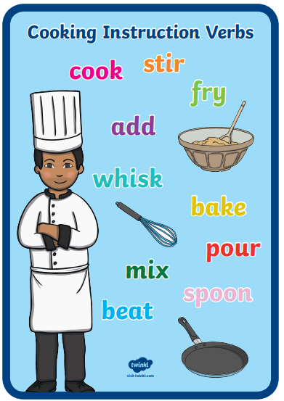
Writing a Recipe
Go through the PPT in the folder
Have your list of unusual ingredients
Use the template in the folder
Write your own recipe for Wormy Spaghetti
Remember to include all the features of instructional writing
You can draw a picture at the end

Slide 5
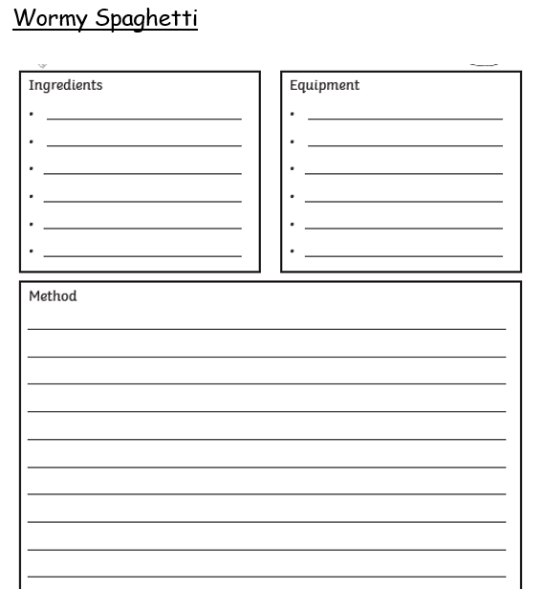

Slide 6
Super Work!
Have a short break and then start on the English Tasks.

Slide 7

Maths :
Related Calculations
Follow this link to the White Rose website to watch the video clip and pause to complete the activities. Have paper, a pencil and rubber ready to jot down your answers.
https://whiterosemaths.com/homelearning/year-3/week-1-number-multiplication-division/
You will find related worksheets in the math’s folder on the Kingsland Website.

Slide 8


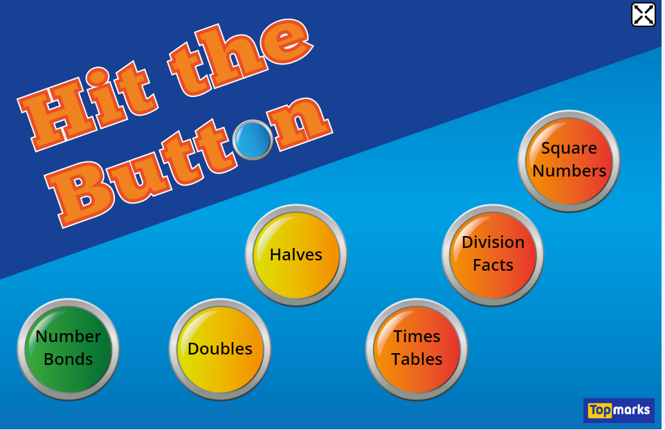
Times Tables Rock
https://play.ttrockstars.com/auth/school/student/78867
8x table
https://www.youtube.com/watch?v=TdqAA9Ky2DY
https://www.topmarks.co.uk/maths-games/hit-the-button

Slide 9
Have a lunch break!

Slide 10

For French and PE, see activities in the Year 3 Folder.

Slide 11

Follow the link for Today’s Worship
This can be found in the
‘Whole School’ folder.

Slide 12
Have a super day, give of your best and please send me an e mail this afternoon with examples of your work.
teacher@kingslandengland.hereford.sch.uk
In the subject line could you have :
Year 3 and name of your child
Please only send one email a day with either attachments or a photo of work completed.

