Slide 1
An Outline of Today’s Work Thursday 28th January 2021
Subject | Subject/Website | Topic | Activity/ Instruction
English | Spag Mat 4 | Spelling, punctuation and grammar | Worksheet is in the English folder
 | Imperative Verbs | Using bossy verbs | PPT Worksheet in the folder
 | Written Task | Ridiculous Recipe | Read or Listen again to the Chapter: ‘The Wormy Spaghetti’ Sheet to complete
Maths | White Rose Year 3 Spring Block Multiplication and Division | Comparing Statements | Watch the White Rose video and pause to complete the activities In the Math’s Folder you will find a related White Rose sheet and extension sheets.
PE/Dance | Go -Noodle | Footloose I Can’t Stop the Feeling | Watch the video clip and get up and move
ICT | Digital Literacy | What is the Internet? How can you use the internet? | Follow the BBC link and complete the activity sheet in the folder.
Worship | Mark Harrington, Hereford Diocese |  | Links are emailed or can be found in the ‘Whole School ‘folder.

Slide 2
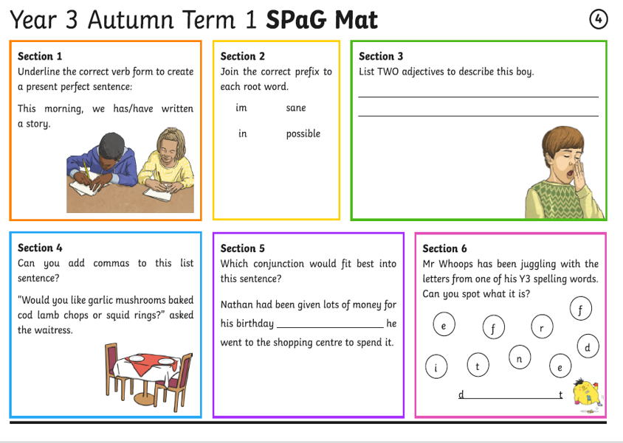

Slide 3
Twinkle Go!
Let’s Have a Go!
Please could you try to log in to ‘Twinkle Go’ for a PPT about Imperative Verbs
The same PPT is available in the Year 3 folder in case your login does not work.
I would like to use this site occasionally for access to interactive PPTs and files that are too large to upload onto the website.
The login details should be in the email sent to you today, if not let me know and I’ll resend it.
If you personalise passwords, please keep these details as I will not have a record of the changes you have made.
Please let me know how you get on and if you now have access.
Step by step instructions are on the next slide.

Slide 4
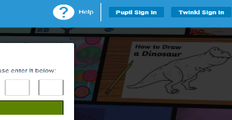

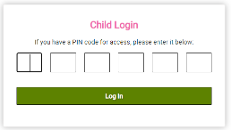
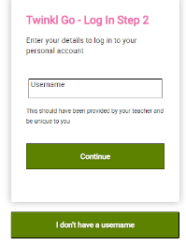

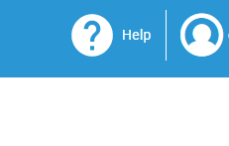
TWINKLE GO
Follow the instructions to have access to Twinkle Go
Follow this link:
https://www.twinkl.co.uk/go
Select the ‘Pupil Sign In’ button in the top, right hand corner
Enter the PIN code: DO5423
Now fill in the Username and password e-mailed to you.
This is your account. Click on the account icon to see resources shared.

Slide 5
If you have successfully logged in to Twinkle Go,
watch the PPT on Imperative Verbs and then complete the sheet in the folder
OR
If you have not successfully logged in to Twinkle Go,
watch the PPT on Imperative Verbs in the folder and then complete the sheet in the folder

Slide 6
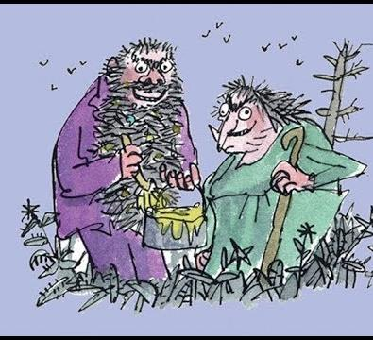

The Twits
By Roald Dahl
9:31
Wormy Spaghetti
https://www.youtube.com/watch?v=EgppUh8ukZ8
Audio Book

Slide 7
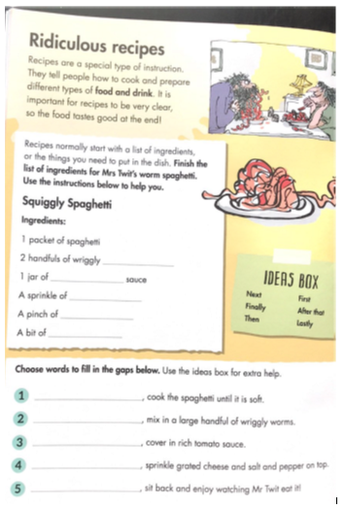
This sheet is in the Year 3 folder for you to complete

Slide 8
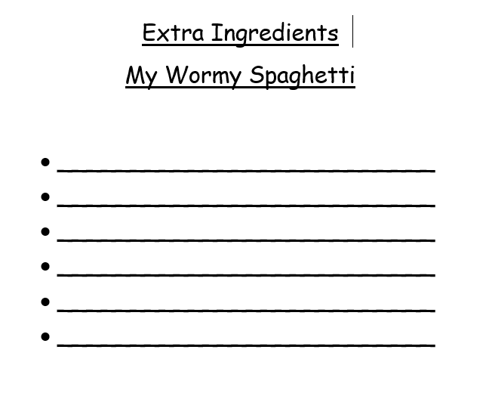
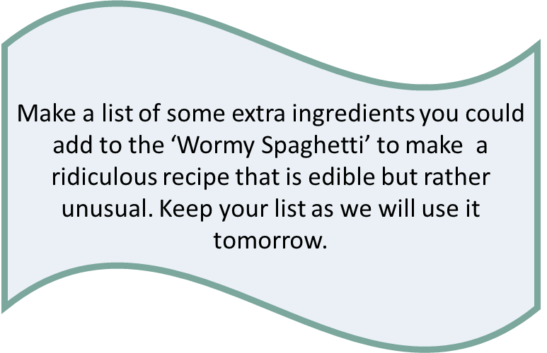

Slide 9
Super Work!
Have a short break and then start on the English Tasks.

Slide 10

Maths :
Comparing Statements
Follow this link to the White Rose website to watch the video clip and pause to complete the activities. Have paper, a pencil and rubber ready to jot down your answers.
https://whiterosemaths.com/homelearning/year-3/week-1-number-multiplication-division/
You will find related worksheets in the math’s folder on the Kingsland Website.

Slide 11



Times Tables Rock
https://play.ttrockstars.com/auth/school/student/78867
8x table
https://www.youtube.com/watch?v=SNFXWEXaCQw
https://www.topmarks.co.uk/maths-games/hit-the-button

Slide 12
Have a lunch break!

Slide 13

Digital Literacy
This term we will be following the BBC Bitesize computing curriculum.
We will be using both KS1 and KS2 lessons where appropriate for Year 3.
Each short lesson contains games, interactive programmes or video clips to help you understand the topic.
As the lessons are short we may cover two in one session.
This week we will be looking at:
Lesson 1: What is the Internet?
There is a video clip to watch.
https://www.bbc.co.uk/bitesize/topics/zymykqt/articles/zgwnsbk
Lesson2: How can you use the internet?
There is an interactive activity.
https://www.bbc.co.uk/bitesize/topics/zymykqt/articles/zgqfyrd

Slide 14
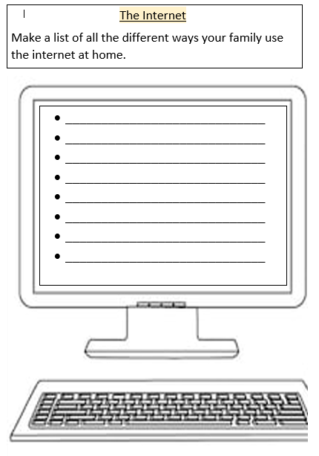

Slide 15
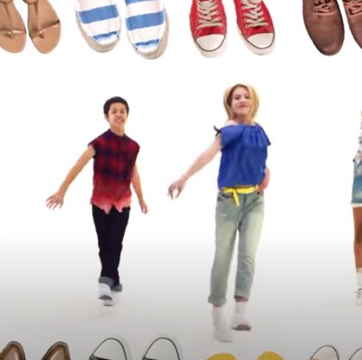
https://www.youtube.com/watch?v=lJPvEs8qpQc
Go Noodle
Get Up and Dance!
Footloose:
Can’t Stop the Feeling
https://www.youtube.com/watch?v=KhfkYzUwYFk

Slide 16

Follow the link for Today’s Worship
This can be found in the
‘Whole School’ folder.

Slide 17


Tomorrow, please could you have a sheet of paper (lined or blank) ready for our TEAMS meeting.

Slide 18
Have a super day, give of your best and please send me an e mail this afternoon with examples of your work.
teacher@kingslandengland.hereford.sch.uk
In the subject line could you have :
Year 3 and name of your child
Please only send one email a day with either attachments or a photo of work completed.

