Slide 1
An Outline of Today’s Work Wednesday 27th January 2021
Subject | Subject/Website | Topic | Activity/ Instruction
Maths | White Rose Year 3 Autumn Block Multiplication and Division | Consolidate 2,4,8 Times Tables | Watch the White Rose video and pause to complete the activities In the Math’s Folder you will find a related White Rose sheet and extension sheets.
English | Dictation | A sentence including spelling words, punctuation and grammar | Listen to the audio on this PPT Write it. Mark it using the PPT slide
 | Grammar | Pronouns | Follow the link and complete the tasks Activity sheet in the folder
 | ‘The Twits’ | Pre Reading-Task | Read or Listen to the chapter ‘The Wormy Spaghetti’
Science | Materials | Changing Materials | PPT Activity sheet to complete in the folder
Worship | iSing Pop |  | Links can be found either in emails sent or the ‘Whole School’ folder

Slide 2



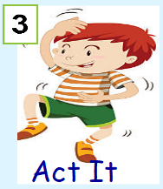


Dictation
Click on the speaker to hear the sentence.
Do not go to the next slide until you have written and checked your sentence.

Slide 3

Mark your dictation and see where you need to make corrections.
‘Have you heard the good news about the children working so hard at home? ‘ asked the teacher.
Give yourself a tick for the following if correct:
Correct spelling for : heard
Inverted commas to show speech: ‘’ ‘’
Exclamation mark: ?
Full stop
Neat joined handwriting

Slide 4


Looking at Pronouns
Have a pencil and paper ready.
Follow the link to watch the video clip and complete the tasks.
There is a sheet in the folder to complete and help you to practise using pronouns.
https://www.bbc.co.uk/bitesize/articles/zjsnm39

Slide 5
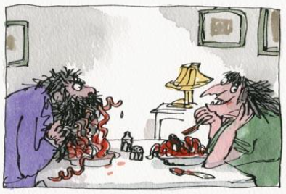
Please read or listen to the audio of the next chapter in ‘The Twits’
‘The Wormy Spaghetti’
The audio link is on the next slide with the starting point.
Jot down the ingredients that Mrs Twit put into her Spaghetti Dish.
Keep your list for our TEAMS meeting tomorrow morning.

Slide 6
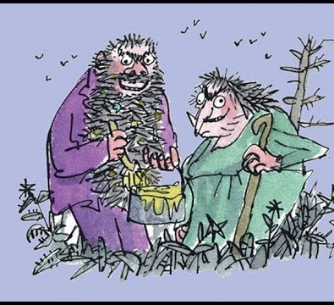

The Twits
By Roald Dahl
Wormy Spaghetti
9:31
https://www.youtube.com/watch?v=EgppUh8ukZ8
Audio Book

Slide 7
Super Work!
Have a short break and then start on the English Tasks.

Slide 8

Maths :
Consolidate
2,4,8 Times Tables
Follow this link to the White Rose website to watch the video clip and pause to complete the activities. Have paper, a pencil and rubber ready to jot down your answers.
https://whiterosemaths.com/homelearning/year-3/week-1-number-multiplication-division/
You will find related worksheets in the math’s folder on the Kingsland Website.

Slide 9



Times Tables Rock
https://play.ttrockstars.com/auth/school/student/78867
8x table
https://www.youtube.com/watch?v=SNFXWEXaCQw
https://www.topmarks.co.uk/maths-games/hit-the-button

Slide 10
Have a lunch break!

Slide 11
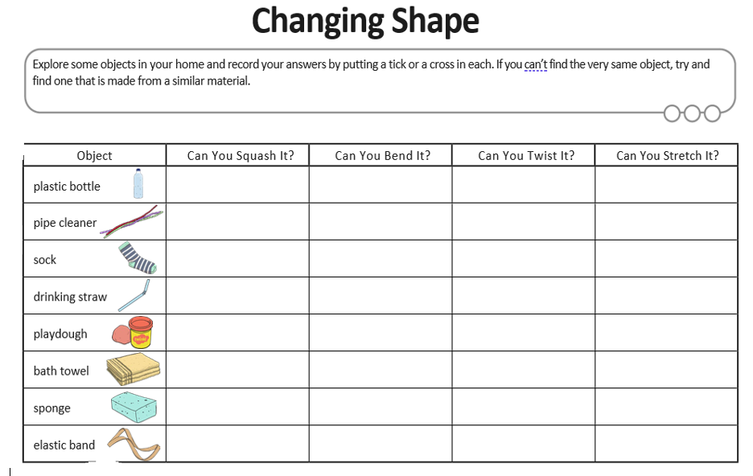
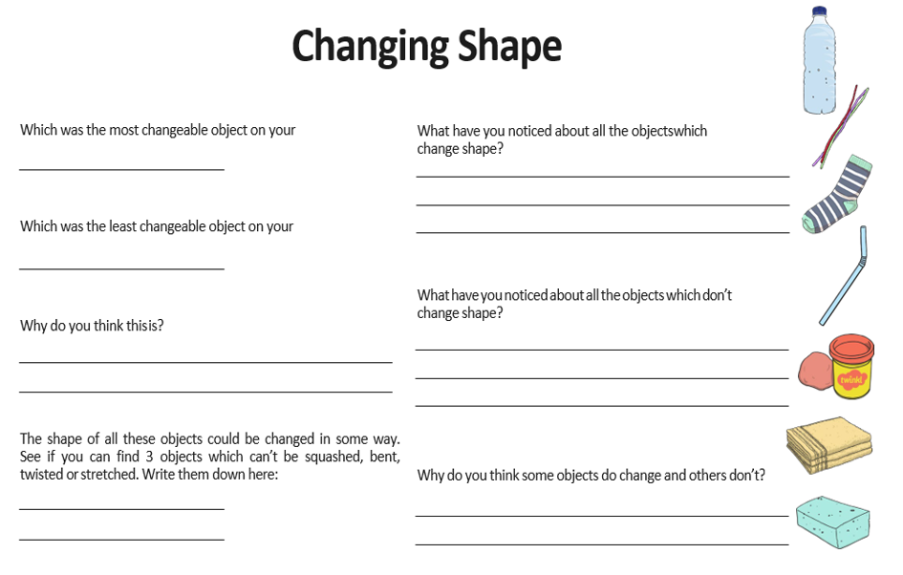
Changing Materials
Materials and their properties has been covered previously in year 2 . Changing materials is a continuation of this topic before we start the topic of rocks , soils and fossils.
You will find:
A PPT about materials to recap on vocabulary and types of materials
A PPT about changing materials
Activity Sheets to complete

Slide 12

Follow the link for Today’s Worship
This can be found in the
‘Whole School’ folder.

Slide 13
Have a super day, give of your best and please send me an e mail this afternoon with examples of your work.
teacher@kingslandengland.hereford.sch.uk
In the subject line could you have :
Year 3 and name of your child
Please only send one email a day with either attachments or a photo of work completed.

