Slide 1


Science
Uses of Everyday Materials
Year One
Science | Year 2 | Uses of Everyday Materials | Changing Shape | Lesson 4

Slide 2
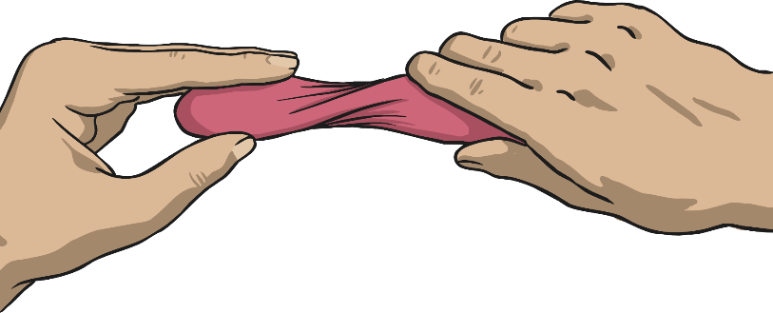

Changing Shape

Slide 3
Aim
I can explain how the shapes of objects made from some materials can be changed.
Success Criteria
I can tell you four ways the shapes of some objects can be changed.
I can demonstrate four ways to change the shape of some objects.

Slide 4


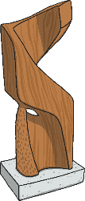
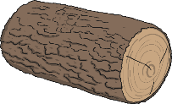
Changing the Shape of Materials
How can we change the shape of objects made from some materials?
Can you think of an example of when you have changed the shape of something? What was it and how did you change it?
Which materials do you think would be easy to change the shape of? Why?
Which materials do you think would be more difficult to change the shape of and why?

Slide 5
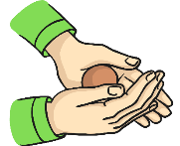


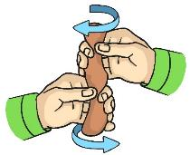
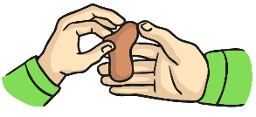
Squashing, Bending, Twisting and Stretching
Bend an object by grabbing both ends of the object and bringing the ends inwards together.
Squash an object by pushing both hands together.
Twist an object by turning your hands in opposite directions.
Stretch an object by pulling your hands slowly and gently apart.

Slide 6





Instructions
Look carefully at the objects on your table. Before you touch any of them, think about how you could change the shape of them. Tell someone on your table your idea.
Explore changing the shape of the objects on your table by gently squashing, bending, twisting or stretching them.
What happens to these objects after you have manipulated them? Tell someone on your table.
Record what you find out on your Changing Shape Activity Sheet.

Slide 7

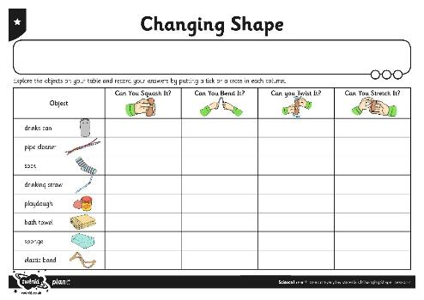
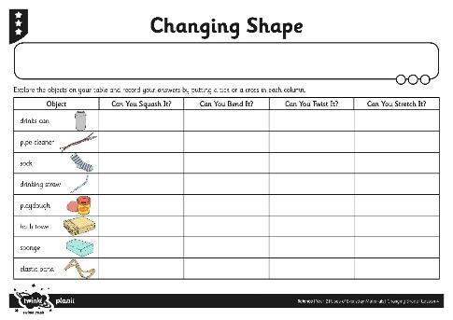
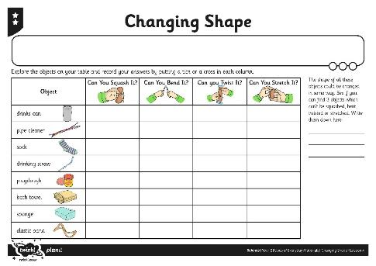
Changing Shape

Slide 8



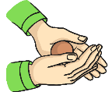




Can You?
Have a think about these questions:
Can you twist a ruler?
Can you squash a ruler?
Can you stretch a pencil?
Can you bend a pencil?

Slide 9

Aim
I can explain how the shapes of objects made from some materials can be changed.
Success Criteria
I can tell you four ways the shapes of some objects can be changed.
I can demonstrate four ways to change the shape of some objects.

