Slide 1
An Outline of Today’s Work Tuesday 26th January 2021
Subject | Subject/Website | Topic | Activity/ Instruction
Maths | White Rose Year 3 Autumn Block Multiplication and Division | The 8 Times Table | White Rose Teaching Video Related worksheets in today’s folder
Numberocks and TTR
English | Spelling | Adding the suffix -ness | PPT with tasks -ness worksheet
 | Written task | sentences | Sentences using nouns ending in -ness
Topic | Climate Change | The Polar Regions | PPT Video links Research task
Worship | Mr Debenham | Live Worship On TEAMS | Links were e mailed out or can be found on the school website.

Slide 2
Adding the Suffix - ness
Go through the PPT in the folder
There is also a video link below to watch
Now complete the worksheet
https://www.youtube.com/watch?v=_EfeknsxIn0

Slide 3
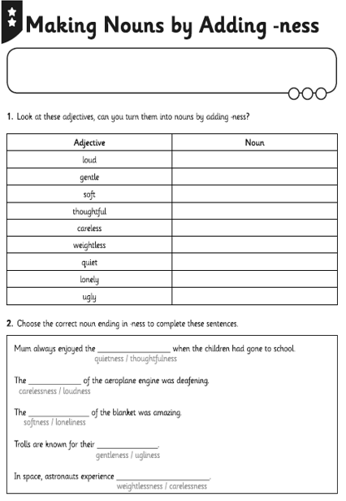

Slide 4
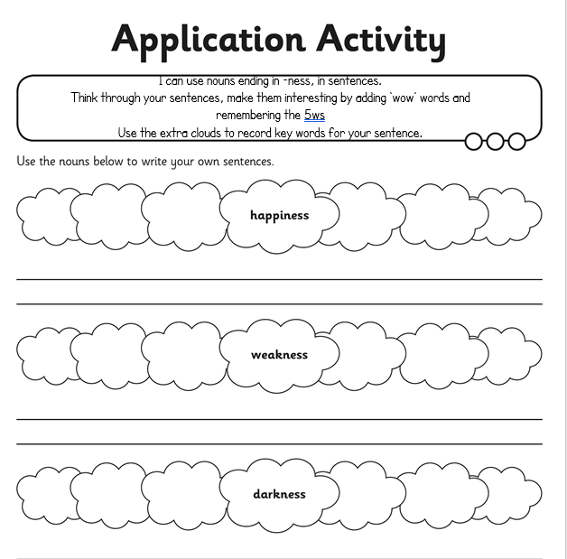
Using the word in the cloud, create a ‘wow’ sentence.
Use the extra clouds to record key words and their spelling before writing your sentence.

Slide 5
Super Work!
Have a short break and then start on the English Tasks.

Slide 6

Maths :
The 8 Times Table
Follow this link to the White Rose website to watch the video clip and pause to complete the activities. Have paper, a pencil and rubber ready to jot down your answers.
https://whiterosemaths.com/homelearning/year-3/week-12-number-multiplication-division/
You will find related worksheets in the math’s folder on the Kingsland Website.

Slide 7


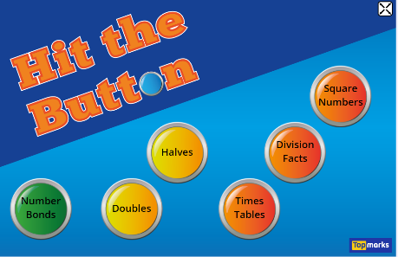
Times Tables Rock
https://play.ttrockstars.com/auth/school/student/78867
8x table
https://www.youtube.com/watch?v=SNFXWEXaCQw
https://www.topmarks.co.uk/maths-games/hit-the-button

Slide 8
Have a lunch break!

Slide 9
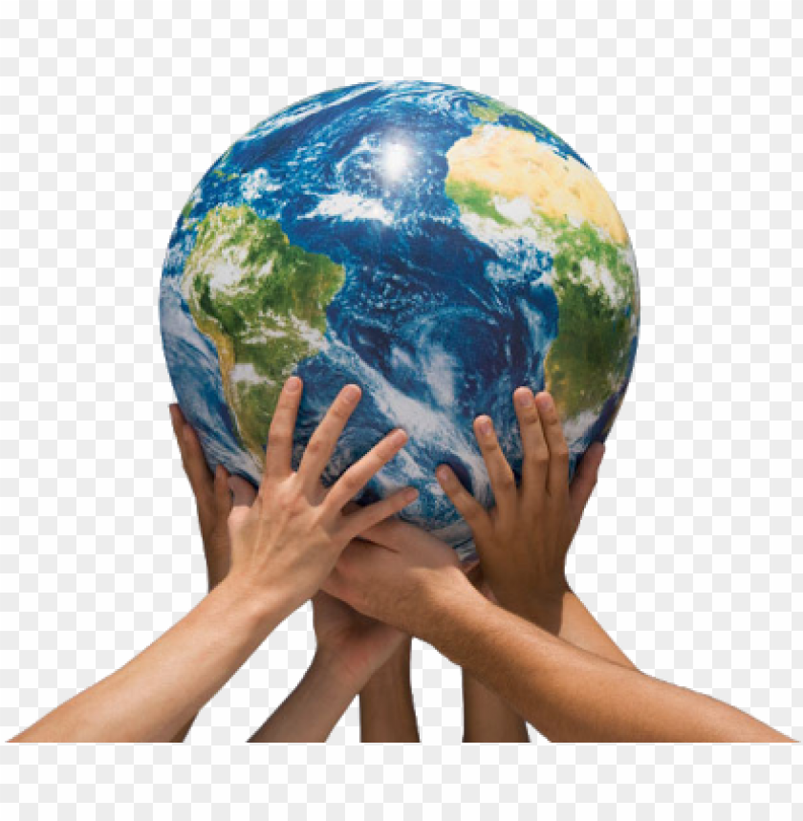
Climate Change
Follow the PPT in the Folder under ‘Topic’

Slide 10

Follow the link for Today’s Worship
Live on TEAMS with
Mr Debenham

Slide 11
Have a super day, give of your best and please send me an e mail this afternoon with examples of your work.
teacher@kingslandengland.hereford.sch.uk
In the subject line could you have :
Year 3 and name of your child
Please only send one email a day with either attachments or a photo of work completed.

