Slide 2
If you have a world globe or map of the world, look at where the North Pole ( Arctic ) and South Pole (Antarctic ) are.
Watch the first video and go through the PPT
Looking at Climate Zones
https://www.youtube.com/watch?v=Ob8zzXjDfc4

Slide 3
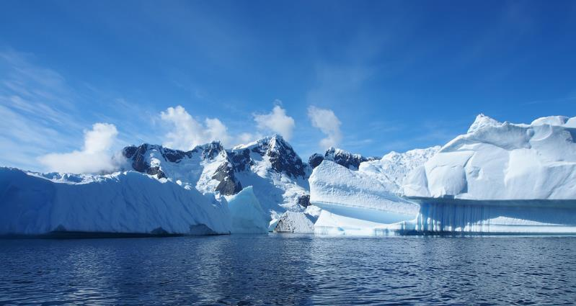
Where Are the Polar Regions?
Over 20,000 years ago, most of the world was covered in ice. Now, these huge sheets of ice are found only in the Antarctic and Arctic.
They are called the polar regions.
Photo courtesy of londoncyclist (@flickr.com) - granted under creative commons licence - attribution

Slide 4
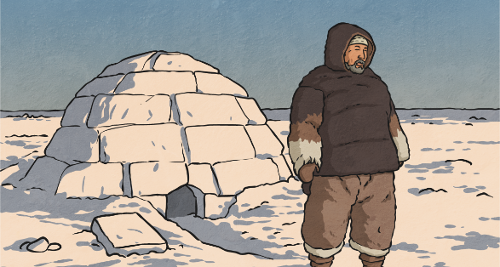
Who Lives in the Polar Regions?
What people and animals do you think live in these places?
Even though it is so cold, over four million people live in the Arctic!
Many of these are Inuit; they are indigenous to the Arctic.
What do you think indigenous means?
They have adapted to live in these cold conditions.
What do you think they do to make sure they can live there?

Slide 5
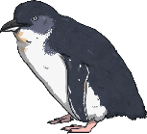
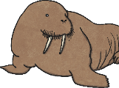
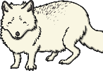
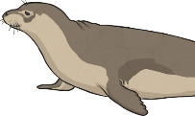

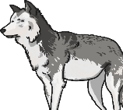
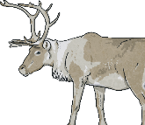
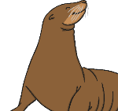

Which Animals Live in the Polar Regions?
penguins
walruses
Arctic foxes
seals
polar bears
huskies
reindeer
sea lions
Arctic hares

Slide 6
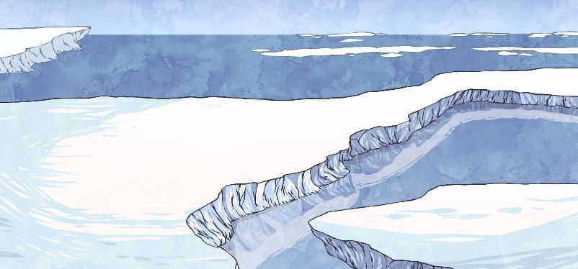
What Is Climate?
What do you think the word climate means?
'Climate' is the type of weather a place has; the temperature,
the amount of rainfall and the amount of sunlight.
The polar regions have very cold weather all year round and there is lots and lots of ice! They have long periods of time where they are in complete sunlight or complete darkness.

Slide 7
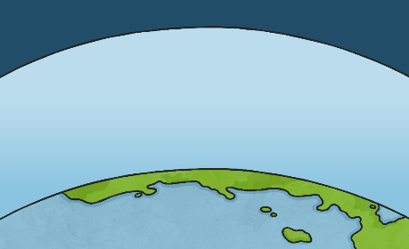
What Is Climate Change?
Planet Earth is surrounded by a layer we call the atmosphere, which contains a layer of gas. This gas enables the Sun's rays to get through and heat up the earth.
This gas is incredibly important, as it also allows some of the heat from the Sun, to go back into space, so that Earth does not get too hot, and we are not damaged by the strong rays from the Sun.
It acts like a protective blanket! But unfortunately, our protective blanket is being damaged causing something called
climate change.

Slide 8
What Are Greenhouse Gases?
Greenhouse gases are substances such as methane, carbon dioxide
and water vapour.
These gases stop heat from getting back from the Earth's
atmosphere into space.
This means the Earth is slowly getting warmer.

Slide 9
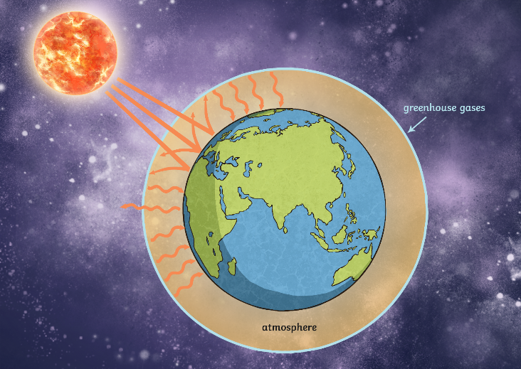
What Are Greenhouse Gases?
The Sun's rays penetrate the atmosphere, which warms the Earth.
The greenhouse gases have thickened the layer of the atmosphere so less gases can be released back into space. This is climate change.
Some radiation is absorbed by the earth and it warms up.

Slide 10
What Is Causing These Greenhouse Gases?
Greenhouse Gas | Natural Cause | Man-made Cause
Methane | Plants decomposing | Cows, coal, mines, some types of rice fields
Water vapour | Evaporating water within lakes, oceans and rivers | Burning of hydrocarbon fuels
Carbon dioxide | Respiration of plants and animals; volcanoes and forest fires | Cement-making, burning fossil fuels and cutting down trees (deforestation)

Slide 11
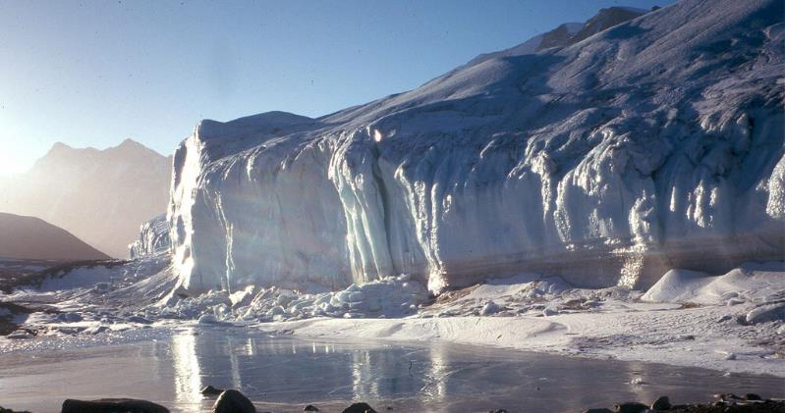
What Is Happening in the Polar Regions?
Due to climate change, the polar ice caps are melting as the regions become warmer.
How do you think this is affecting the people and animals living there?
Photo courtesy of Gerald Simmons (@flickr.com) - granted under creative commons licence - attribution

Slide 12
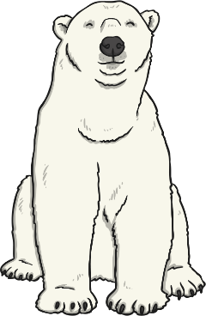
How Are Animals Affected?
Animals in these areas have adapted to live in the cold weather
and they rely on the ice cover and having cold and
warm seasons to survive.
For example, the polar bear is most active during winter and spring because this is when there is the most ice. But because the weather is warmer, the cold season is now shorter. If the warm season lasts longer, the polar bears have to survive for longer without food. Lots of polar bears have lost weight and there are now less polar bear cubs to carry on the species. There are approximately only 20,000 polar bears left in the world.

Slide 13
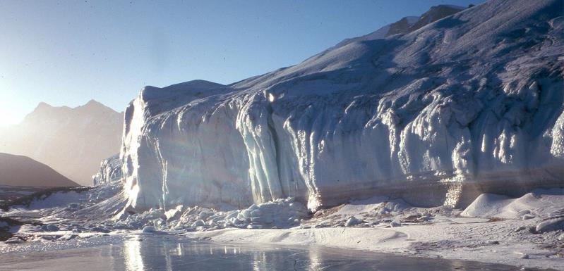
How Are People Affected?
Many indigenous people rely on local wildlife, like fish and reindeer, as the main part of their diet. As the number of animals decreases, the amount of available food also goes down.
The melting ice is also causing sea levels to rise, which in
turn causes flooding.
Photo courtesy of Gerald Simmons (@flickr.com) - granted under creative commons licence - attribution

Slide 14
Choose an animal from the Arctic or Antarctic to research.
Use an A4 sheet to:
Find out some facts about your animal.
How would climate change effect your animal?
Draw your animal and its environment.
How could we protect your animal?
National Geographic-Kids
https://www.natgeokids.com/uk/home-is-good/save-our-polar-habitats/

Slide 15

You may want to watch some of the following videos.
https://www.bbc.co.uk/iplayer/episode/b00zj39j/frozen-planet-7-on-thin-ice

