Slide 1
An Outline of Today’s Work Monday 25th January 2021
Subject | Subject/Website | Topic | Activity/ Instruction
Maths | White Rose Year 3 Autumn Block Multiplication and Division | Divide by 8 | White Rose Teaching Video Related worksheets in today’s folder
English | National Curriculum Word | ‘heard’ | Worksheet is in the today’s folder
 | Comprehension | Making Inferences | Follow the PPT Complete the inference sheets
RE | Islam | Why is prayer (Salat) Important to Muslims? | Video link to watch PPT Prayer Mat
Worship | Rev Julie |  | A link can be found in the Whole School Folder

Slide 2
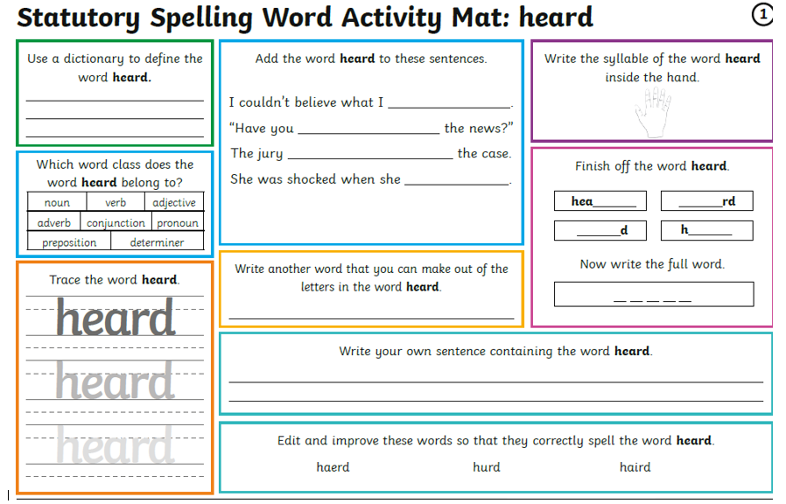
homophone: herd ( group of animals)

Slide 3


Inference
What is Inference?
Inference is where we 'read between the lines' to gain a greater understanding of what we are looking at and to reach logical conclusions.

Slide 4
Inference
How can we use the clues?

Slide 5
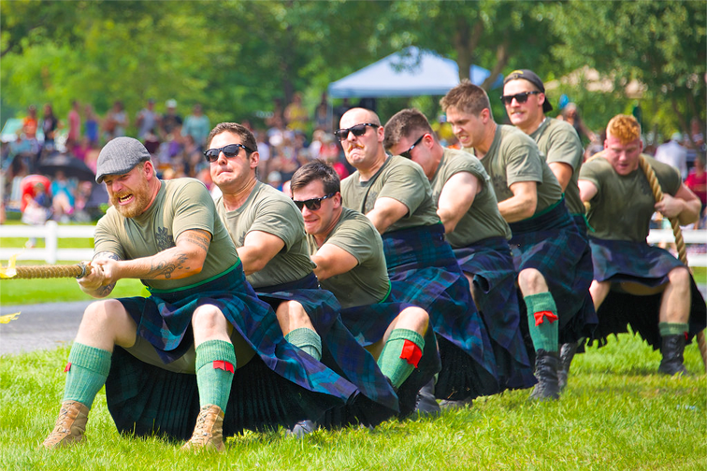
Inference
What is happening here?
How can you tell that the men are putting in a lot of effort?
Why does the man at the back only have one hand on the rope?
How can you tell that these men belong to
a club or group?
What is the weather like?
Have a discussion about this picture, with and adult.
Photo courtesy of Jamie McCaffrey (@flickr.com) - granted under creative commons licence - attribution

Slide 6
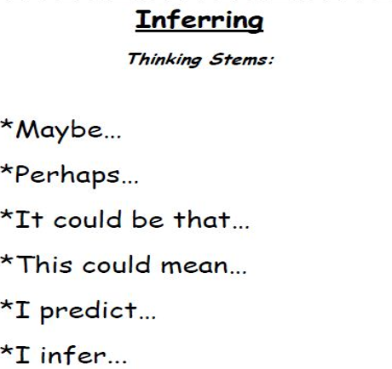
Your inference is not right or wrong, but should be guided by clues in the text or picture. It could be called a ‘clever guess’.
Above are ways you could start your answer.

Slide 7
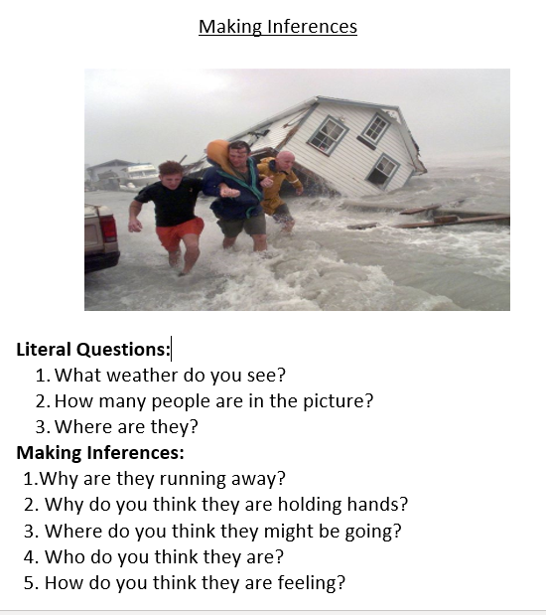
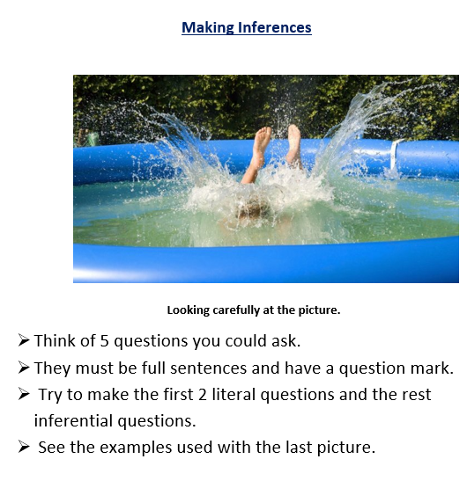
Comprehension
Ask an adult to discuss the questions with you if you are not feeling confident.
You must use paper or an exercise book to answer the questions.

Slide 8
Super Work!
Have a short break and then start on the English Tasks.

Slide 9

Maths :
Divide by 8
Follow this link to the White Rose website to watch the video clip and pause to complete the activities. Have paper, a pencil and rubber ready to jot down your answers.
https://whiterosemaths.com/homelearning/year-3/week-12-number-multiplication-division/
You will find related worksheets in the math’s folder on the Kingsland Website.

Slide 10


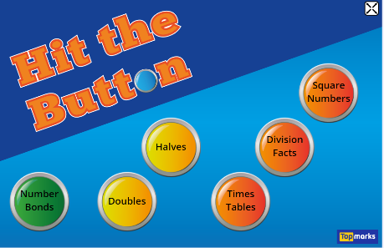
Times Tables Rock
https://play.ttrockstars.com/auth/school/student/78867
8x table
https://www.youtube.com/watch?v=TdqAA9Ky2DY
https://www.topmarks.co.uk/maths-games/hit-the-button

Slide 11
Have a lunch break!

Slide 12

Why is Prayer Important to Muslims?
Follow the PPT and Instructions under RE

Slide 13

Follow the link for Today’s Worship
In the Whole School Folder

Slide 14
Have a super day, give of your best and please send me an e mail this afternoon with examples of your work.
teacher@kingslandengland.hereford.sch.uk
In the subject line could you have :
Year 3 and name of your child
Please only send one email a day with either attachments or a photo of work completed.

