Slide 2
Today we are going to learn about Salat (Muslim Prayer)
I would like you to :
Follow the link below to watch the BBC video clip.
Read through the slides with the help of an adult.
Complete the Quiz.
Design a prayer mat and write a sentence.
https://www.bbc.co.uk/teach/class-clips-video/religious-education-ks2-my-life-my-religion-prayer-in-islam/zjndxyc

Slide 3




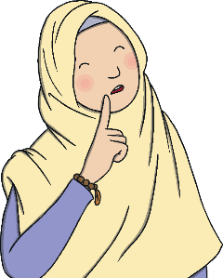
What Are Ritual Prayers?
Can you think of any prayers you know or take part in that are the same every time?
What is a ritual?
A ritual is similar to a ceremony. In a ritual, a series of things is done in a special order. Rituals are sometimes done every week, or every day, or at special times.
Is there anything you have seen people always do when they pray?
+
Many religious people take part in special prayers.
Often, these prayers are ritual prayers.
+
When people take part in some special prayers,
they may use the same actions or the same words
each time they pray.

Slide 4
Ritual Prayer
Prayer (Salat or Salah) is one of the Five Pillars of Islam. These are the ‘rules’ Muslims follow.
Salat should be performed five times a day. The times depend on the sun and so they change daily.
The five different times of day when Muslims must pray are:
1.
Salat al-fajr
Dawn, before sunrise.
2.
Salat al-zuhr
Midday, after the sun has passed its highest point.
3.
Salat al-’asr
Late in the afternoon.
4.
Salat al-maghrib
After the sun has finished setting.
5.
Salat al-’isha
In the dark of the night.

Slide 5
Ritual Prayer
Salat (prayer) is important to Muslims as it makes them feel connected to God (Allah).
Muslims usually go to a mosque to pray, but if they can’t go to the mosque, they can pray anywhere that is clean. Muslims may use a prayer mat when they pray in places other than the mosque, to be sure the floor is clean where they pray.
Prayer mats are quite often highly decorated
with patterns and colours but they never
have pictures of people or animals on them.
Muslims always face Mecca (a holy place)
when they pray.

Slide 6


True or False
Decide if each of the statements is true or false.
Salat means prayer and it is one of the Five Pillars of Islam.
True
False

Slide 7
True or False
Decide if each of the statements is true or false.
Muslims can only pray in a mosque.
Muslims usually go to a mosque to pray, but if they can’t go to the mosque, they can pray anywhere that is clean.
True
False

Slide 8
True or False
Decide if each of the statements is true or false.
Salat is important to Muslims as it makes them feel connected
to God (Allah).
True
False

Slide 9
True or False
Decide if each of the statements is true or false.
Muslims should pray five times each day.
True
False

Slide 10
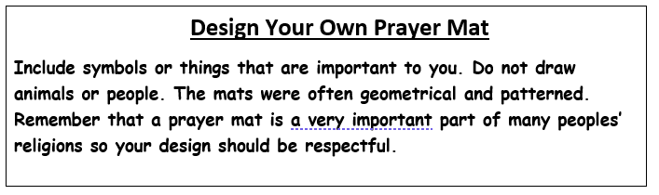

Salut ( prayer) is important to Muslims because:
_______________________________________________________________________________________________________________________________________________________________________________________

