Slide 1
An Outline of Today’s Work Friday 22nd January 2021
Subject | Subject/Website | Topic | Activity/ Instruction
English | Handwriting | Joins to practice | Sentences to trace and write
 | Written Task | The thoughts of ‘The Frog’ | Outline in the folder
Maths | White Rose Year 3 Autumn Block Multiplication and Division | Multiply by 8 | Watch the White Rose video and pause to complete the activities In the Math’s Folder you will find a related White Rose sheet and extension sheets.
French |  |  | See work set by Mr Powell in our Year 3 folder
PE |  |  | See work set by Mr Powell and Miss Price in our Year 3 folder
Worship |  |  | Links are emailed or can be found in the ‘Whole School ‘folder.

Slide 2

Handwriting Lines

Slide 3
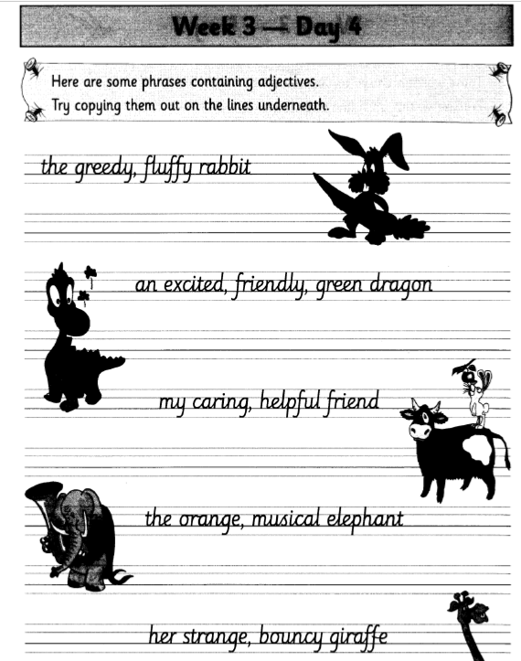

Slide 4
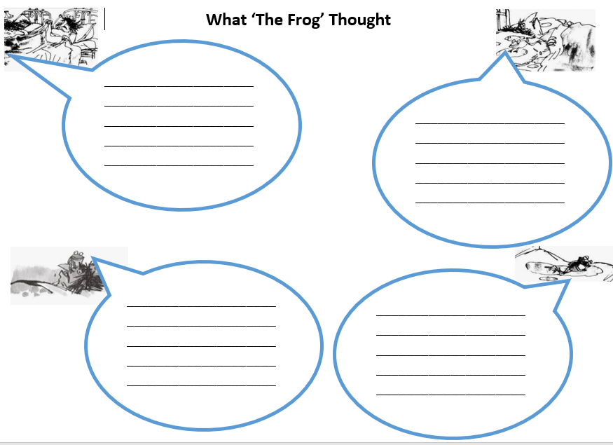

Slide 5
Remember when writing in a speech bubble:
You do not need inverted commas as you already know who is talking.
You must use proper sentences with punctuation.
. ? !
Stretch your sentences, add detail and wow words.

Slide 6
Super Work!
Have a short break and then start on the English Tasks.

Slide 7

Maths :
Multiply by 8
Follow this link to the White Rose website to watch the video clip and pause to complete the activities. Have paper, a pencil and rubber ready to jot down your answers.
https://whiterosemaths.com/homelearning/year-3/week-12-number-multiplication-division/
You will find related worksheets in the math’s folder on the Kingsland Website.

Slide 8


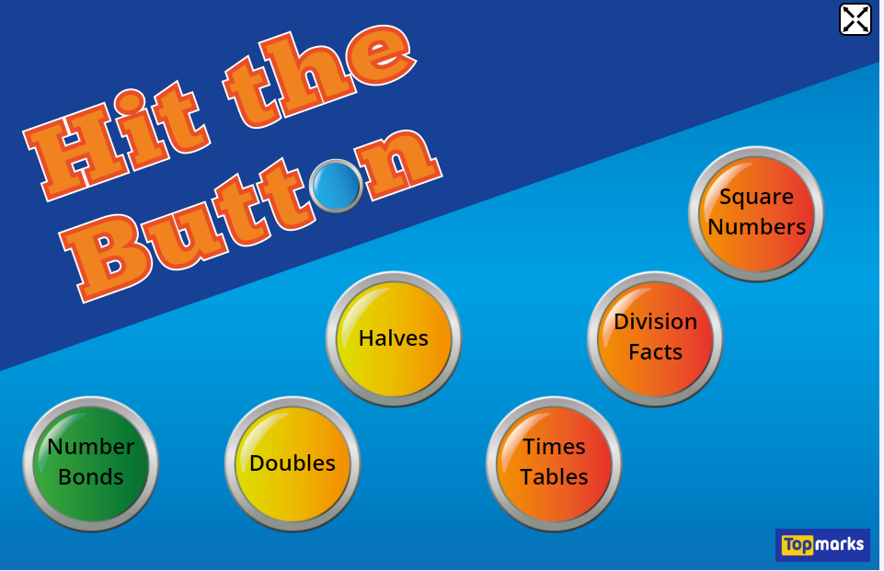
Times Tables Rock
https://play.ttrockstars.com/auth/school/student/78867
8x table
https://www.youtube.com/watch?v=TdqAA9Ky2DY
https://www.topmarks.co.uk/maths-games/hit-the-button

Slide 9
Have a lunch break!

Slide 10

For French and PE, see activities in the Year 3 Folder.

Slide 11

Follow the link for Today’s Worship
This can be found in the
‘Whole School’ folder.

Slide 12
Have a super day, give of your best and please send me an e mail this afternoon with examples of your work.
teacher@kingslandengland.hereford.sch.uk
In the subject line could you have :
Year 3 and name of your child
Please only send one email a day with either attachments or a photo of work completed.

