Slide 1
An Outline of Today’s Work Thursday 21st January 2021
Subject | Subject/Website | Topic | Activity/ Instruction
English | Spag Mat 3 | Spelling, punctuation and grammar | Worksheet is in the English folder
 | Written Task | The Twits The Frog | Read or listen to the chapter ‘The Frog’ Write a summary of the sequence of events.
Maths | White Rose Year 3 Autumn Block Multiplication and Division | The 4 Times Table | Watch the White Rose video and pause to complete the activities In the Math’s Folder you will find a related White Rose sheet and extension sheets.
Music | Understanding Pulse and Rhythm | National Oak Academy | Watch the video clip Create your own pulse and rhythm
Dance | Go Noodle | Footloose | Get up and Move!
Worship | Mark Harrington, Hereford Diocese |  | Links are emailed or can be found in the ‘Whole School ‘folder.

Slide 2
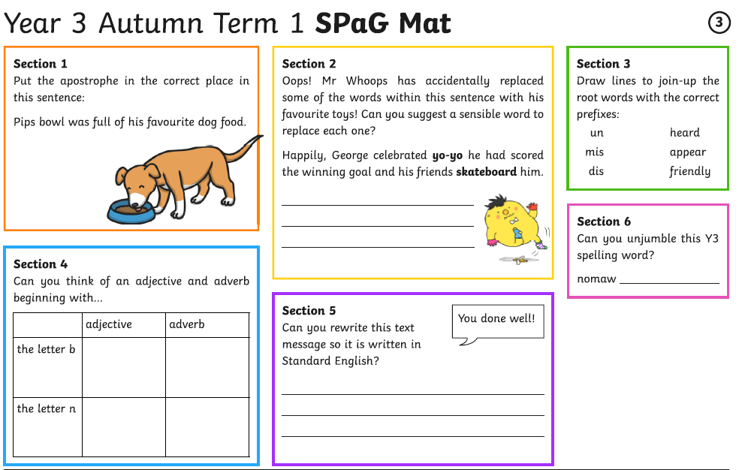

Slide 3
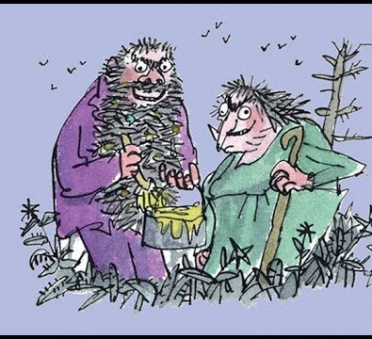

The Twits
By Roald Dahl
The Frog:
7:33
https://www.youtube.com/watch?v=EgppUh8ukZ8
Audio Book

Slide 4
When writing a summary of a sequence of events:
Listen to or read the chapter a few times
Tell it in the order it happened
You can use numbers or bullet points
They can be short sentences
Include the main events
Use correct punctuation in proper sentences.

Slide 5
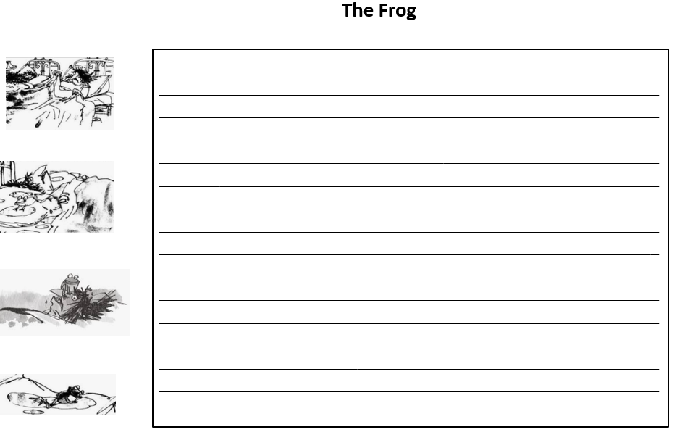

Slide 6
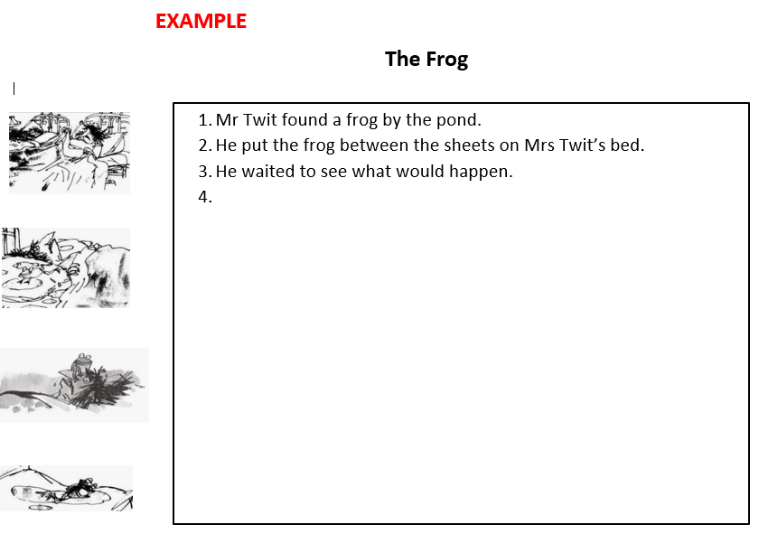

Slide 7
Super Work!
Have a short break and then start on the English Tasks.

Slide 8

Maths :
The 4 Times Table
Follow this link to the White Rose website to watch the video clip and pause to complete the activities. Have paper, a pencil and rubber ready to jot down your answers.
https://whiterosemaths.com/homelearning/year-3/week-12-number-multiplication-division/
You will find related worksheets in the math’s folder on the Kingsland Website.

Slide 9

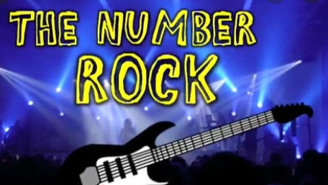
Times Tables Rock
https://play.ttrockstars.com/auth/school/student/78867
4x table
https://www.youtube.com/watch?v=UJY1_fzzM6Y

Slide 10
Have a lunch break!

Slide 11

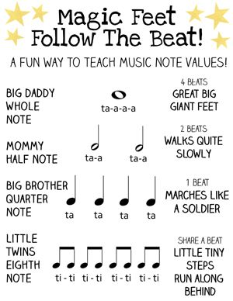
Music
Click on the link below and follow the lesson .
Your task after watching is to create your own rhythm and write it down for me to clap.
https://classroom.thenational.academy/lessons/understanding-pulse-and-rhythm-chj3cr?activity=video&step=1
When creating your rhythm remember the value of the notes.

Slide 12
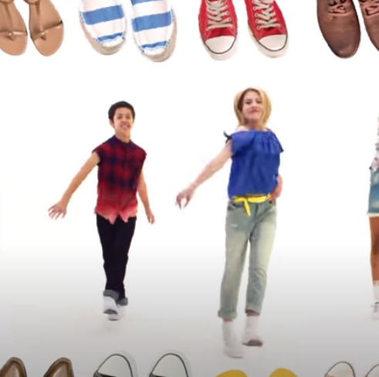
https://www.youtube.com/watch?v=lJPvEs8qpQc
Go Noodle
Get Up and Dance!

Slide 13

Follow the link for Today’s Worship
This can be found in the
‘Whole School’ folder.

Slide 14


Tomorrow, please could you have a sheet of paper (lined or blank) ready for our TEAMS meeting.

Slide 15
Have a super day, give of your best and please send me an e mail this afternoon with examples of your work.
teacher@kingslandengland.hereford.sch.uk
In the subject line could you have :
Year 3 and name of your child
Please only send one email a day with either attachments or a photo of work completed.

