Slide 1
An Outline of Today’s Work Wednesday 20th January 2021
Subject | Subject/Website | Topic | Activity/ Instruction
Maths | White Rose Year 3 Autumn Block Multiplication and Division | Divide by 4 | Watch the White Rose video and pause to complete the activities In the Math’s Folder you will find a related White Rose sheet and extension sheets.
English | Dictation | A sentence including spelling words, punctuation and grammar | Listen to the audio on this PPT Write it. Mark it using the PPT slide
 | Written Task | Write a description of Mr and Mrs Twit | A paragraph on each character
Science | Light | Sun Safety | Video links to follow Activity sheet to complete in the folder
Worship | iSing Pop |  | Links can be found either in emails sent or the ‘Whole School’ folder

Slide 2
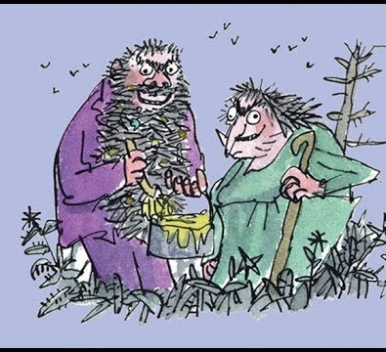

The Twits
By Roald Dahl
https://www.youtube.com/watch?v=EgppUh8ukZ8
Audio Book

Slide 3
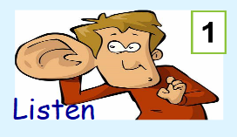

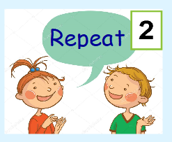
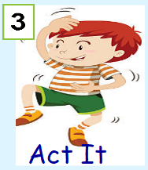
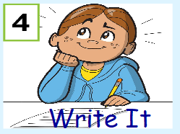

Dictation
Click on the speaker to hear the sentence.
Do not go to the next slide until you have written and checked your sentence.

Slide 4

Mark your dictation and see where you need to make corrections.
‘’Come and sit in a circle on the mat! ‘’ shouted the angry man.
Give yourself a tick for the following if correct:
Correct spelling for : circle
Inverted commas to show speech: ‘’ ‘’
Exclamation mark: !

Slide 5
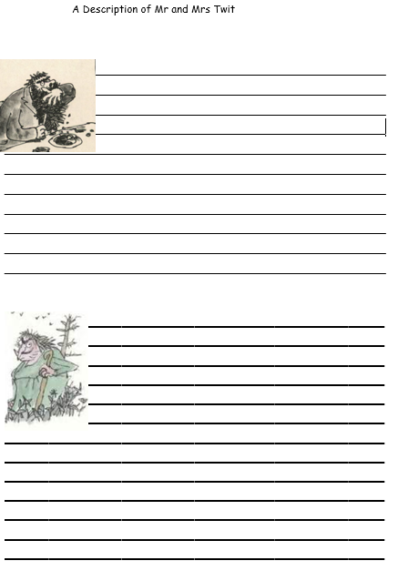
Your paragraphs should:
Be written in full, interesting sentences.
Use different sentence starters.
Stretch your sentences using adjectives and wow words.
Use neat joined writing.
Check spellings with an adult.

Slide 6
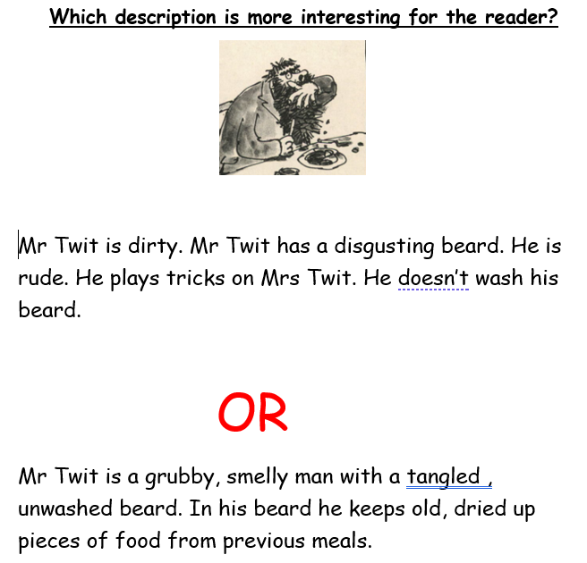

Slide 7
Super Work!
Have a short break and then start on the English Tasks.

Slide 8

Maths :
Divide by 4
Follow this link to the White Rose website to watch the video clip and pause to complete the activities. Have paper, a pencil and rubber ready to jot down your answers.
https://whiterosemaths.com/homelearning/year-3/week-11-number-multiplication-division/
You will find related worksheets in the math’s folder on the Kingsland Website.

Slide 9


Times Tables Rock
https://play.ttrockstars.com/auth/school/student/78867
4x table
https://www.youtube.com/watch?v=UJY1_fzzM6Y

Slide 10
Have a lunch break!

Slide 11

Safety in the Sun
Although we are not seeing much of the sun at the moment, it is important to know how to protect yourself from the sun. The sun is a vital source of light and warmth but can also be very dangerous.
I would like you to create a poster advertising how to keep safe in the sun and how to protect yourself. You will need:
A4 sheet of blank paper
Pencils, felt tips and crayons
Now watch the video clip and look at the PPT to get ideas and information that is important for your poster.
https://www.bbc.co.uk/cbeebies/watch/sun-safety-for-kids

Slide 12
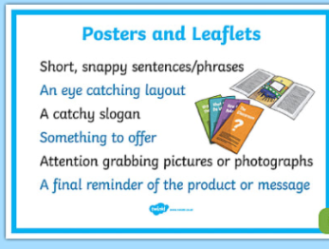
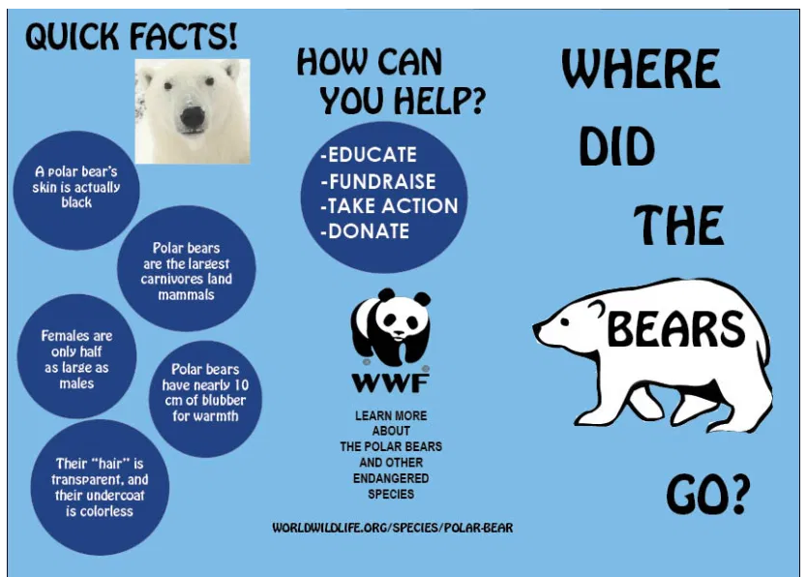

Tips For Designing a Poster
It needs to be clear, well organised and planned
have clear headings and slogans
Include pictures
Have a border around your page
Have bold, neat printing

Slide 13

Follow the link for Today’s Worship
This can be found in the
‘Whole School’ folder.

Slide 14
Have a super day, give of your best and please send me an e mail this afternoon with examples of your work.
teacher@kingslandengland.hereford.sch.uk
In the subject line could you have :
Year 3 and name of your child
Please only send one email a day with either attachments or a photo of work completed.

