Slide 1
An Outline of Today’s Work Tuesday 12th January 2021
Subject | Subject/Website | Topic | Activity/ Instruction
Maths | White Rose Year 3 Autumn Block Multiplication and Division | Multiply by 4 | White Rose Teaching Video Related worksheets in today’s folder
Numberocks and TTR
English | Grammar | adjectives Video link and ‘The Twits’ extract | Underline adjectives in ‘The Twits’ text and record them
 | Written task | Record phrases and words to describe Mr and Mrs Twit. | ‘The Twits’ text and a worksheet to record phrases
Topic | Climate Change | Our Environment and Climate Change | Watch the video clip Match –picture to explanation Experiment
Worship | Mr Debenham | Live Worship On TEAMS | Links were e mailed out or can be found on the school website.

Slide 2
Adjectives
https://www.bbc.co.uk/bitesize/articles/zf6c47h
Follow the link to find out more about adjectives. You only need to watch the video and complete the examples they ask for on the video.
Look at the text from ‘The Twits’. You can either work from the screen or print the text sheets.
Underline and write down any adjectives you can spot.

Slide 3
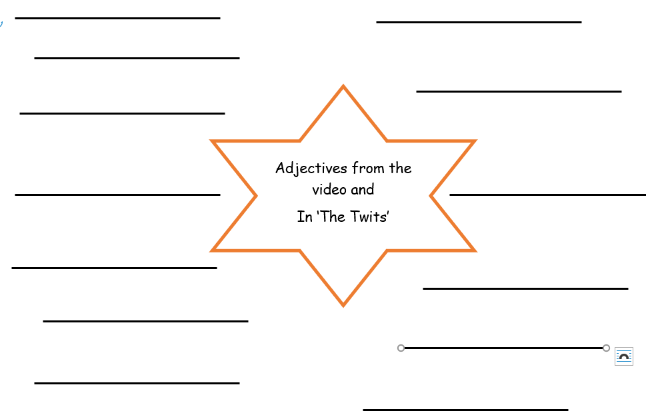

Slide 4
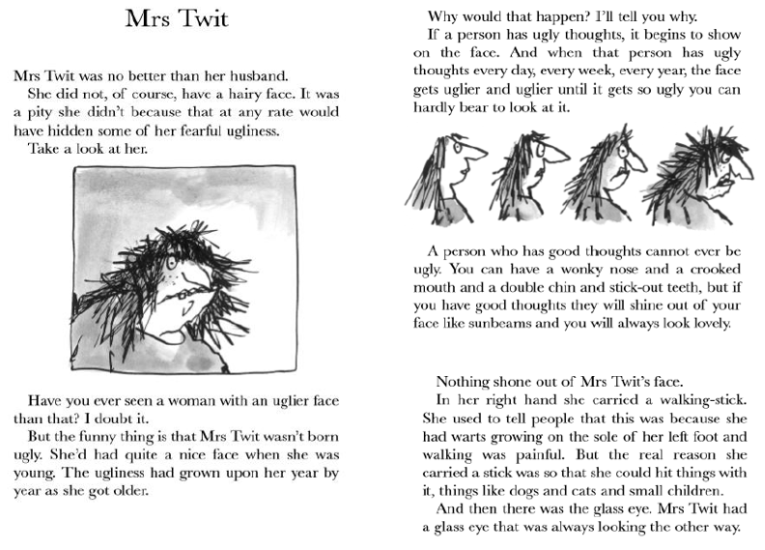

Slide 5
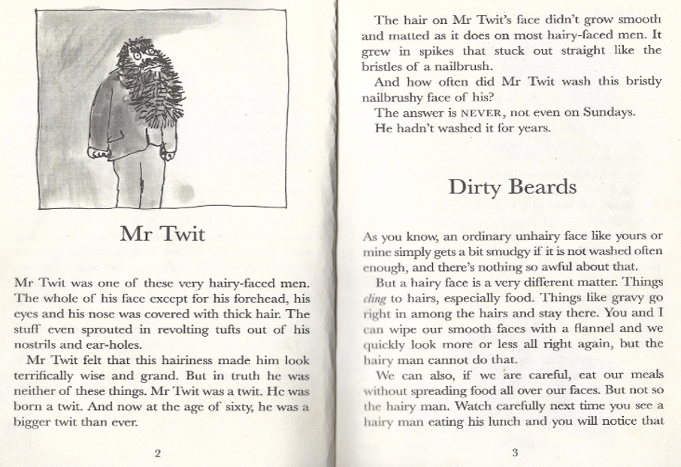

Slide 6
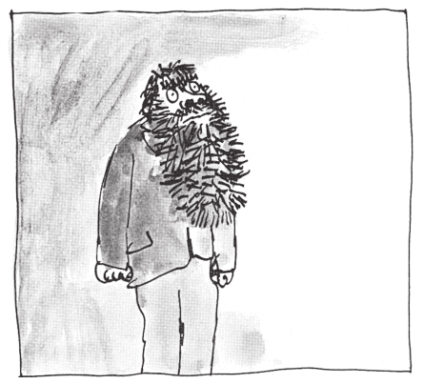
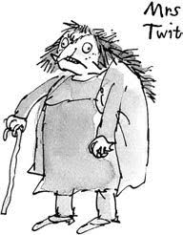
Record phrases to describe Mr and Mrs Twit.
Remember a phrase is a group of words , not a sentence so do not need capital letters or full stops.
You can use bullet points
Mr Twit
You can use the text on the slides to help you but I would like you to think of some of your own descriptions too.
______________________________________________________________________________________________________________________________________________________________________________________________________________________________________________________________________________________________________________________________________________________________________________________________________________________________________________________________________________
______________________________________________________________________________________________________________________________________________________________________________________________________________________________________________________________________________________________________________________________________________________________________________________________________________________________________________________________________________

Slide 7
Super Work!
Have a short break and then start on the English Tasks.

Slide 8

Maths :
Multiply by 4
Follow this link to the White Rose website to watch the video clip and pause to complete the activities. Have paper, a pencil and rubber ready to jot down your answers.
https://whiterosemaths.com/homelearning/year-3/week-11-number-multiplication-division/
You will find related worksheets in the math’s folder on the Kingsland Website.

Slide 9


Times Tables Rock
https://play.ttrockstars.com/auth/school/student/78867
4x table
https://www.youtube.com/watch?v=UJY1_fzzM6Y

Slide 10
Have a lunch break!

Slide 11

Our Environment and Climate Change
Watch the following video clip before going through the PPT in the folder.
https://www.bbc.co.uk/programmes/p075tsy2
https://www.bbc.co.uk/bitesize/topics/zp22pv4/articles/z2md82p

Slide 12

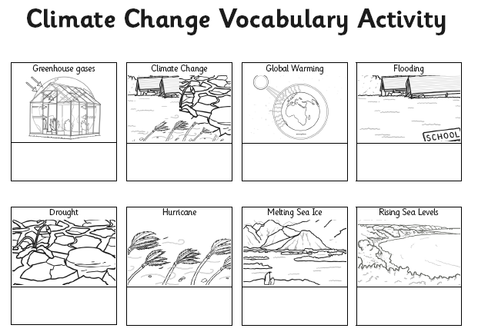
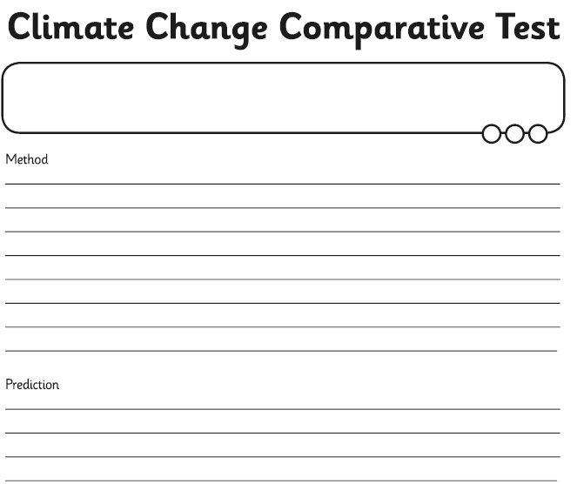
Our Environment and Climate Change
In the folder you will find a PPT explaining what is happening to our environment.
Use the sheet to match the labelled picture with the explanation.
There is an experiment you may want to try and a sheet to record on.

Slide 13

Follow the link for Today’s Worship
Live on TEAMS with
Mr Debenham

Slide 14
Have a super day, give of your best and please send me an e mail this afternoon with examples of your work.
teacher@kingslandengland.hereford.sch.uk
In the subject line could you have :
Year 3 and name of your child
Please only send one email a day with either attachments or a photo of work completed.

