Slide 1
An Outline of Today’s Work Monday 18th January 2021
Subject | Subject/Website | Topic | Activity/ Instruction
Maths | White Rose Year 3 Autumn Block Multiplication and Division | The 3 Times Table | White Rose Teaching Video Related worksheets in today’s folder
English | National Curriculum Word | ‘circle’ | Worksheet is in the today’s folder
 | Comprehension | Mrs Twit | Text and questions in today’s folder
RE | Islam | The Qur’an | Video link to watch Sentences to complete Write your name in Arabic
Worship | Rev Julie |  | A link can be found in the Whole School Folder

Slide 2

Maths :
The 3 Times Table
Follow this link to the White Rose website to watch the video clip and pause to complete the activities. Have paper, a pencil and rubber ready to jot down your answers.
https://whiterosemaths.com/homelearning/year-3/week-11-number-multiplication-division/
You will find related worksheets in the math’s folder on the Kingsland Website.

Slide 3

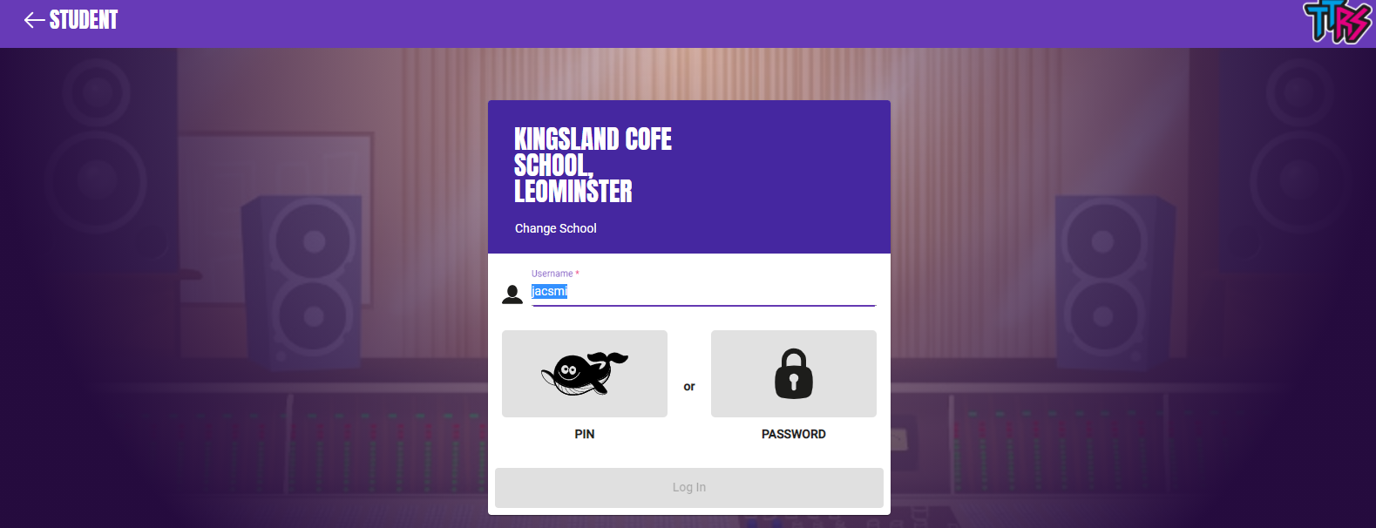
Times Tables Rock
Login using the username and password sent to you on your email. There is an explanation sheet in the Year 3 Folder
https://play.ttrockstars.com/auth/school/student/78867

Slide 4
Super Work!
Have a short break and then start on the English Tasks.

Slide 5
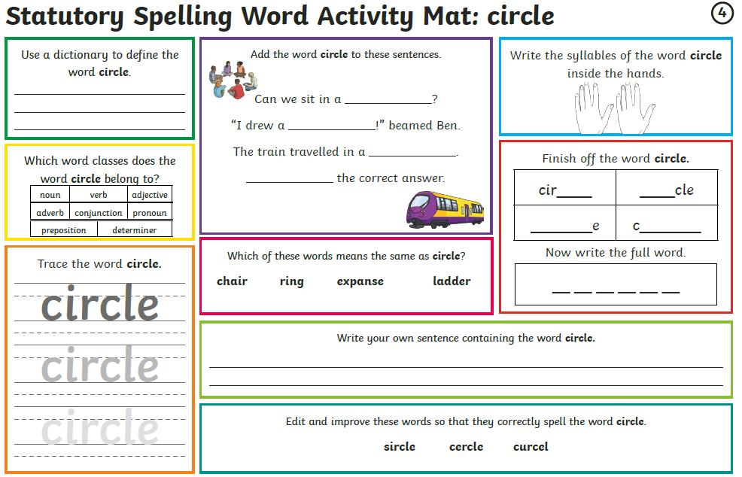

Slide 6
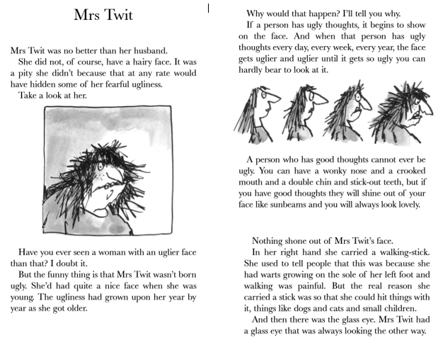
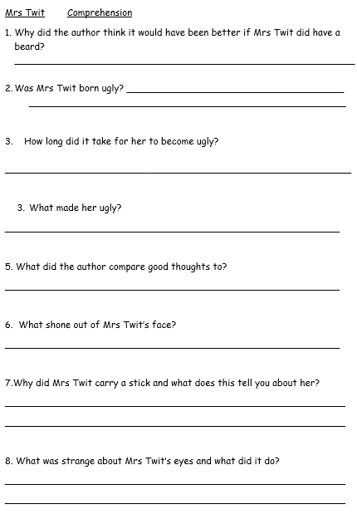
Comprehension
Ask an adult to help you with the reading if you are not feeling confident.
You can use paper or an exercise book instead of printing sheets

Slide 8
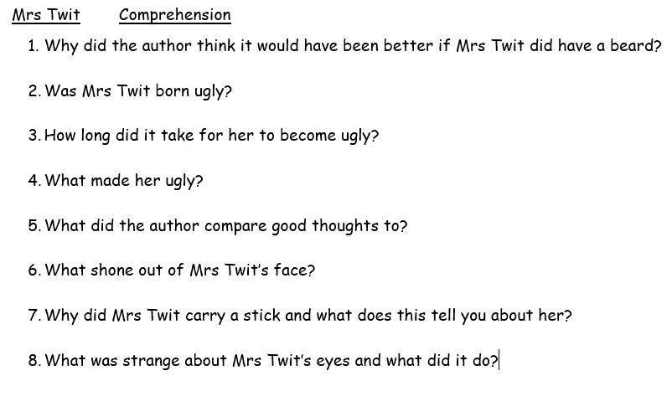
Using the text. Record 3 of your own questions.

Slide 9
Answers in full sentences with detail, capital letters, full stops and joined writing.
Question
What grew out of Mrs Twit’s ears?
Answer:
Long hairs grew out of Mrs Twit’s ears .

Slide 10
Have a lunch break!

Slide 11

The Qur’ an
Follow the links and learn about the Qur’an before doing the worksheet.
https://www.bbc.co.uk/bitesize/clips/z6d2hyc
https://www.bbc.co.uk/bitesize/clips/zrn34wx
https://www.bbc.co.uk/teach/class-clips-video/religious-education-ks2-my-life-my-religion-the-quran/z4p8mfr

Slide 12
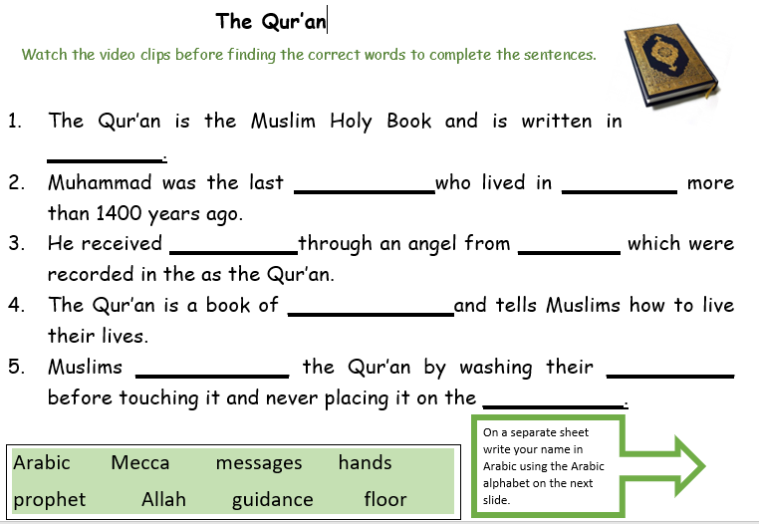
The Qur’ an
Watch the three video clips and think about why the Qur’an is important to Muslims.
Once you have finished watching and listening , complete the sentences by filling in the
correct word from the vocabulary box.
Using the Arabic alphabet , write your name in Arabic .

Slide 13
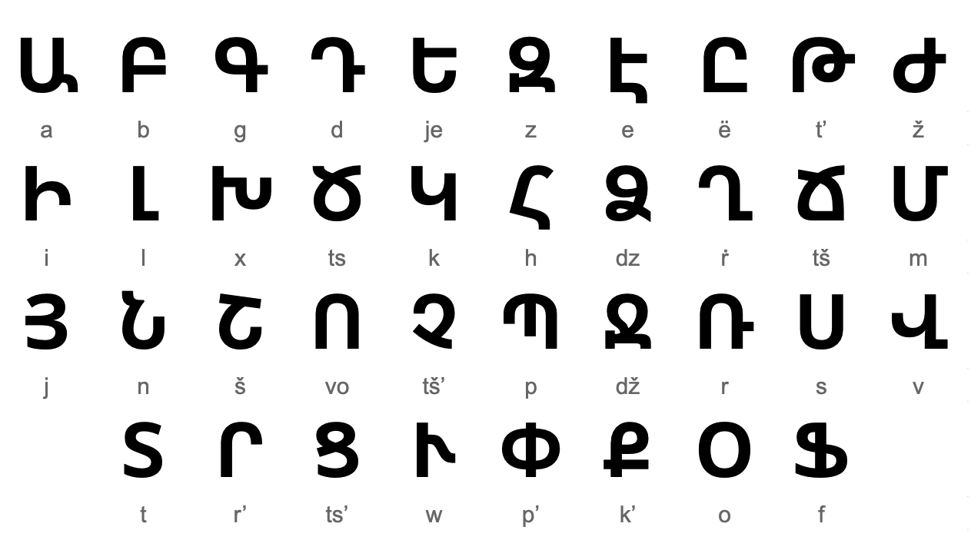

Slide 14

Follow the link for Today’s Worship
In the Whole School Folder

Slide 15
Have a super day, give of your best and please send me an e mail this afternoon with examples of your work.
teacher@kingslandengland.hereford.sch.uk
In the subject line could you have :
Year 3 and name of your child
Please only send one email a day with either attachments or a photo of work completed.

