Slide 1
An Outline of Today’s Work Friday 15th January 2021
Subject | Subject/Website | Topic | Activity/ Instruction
English | Handwriting | Trace and copy | Handwriting paper in the folder
 | Written Task | Pros and Cons Of a beard | Outline in the folder
Maths | White Rose Year 3 Autumn Block Multiplication and Division | Divide by 3 | Watch the White Rose video and pause to complete the activities In the Math’s Folder you will find a related White Rose sheet and extension sheets.
https://whiterosemaths.com/homelearning/year-3/week-11-number-multiplication-division/
French | Talking about Ourselves | ‘What are you called?’ | See work set by Mr Powell in our folder
PE | Circuit Training Jump Start Johnny | Keep Moving | Links and instructions in the Year 3 folder
Worship |  |  | Links are emailed or can be found in the ‘Whole School ‘folder.

Slide 2
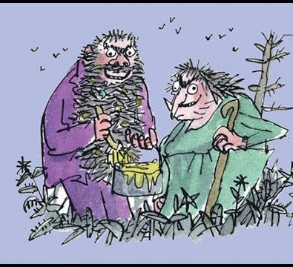

The Twits
By Roald Dahl
https://www.youtube.com/watch?v=EgppUh8ukZ8
Audio Book

Slide 3

Handwriting Lines
You can either print the lined sheet in the folder or collect a few sheets at the school office.

Slide 4
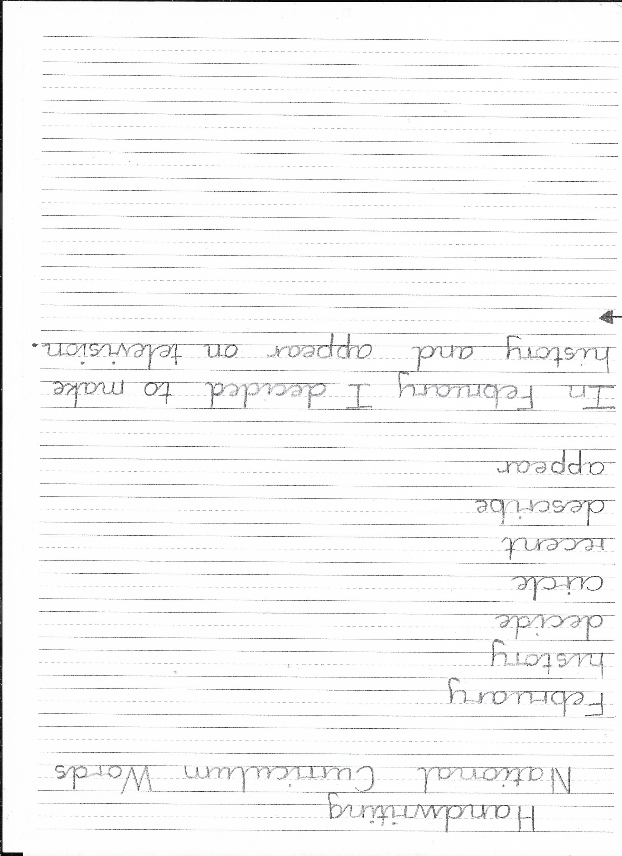
Neatly trace the joined writing and the rewrite the words to fill the line.
Trace the sentence and the rewrite it.

Slide 5
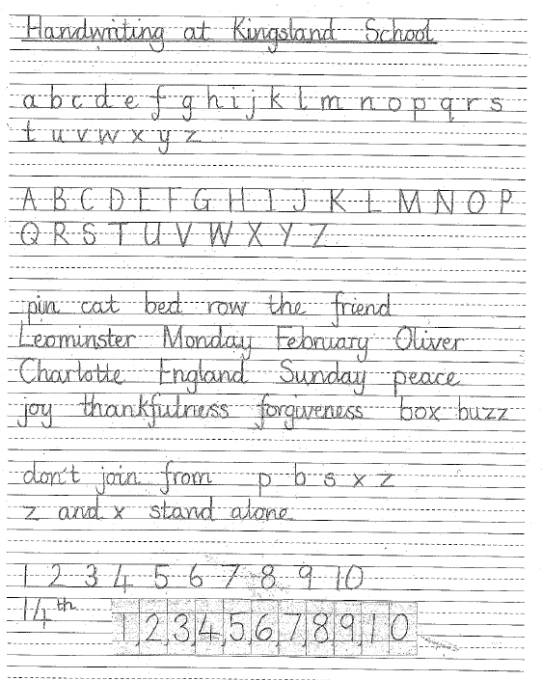
Here are all the correct letter formations and joins to guide you.

Slide 6
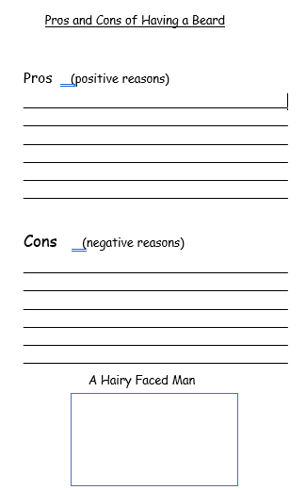
Having listened to the first few chapters of ‘The Twits’, think about the pros and cons of having a beard.
What are the good things about having a beard? Perhaps it keeps your face warm.
What are the bad things about having a beard? A long one may get into a tangle!

Slide 7

Maths :
Divide by 3
Follow this link to the White Rose website to watch the video clip and pause to complete the activities. Have paper, a pencil and rubber ready to jot down your answers.
https://whiterosemaths.com/homelearning/year-3/week-11-number-multiplication-division/
You will find related worksheets in the math’s folder on the Kingsland Website.

Slide 8

A fun way to revisit and learn your times tables
Counting in 3s:
https://www.youtube.com/watch?v=70aG99v704k

Slide 9
Super Work!
Have a short break and then start on the English Tasks.

Slide 10
Have a lunch break!

Slide 11

Follow the link for Today’s Worship
This can be found in the
‘Whole School’ folder.

Slide 12
Have a super day, give of your best and please send me an e mail this afternoon with examples of your work.
teacher@kingslandengland.hereford.sch.uk
In the subject line could you have :
Year 3 and name of your child
Please only send one email a day with either attachments or a photo of work completed.

