Slide 1
An Outline of Today’s Work Thursday 14th January 2021
Subject | Subject/Website | Topic | Activity/ Instruction
English | Spag Mat | Spelling, punctuation and grammar | Worksheet is in the English folder
 | Written Task | The Twits Make a Prediction | Choose one of the two frameworks in the folder
Maths | White Rose Year 3 Autumn Block Multiplication and Division | Multiply by 3 | Watch the White Rose video and pause to complete the activities In the Math’s Folder you will find a related White Rose sheet and extension sheets.
https://whiterosemaths.com/homelearning/year-3/week-11-number-multiplication-division/
Art | Sketching | Drawing Small | Watch the video clip Sketch small items
Computer Science | Digital Literacy | What is a computer? How computers help us. | Follow the links on the PPT slide
Worship |  |  | Links are emailed or can be found in the ‘Whole School ‘folder.

Slide 2
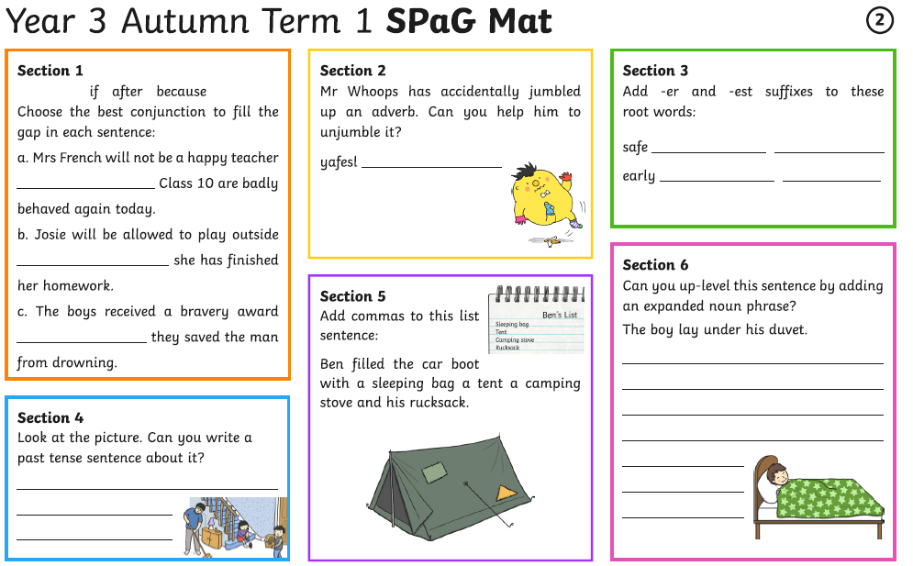

Slide 3
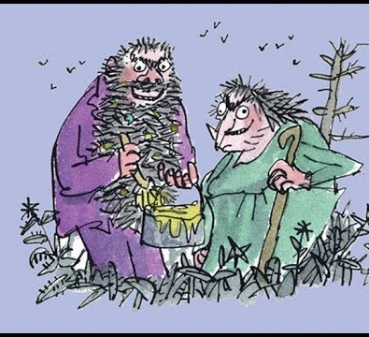

The Twits
By Roald Dahl
https://www.youtube.com/watch?v=EgppUh8ukZ8
Audio Book

Slide 4
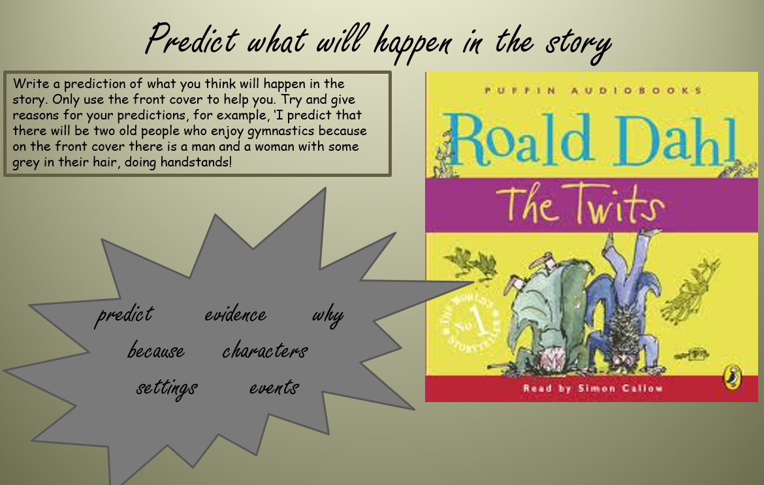

Slide 5
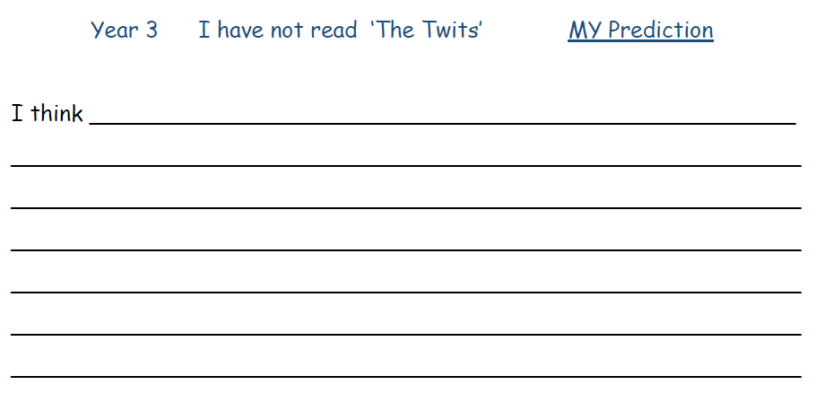
Use the cover of the book, the title and first chapter to make a prediction.
What do you think the book may be about?
What do you think the characters are like?
Where do you think it takes place?
Is it a fiction, non fiction, humorous or serious book.
Remember to write in full sentences with joined handwriting.

Slide 6
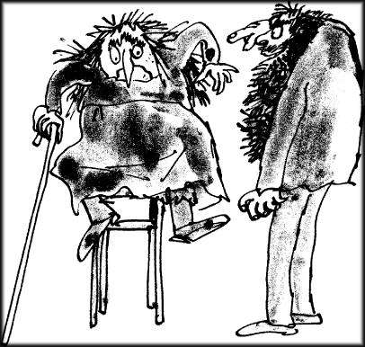
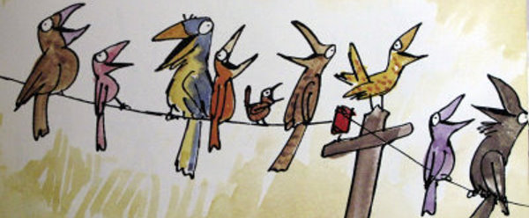
Already Read the Book?
If you have read the book , your task will be to predict the response of the children in our class when they read the book.
Think about:
Their reaction to some of the descriptions
Will they find it sad, funny or serious?
Will they feel sorry for the characters or dislike them?
Are there incidents in the book they may find unfair, cruel or wrong?
What would they think about some of the language used?

Slide 7
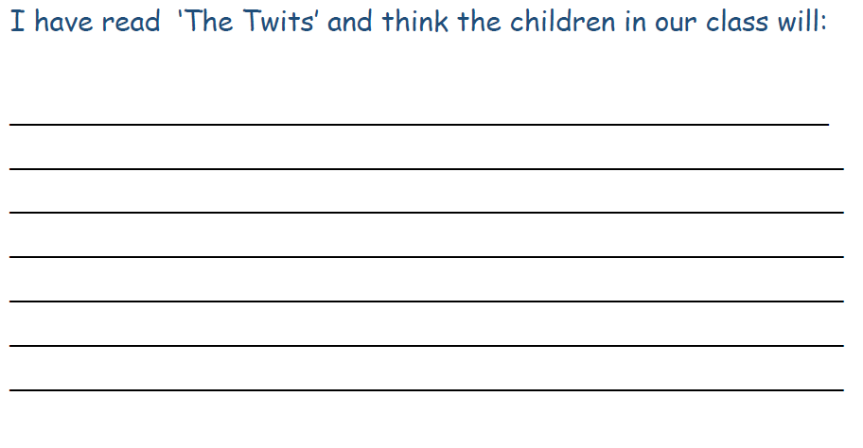
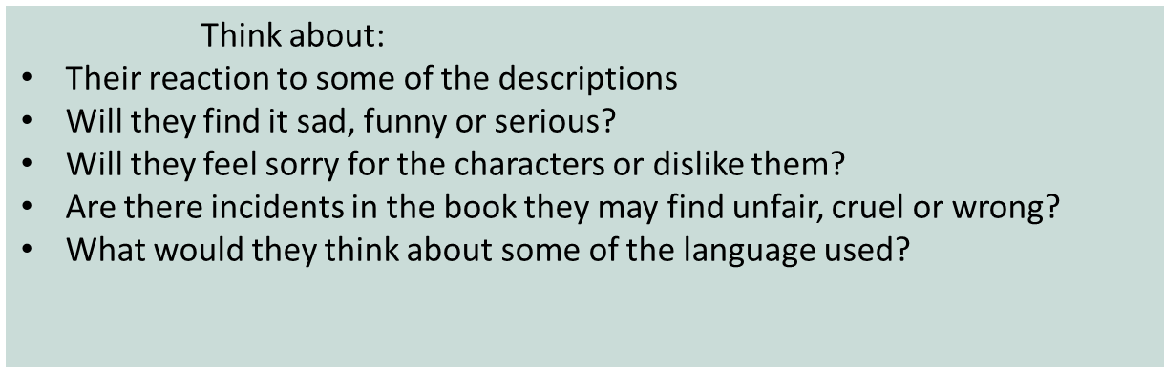

Slide 8
Super Work!
Have a short break and then start on the English Tasks.

Slide 9

Maths :
Multiply by 3
Follow this link to the White Rose website to watch the video clip and pause to complete the activities. Have paper, a pencil and rubber ready to jot down your answers.
https://whiterosemaths.com/homelearning/year-3/week-11-number-multiplication-division/
You will find related worksheets in the math’s folder on the Kingsland Website.

Slide 10
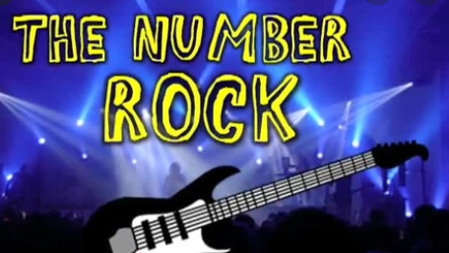
A fun way to revisit and learn your times tables
Counting in 3s:
https://www.youtube.com/watch?v=70aG99v704k

Slide 11
Have a lunch break!

Slide 12
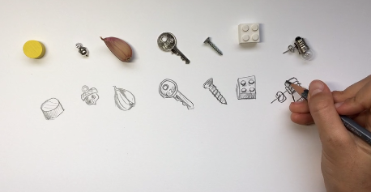
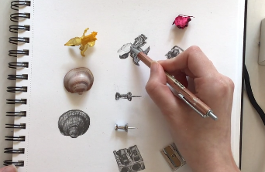
ART
You will need:
Plain paper
Pencil
A few small objects from around your house
Some calm background music
https://www.ramsgateartsprimaryschool.co.uk/blog/?pid=9&nid=23&storyid=5634
After watching the video, choose a few small objects to sketch.

Slide 13

Digital Literacy
This term we will be following the BBC Bitesize computing curriculum.
We will be using both KS1 and KS2 lessons where appropriate for Year 3.
Each short lesson contains games, interactive programmes or video clips to help you understand the topic.
As the lessons are short we may cover two in one session.
This week we will be looking at:
Lesson 1: What is a computer
There is an interactive activity and game to follow.
https://www.bbc.co.uk/bitesize/topics/zymykqt/articles/zc4x6sg
Lesson2: How can computers help you to learn?
Here there are matching activities
https://www.bbc.co.uk/bitesize/topics/zymykqt/articles/zxbwjxs

Slide 14

Follow the link for Today’s Worship
This can be found in the
‘Whole School’ folder.

Slide 15


Tomorrow, please could you have a sheet of paper (lined or blank) ready for our TEAMS meeting.

Slide 16
Have a super day, give of your best and please send me an e mail this afternoon with examples of your work.
teacher@kingslandengland.hereford.sch.uk
In the subject line could you have :
Year 3 and name of your child
Please only send one email a day with either attachments or a photo of work completed.

