Slide 1
An Outline of Today’s Work Wednesday 13th January 2021
Subject | Subject/Website | Topic | Activity/ Instruction
Maths | White Rose Year 3 Autumn Block Multiplication and Division | Divide by 10 | Watch the White Rose video and pause to complete the activities In the Math’s Folder you will find a related White Rose sheet and extension sheets.
https://whiterosemaths.com/homelearning/year-3/week-10-number-multiplication-division/
English | Dictation | A sentence including spelling words, punctuation and grammar | Listen to the audio on this PPT Write it. Mark it using the PPT slide
 | Written Task | Conjunctions | Use the ‘Conjunction Mat’ To create sentences.
Science | Light | Sources of light (recap) | Video links to follow Activity sheet to complete in the folder
Worship |  |  | Links can be found either in emails sent or the ‘Whole School’ folder

Slide 2
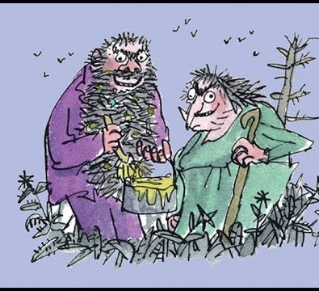

The Twits
By Roald Dahl
https://www.youtube.com/watch?v=EgppUh8ukZ8
Audio Book

Slide 3

A fun way to revisit and learn your times tables
Counting in 10s: descending and ascending order
https://www.youtube.com/watch?v=dSdjzFl9H6k

Slide 4

Maths :
Divide by 10
Follow this link to the White Rose website to watch the video clip and pause to complete the activities. Have paper, a pencil and rubber ready to jot down your answers.
https://whiterosemaths.com/homelearning/year-3/week-10-number-multiplication-division/
You will find related worksheets in the math’s folder on the Kingsland Website.

Slide 5
Super Work!
Have a short break and then start on the English Tasks.

Slide 6
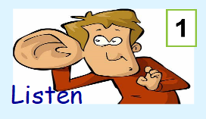


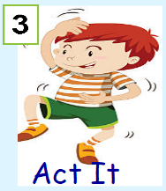


Dictation
Click on the speaker to hear the sentence.
Do not go to the next slide until you have written and checked your sentence.

Slide 7

Mark your dictation and see where you need to make corrections.
I can’t decide which apple to eat so I think I’ll eat both.
Give yourself a tick for the following if correct:
Correct spelling for the contraction: can’t
Correct spelling for: decide.
Correct spelling for the homophone: which
Underlined conjunction: so
Correct spelling for the contraction : I’ll

Slide 8
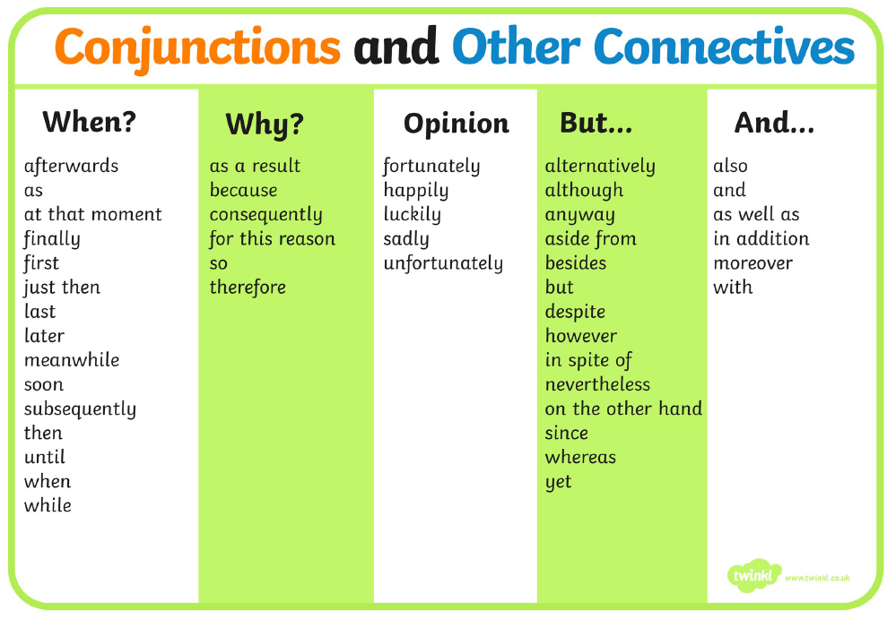
Using the conjunction mat below, choose a conjunction from each column to use in a ‘wow’ sentence.
Write your 5 sentences in your exercise book or paper and underline the conjunction.
Perhaps your sentences could be based on the first chapter of ‘The Twits’

Slide 9
Have a lunch break!

Slide 10
Science
Over the next 2 or 3 weeks, we will be finishing off our topic on light.
So far we have investigated sources of light, reflectors and how light travels through some materials. Watch the following clips to remind you about some of the vocabulary we have discussed before in class.
https://www.bbc.co.uk/programmes/p06skhwf
A ‘get up and move’ song
https://www.bbc.co.uk/bitesize/clips/zg6r82p
Sources of light
https://www.bbc.co.uk/bitesize/clips/zb3s34j
Seeing in the dark

Slide 11
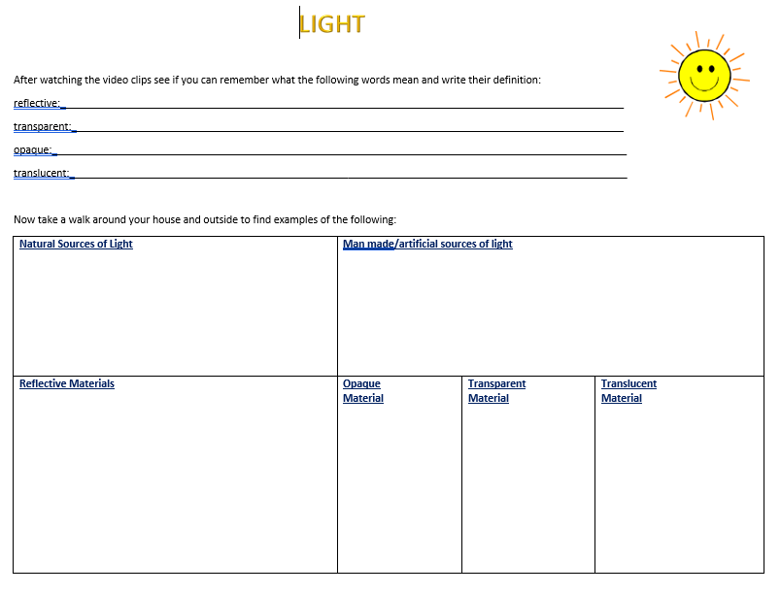

Slide 12

Follow the link for Today’s Worship
This can be found in the
‘Whole School’ folder.

Slide 13
Have a super day, give of your best and please send me an e mail this afternoon with examples of your work.
teacher@kingslandengland.hereford.sch.uk
In the subject line could you have :
Year 3 and name of your child
Please only send one email a day with either attachments or a photo of work completed.

