Slide 1

HAPPY BIRTHDAY
Eve!!

Slide 2
An Outline of Today’s Work Tuesday 12th January 2021
Subject | Subject/Website | Topic | Activity/ Instruction
Maths | White Rose Year 3 Autumn Block Multiplication and Division | dividing by 5 | White Rose Teaching Video Related worksheets in today’s folder
https://whiterosemaths.com/homelearning/year-3/week-10-number-multiplication-division/
English | Grammar | Conjunctions | Follow the Bitesize link with video and the activities after each video
https://www.bbc.co.uk/bitesize/articles/zcdvp4j (bitesize link: conjunctions)
 | Written task | Find out about Roald Dahl’s Life | Information slides and sheet in today’ folder
Topic | Climate Change | Weather and Climate | Describe the weather for today Watch the video clip Cut and match weather vocab Answer the questions
Worship | Mr Debenham | Live Worship On TEAMS | Links were e mailed out or can be found on the school website.

Slide 3

House Point Card
Either draw your own or print the house point card shown. Every time you get a house point draw a smiley face on your card.
When your card is full start another but keep your cards so that we can give house tokens when we return to school.
Name:__________________________ House:___________________________

Slide 4

Maths :
Divide by 5
Follow this link to the White Rose website to watch the video clip and pause to complete the activities. Have paper, a pencil and rubber ready to jot down your answers.
https://whiterosemaths.com/homelearning/year-3/week-10-number-multiplication-division/
You will find related worksheets in the math’s folder on the Kingsland Website.

Slide 5

A fun way to revisit and learn your times tables
5x table
https://www.youtube.com/watch?v=LZAqhF_2vvs

Slide 6
Super Work!
Have a short break and then start on the English Tasks.

Slide 7
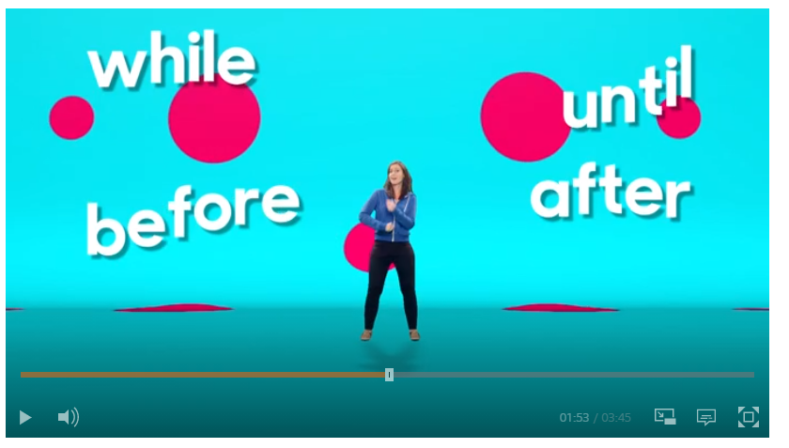
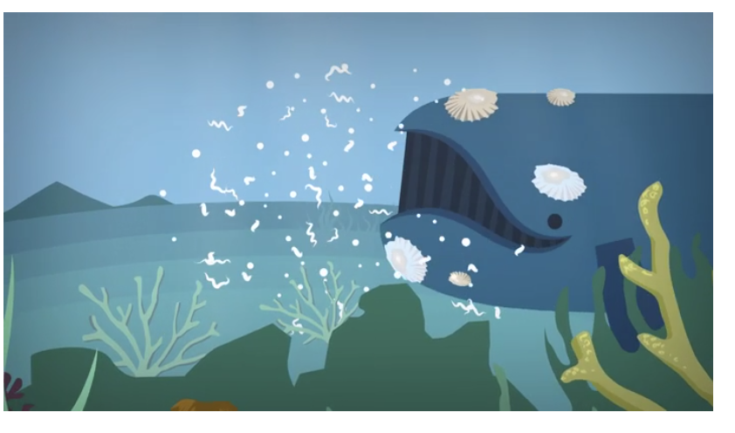
CONJUNCTIONS
https://www.bbc.co.uk/bitesize/articles/zcdvp4j
and, but, for, or, while, until, before, after, because
Have a pencil and paper ready as each video clip has sentences for you to complete using the appropriate conjunctions.

Slide 8
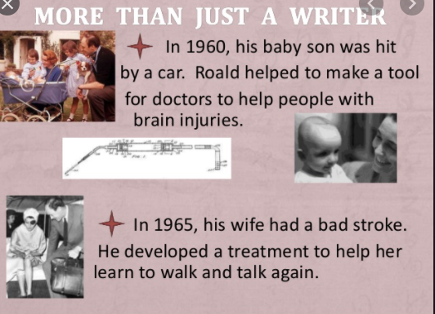
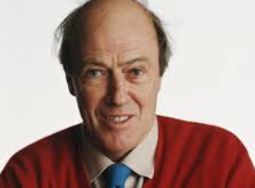
Today we are going to be finding out about the author Roald Dahl
There is a PPT with information about Roald Dahl in today’s folder. Read through it and write down 5 interesting facts you have found out about him.

Slide 9
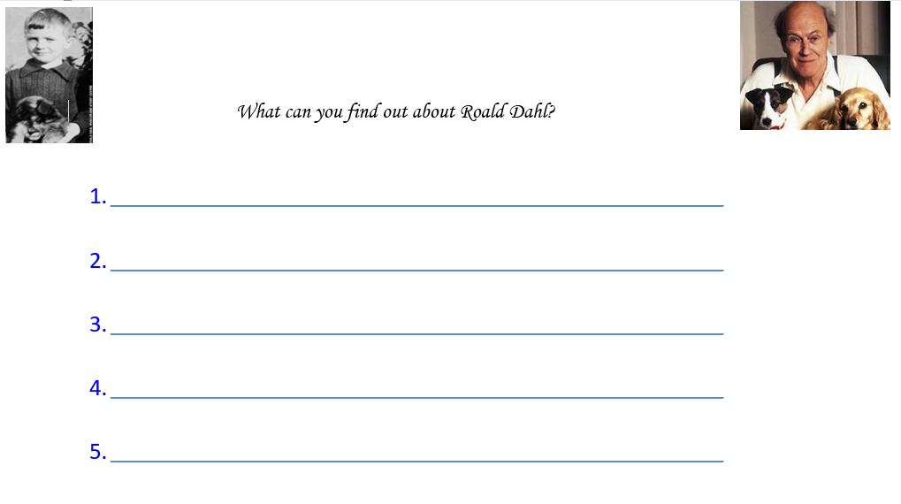

Slide 10

Have you read any of these Roald Dahl Books?
Guess which one we are going to start tomorrow?

Slide 11
Have a lunch break!

Slide 12

This term we will be looking at Climate Change and Our Fragile Earth
First we need to find out what the
difference is between :
The Weather and Climate

Slide 13
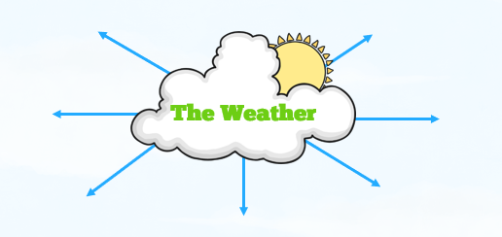
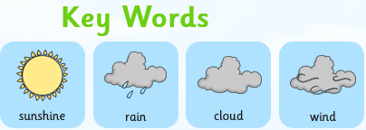
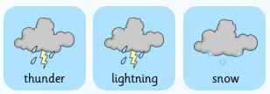
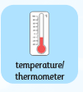
Weather and Climate
Take a quick walk outside and then come back in and give some key words to describe the weather today.

Slide 14
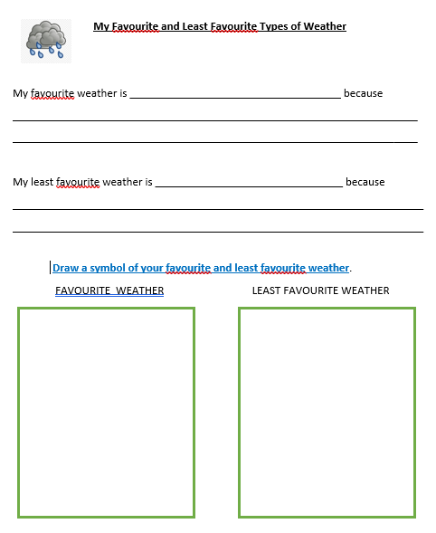
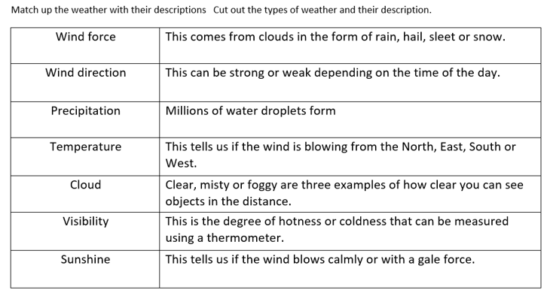
Watch the BBC clip and then complete the activities in today’s folder:
Cut up and match the vocabulary to the definition about weather
Complete the sentences and draw the symbols
https://www.bbc.co.uk/bitesize/topics/z849q6f/articles/z7dkhbk

Slide 15

Follow the link for Today’s Worship
Live on TEAMS with
Mr Debenham

Slide 16
Have a super day, give of your best and please send me an e mail this afternoon with examples of your work.
teacher@kingslandengland.hereford.sch.uk
In the subject line could you have :
Year 3 and name of your child
Please only send one email a day with either attachments or a photo of work completed.

