Slide 1
An Outline of Today’s Work Monday 11th January 2021
Subject | Subject/Website | Topic | Activity/ Instruction
Maths | White Rose Year 3 Autumn Block Multiplication and Division | Dividing by 2 | White Rose Teaching Video Related worksheets in today’s folder
https://whiterosemaths.com/homelearning/year-3/week-10-number-multiplication-division/ (White Rose) https://www.youtube.com/watch?v=FkAzZoqCJ4E (Numberock)
English | National Curriculum Word | decide | Worksheet is in the today’s folder
 | Research | Books by Roald Dahl | Worksheet is in today’s folder
 | Comprehension | Roald Dahl | * ** *** Comprehension to choose from In today’s folder
RE | Islam | Vocabulary Definitions | Video link to watch Questions to answer Knowledge Organiser
Worship |  |  | A link can be found in the Whole School Folder

Slide 2

Maths :
Divide by 2
Follow this link to the White Rose website to watch the video clip and pause to complete the activities. Have paper, a pencil and rubber ready to jot down your answers.
https://whiterosemaths.com/homelearning/year-3/week-10-number-multiplication-division/
You will find related worksheets in the math’s folder on the Kingsland Website.

Slide 3

A fun way to revisit and learn your times tables
2x table
https://www.youtube.com/watch?v=FkAzZoqCJ4E

Slide 4
Super Work!
Have a short break and then start on the English Tasks.

Slide 5
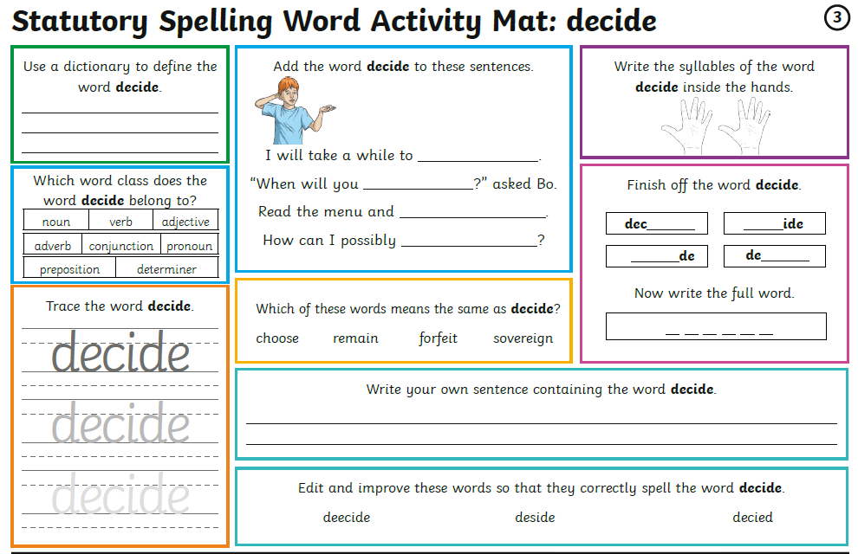

Slide 6
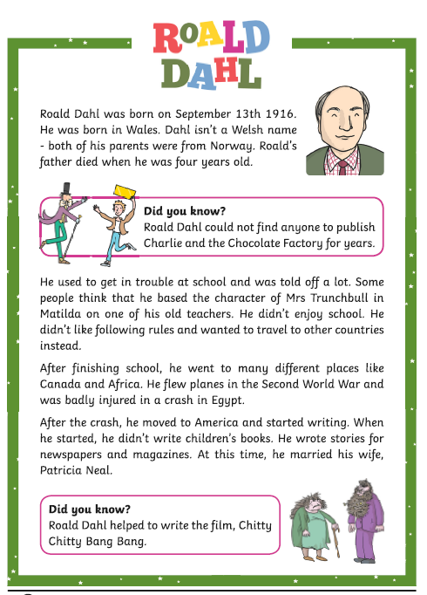
Comprehension
Ask an adult to help you with the reading if you are not feeling confident.
You can use paper or an exercise book instead of printing sheets

Slide 7
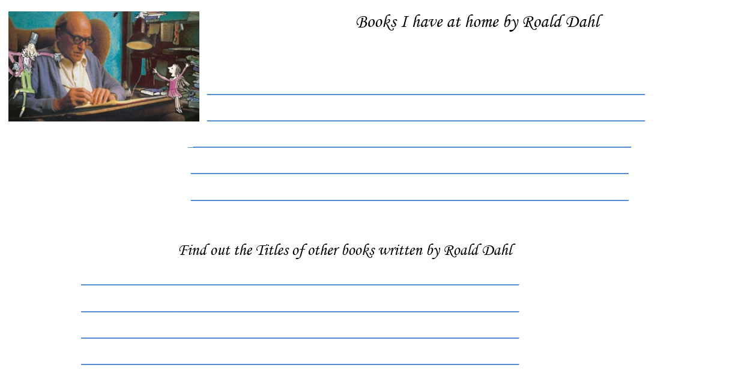

Slide 8
Have a lunch break!

Slide 9

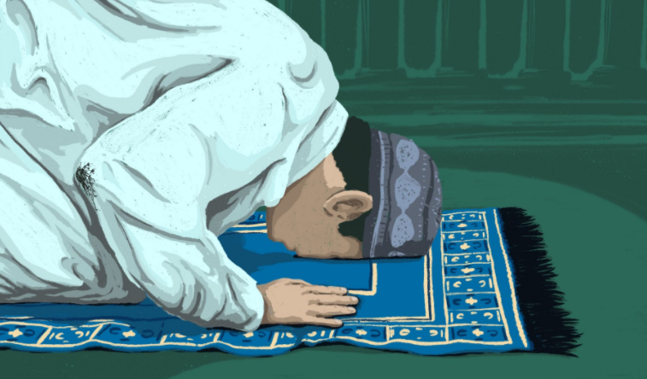
During RE we will be looking at the Muslim Faith, their festivals and worship.
To start, we need to remind ourselves about what we already know and some of the key words we have learnt about previously.
Watch this video before doing the task.
https://www.bbc.co.uk/programmes/p02mwkxn

Slide 10
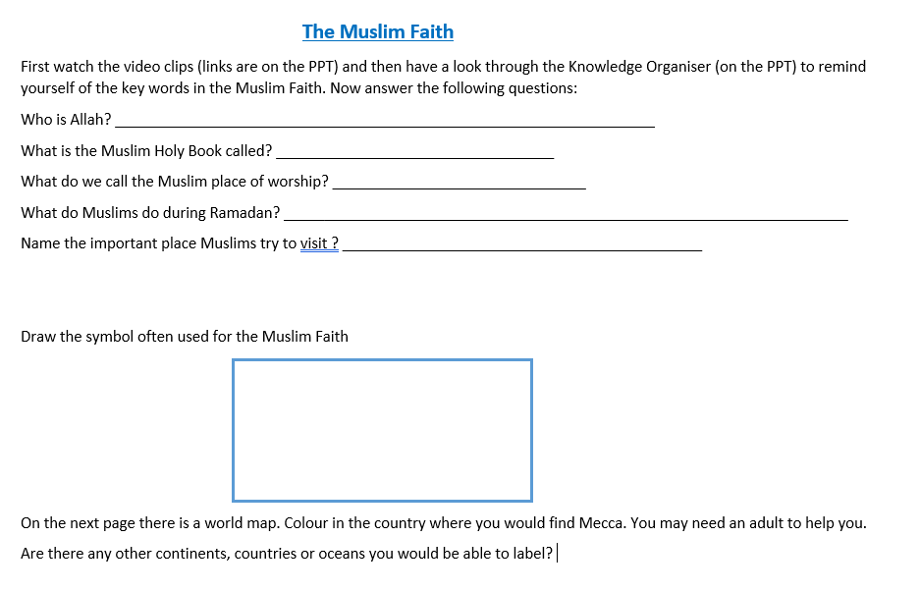

Slide 11
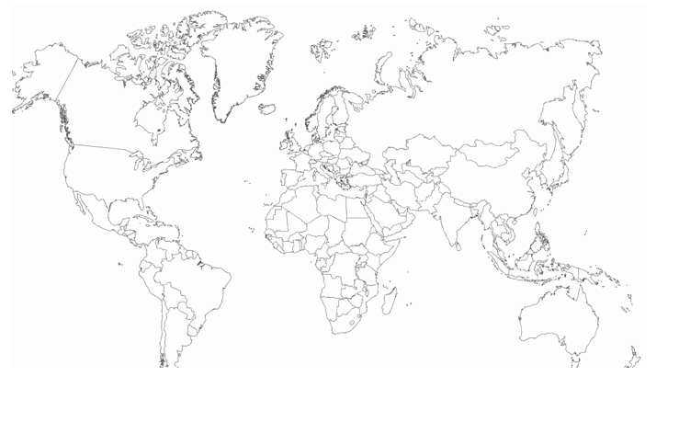

Slide 12
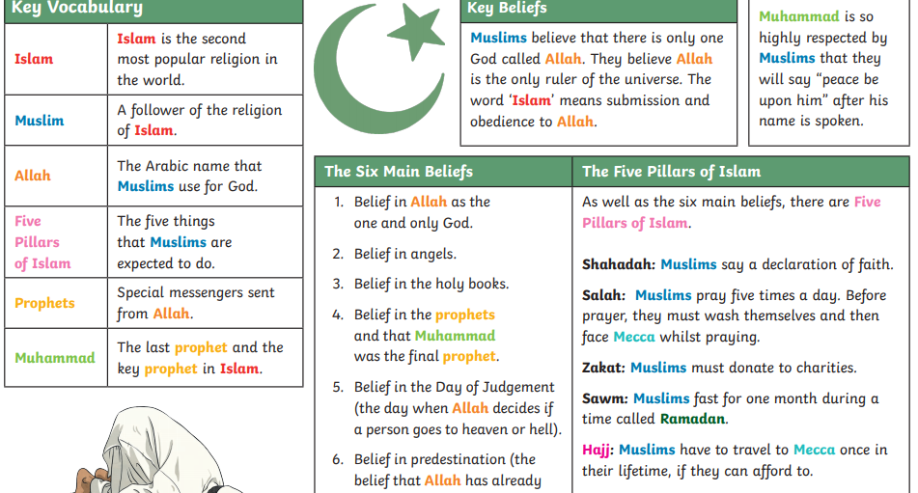

Slide 13
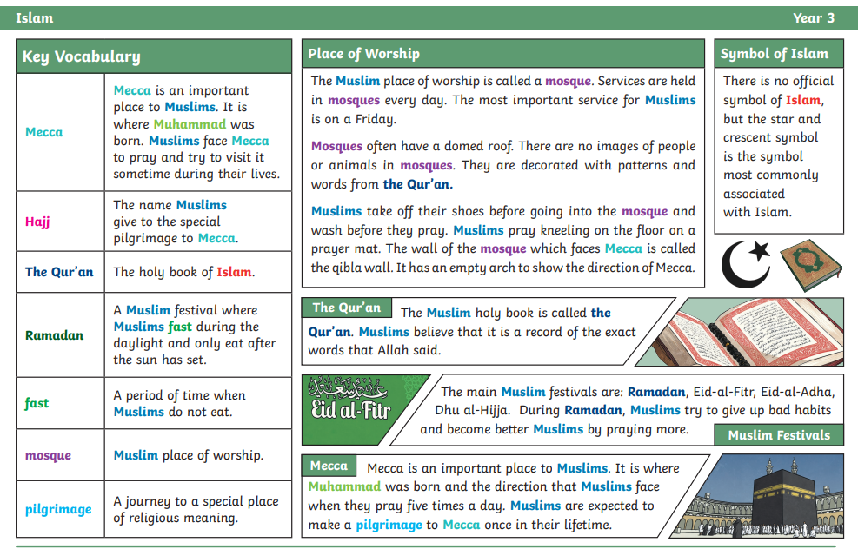

Slide 14

Follow the link for Today’s Worship
In the Whole School Folder

Slide 15
Have a super day, give of your best and please send me an e mail this afternoon with examples of your work.
teacher@kingslandengland.hereford.sch.uk
In the subject line could you have :
Year 3 and name of your child
Please only send one email a day with either attachments or a photo of work completed.

