Slide 1
An Outline of Today’s Work Friday 8th January 2021
Subject | Subject/Website | Topic | Activity/ Instruction
Maths | White Rose Year 3 Autumn Block Multiplication and Division | Making Equal Groups by grouping | Watch the White Rose video and pause to complete the activities In the Math’s Folder you will find a related White Rose sheet and extension sheets.
https://whiterosemaths.com/homelearning/year-3/week-10-number-multiplication-division/
English | Spag (spelling,punctuation & grammar) | Mixed Activities | Worksheet is in the English folder
 | Writing | Holiday News | Use your planning sheet to help you write your ‘Holiday News’
Afternoon Activity | Autumn Pack | Selection of activities | Choose a different activity for this afternoon.
Worship | I sing-Pop https://youtu.be/j3xjCOgzSjU |  | See link from Mr Debenham or on the last slide.

Slide 2
Maths :
Making Equal Groups by - grouping
Follow this link to the White Rose website to watch the video clip and pause to complete the activities. Have paper, a pencil and rubber ready to jot down your answers.
https://whiterosemaths.com/homelearning/year-3/week-10-number-multiplication-division/
You will find related worksheets in the math’s folder on the Kingsland Website.

Slide 3
Super Work!
Have a short break and then start on the English Tasks.

Slide 4
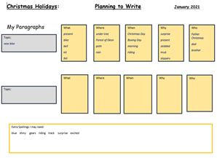
Holiday News
Yesterday you completed a planning sheet for your ‘Holiday News’
Today you will be writing your news either in an exercise book or on paper. You should have at least two paragraphs but are welcome to do more if you can.
On the next slide, I have shown an example of what a reader may find boring and an example of a more interesting piece. There is also a slide reminding you how to set out your work.
Before writing a sentence remember to:
Think it through
Say it out loud
Improve it by adding :
adjectives or some of the 5Ws
Say it out loud again
Write it
Read it
Edit it

Slide 5
Thursday 8th January
My Holiday News
On Christmas Day I got a bike. I was excited. We went riding and I fell off. I had a good day.
Would you find this writing interesting? Why and how could it be improved?
Thursday 8th January
My Holiday News
Early on Christmas Morning, I crept downstairs in my Rudolph PJs and fluffy slippers. I held my breath as I peaked into the living room and there under the Christmas Tree was a large colourful package. Once everyone was up, I was allowed to open my package and there was a sparkling new bicycle. It had shimmering blue trimmings and a shiny bell which made an awful racket when I rang it. I could not wait to go riding in The Forest of Dean that afternoon with my brother!
Was that more interesting for the reader? Why and how did I improve my sentence?

Slide 6
You should now be ready to write your date and heading before starting to write .
Thursday 8th January
My Holiday News

Slide 7
Once you have finished writing you need to read through all your work and edit it.
When editing, check :
Spelling
Are there any missing words?
Full stops and capital letters
Adjectives and adverbs
Does it make sense?

Slide 8
Have a lunch break!

Slide 9
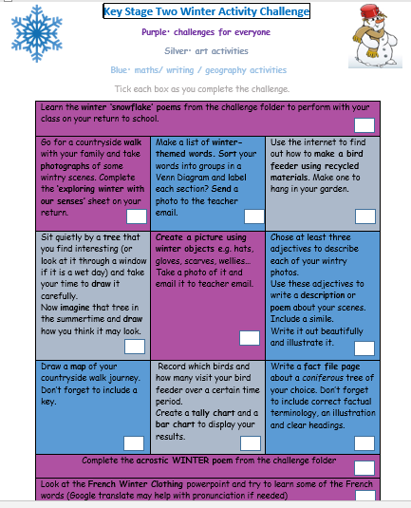
On the School Website you will find an Autumn Pack with activities to choose from.

Slide 10

I Sing-Pop Worship
https://youtu.be/j3xjCOgzSjU

Slide 11
Have a super day, give of your best and please send me an e mail this afternoon with examples of your work.
teacher@kingslandengland.hereford.sch.uk
In the subject line could you have :
Year 3 and name of your child
Please only send one email a day with either attachments or a photo of work completed.

