Slide 1
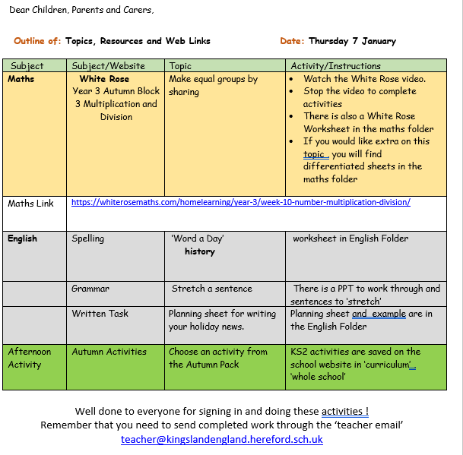


Slide 2
Maths : Making equal groups by sharing
Follow this link to the White Rose website to watch the video clip and pause to complete the activities. Have paper, a pencil and rubber ready to jot down your answers.
https://whiterosemaths.com/homelearning/year-3/week-10-number-multiplication-division/
You will find related worksheets in the math’s folder

Slide 3
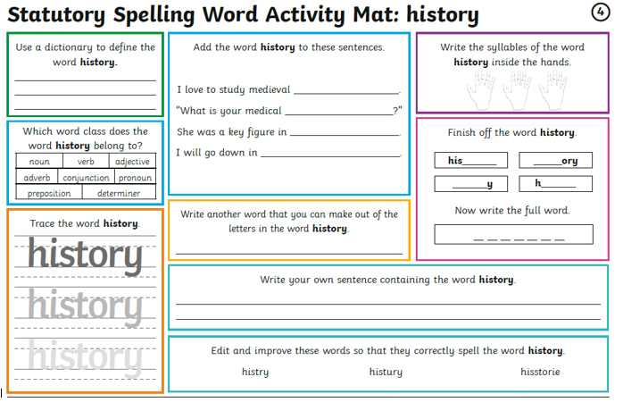

Slide 4
Remember how to ‘Stretch a Sentence’
We use the 5 W’s to add more detail into our sentences. You do not need to add all to the same sentence but try to add some.
Who?
What?
When?
Where?
Why?
In the folder you will find a PPT to work through and remind you how to ‘stretch a sentence’

Slide 5
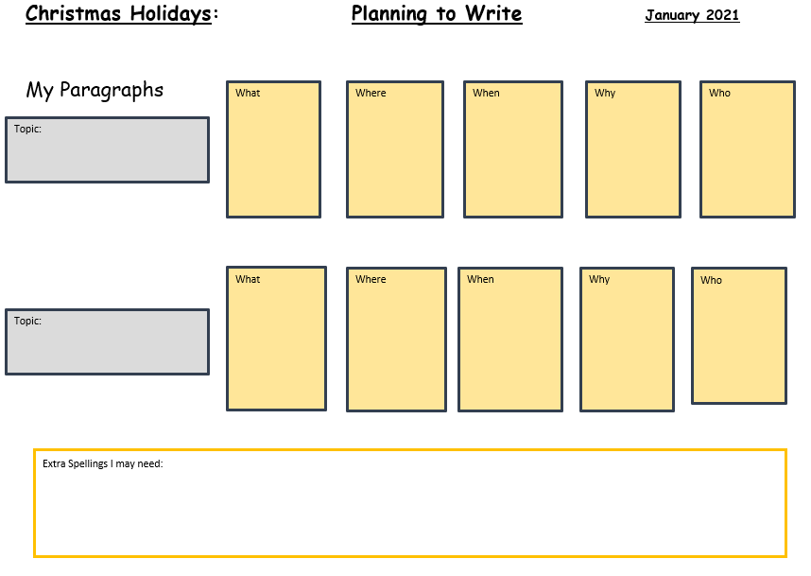

Slide 6
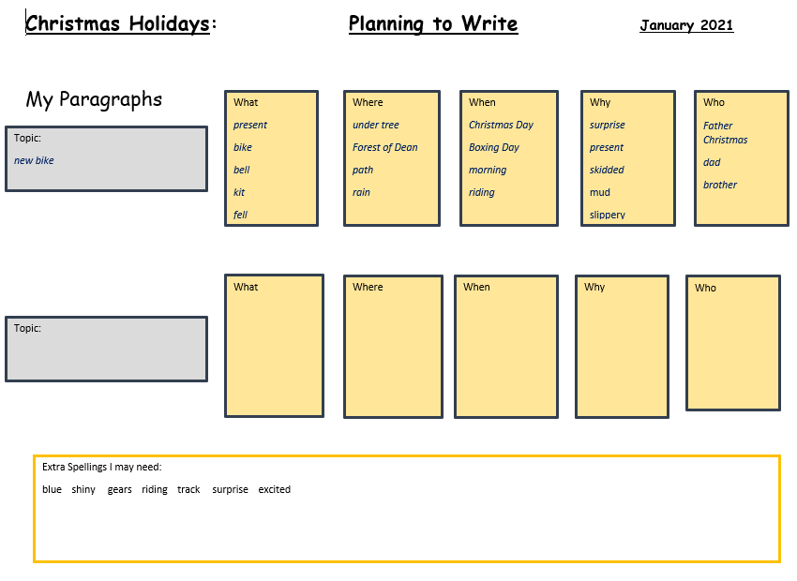

Slide 7
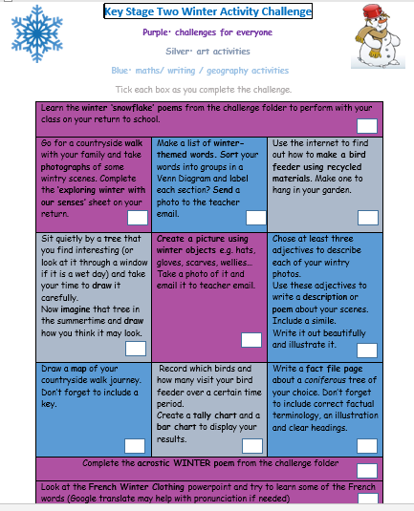
On the School Website you will find an Autumn Pack with activities to choose from.

Slide 8
Have a super day, give of your best and please send me an e mail this afternoon with examples of your work.
teacher@kingslandengland.hereford.sch.uk
In the subject line could you have :
Year 3 and name of your child
Please only send one email a day with either attachments or a photo of work completed.

