Slide 1



Home Learning
Friday 5th March

Slide 2

Start with a story

Slide 3

English - Spellings
The ‘Big 5’ Quiz
It’s time for the ‘Big’ 5 Quiz!
For these activity you will need paper, a pencil and rubber.

Slide 4

English
Today’s task is a grammar task.
Grammar – Conjunctions
when if that becasue
For this activity you will need paper, a pencil and rubber.

Slide 5

Take a break!

Slide 6

Maths
As you have all worked so hard over the last few weeks at home, today you are going to play some math games.
Here are some websites you can visit which contain math games.
Education city
Times Table Rock Stars
Kingsland School Website
Or maybe you could play cards, snake and ladders or similar games.

Slide 7
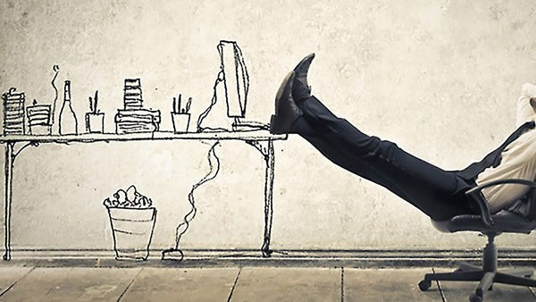
Have another break!

Slide 8

Afternoon Lessons
All Year 2 children’s work will be the same on a Friday afternoon and will be set by Mrs Smith. It can be found on the website.

Slide 9


Slide 10

Reading
We are asking you to find 15-20 minutes during your day to share a book with an adult or family member.
Remember it not just you reading to an adult but also an adult reading to you.
Please could you also make a note of this in
your reading record.

Slide 11

Worship Time
Today is the World Day of Prayer, celebrated around the world. As such, a special Worship Time has been created by Helen Webb, Chair of Governors, Rev Julie Read and Wendy Maddocks, Foundation Governor.
Children should bring a stone or Lego / Duplo brick to the Worship Time. Please follow this link: https://youtu.be/rdbSv-A7zH0

Slide 12

Time - Expectation
The government expectation is for 3 hours of schooling to be a completed a day in Key Stage 1.
We are planning for approximately:
1 hour for English
1 hour for maths
1 hour for afternoon activities
(Plus independent reading)
Obviously if your child would like to do more then please feel free to carry on with any work.

Slide 13

At the end of your day
Please could you please send an email to
teacher@kingslandengland.hereford.sch.uk
showing a selection of your work and I will be able to reply with a comment / feedback. Please could they also be sent in by 3:30pm if possible.
Please keep this to one email a day. If you want to include multiple attachments that will be fine.

Slide 14

Any problems
If you have any problems at all then please feel free to email me and I’ll do my best to help. Remember we are in this together and we will learn as we go along.
teacher@kingslandengland.hereford.sch.uk

