Slide 1


Slide 2

This week we are going to take a look at conjunctions again.

Slide 3
An conjunction is the name given to words that allow us to extend our sentences.
Today we are going to concentrate on using the conjunctions if, when, that and because.
For example
I walked to the shop. We can extend this sentence by using because.
I walked to the shop because I needed to buy some flapjack.

Slide 4

We can add different conjunctions to the same sentence and it will change it.
India thought she would go to the concert if she could get tickets.
India thought she would go to the concert when she had saved up enough money.

Slide 5
We can add different conjunctions to the same sentence and it will change it.
Bella saw a cow that she used to feed on her way to school.
Bella saw a cow when she ran across the meadow.

Slide 6
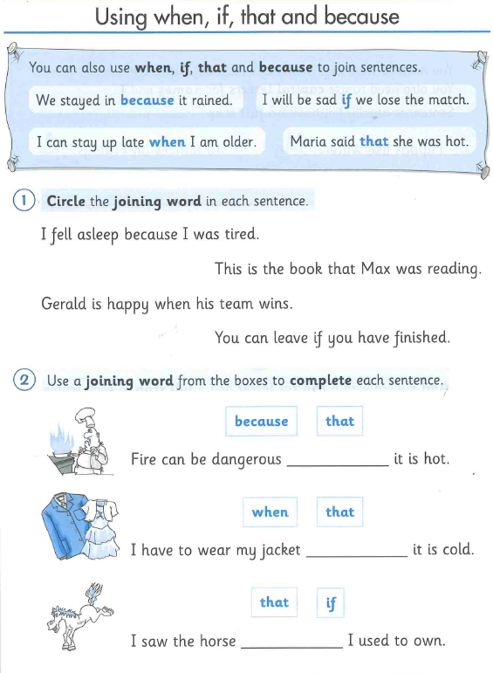
Can you complete the worksheets on conjunctions.
After you have completed it, you will need to complete the 6 sentences using either if, when, because or that.
If you are unable to print the worksheet, completing it on a separate book or paper will be great.

