Slide 1


Slide 2
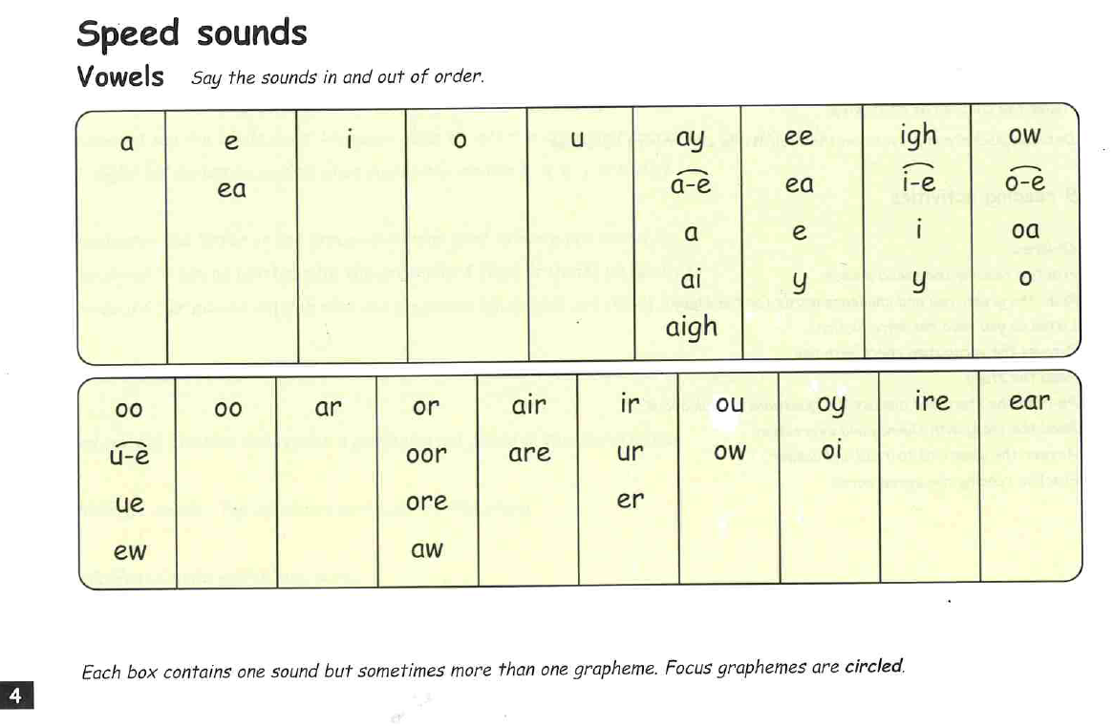

Slide 3
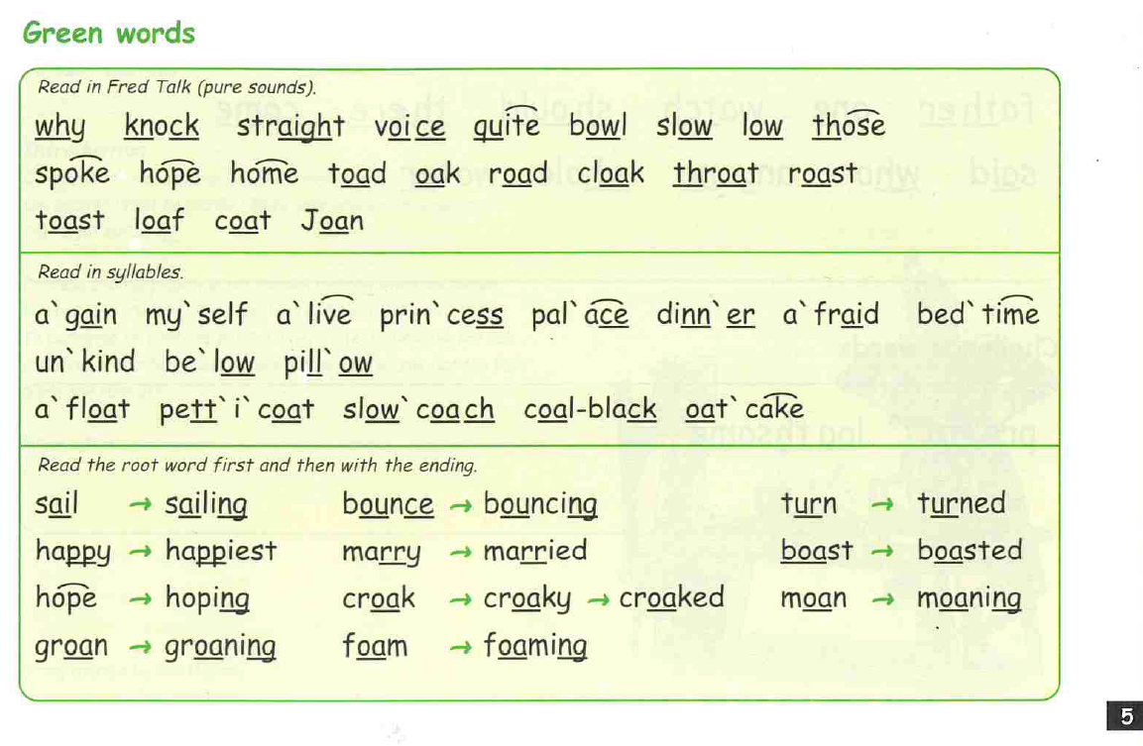

Slide 4
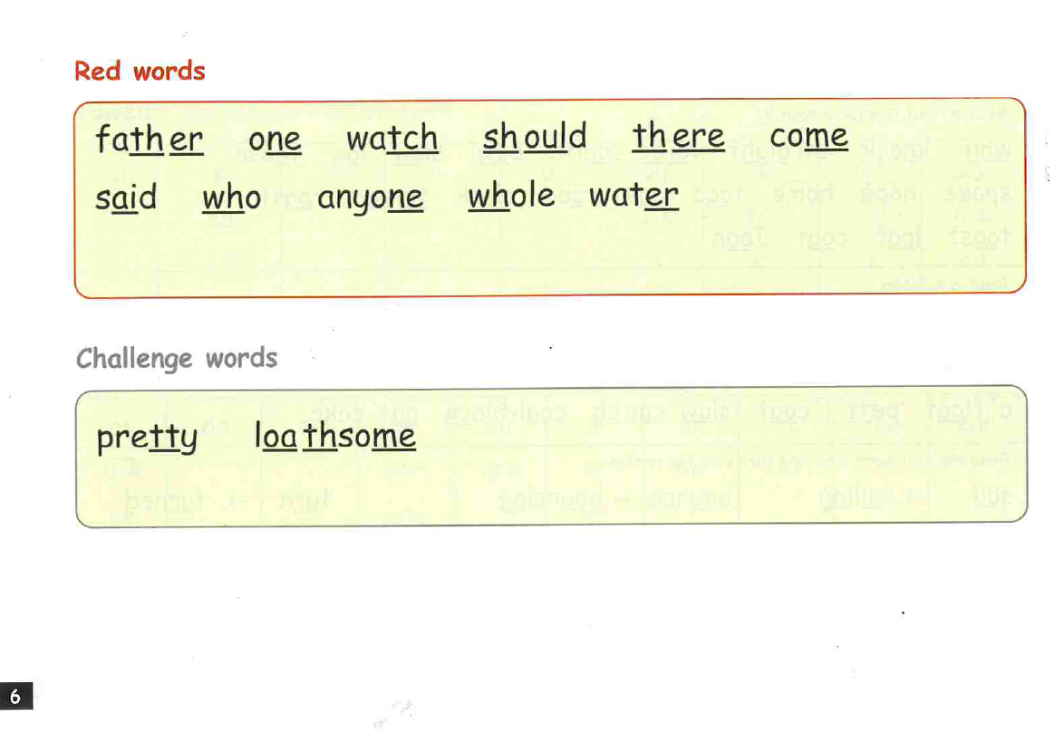

Slide 5
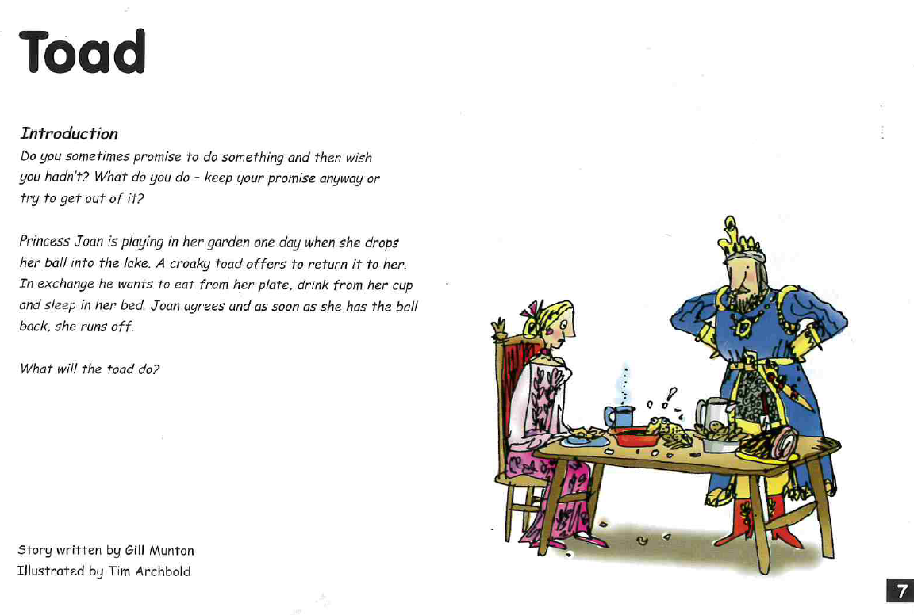

Slide 6
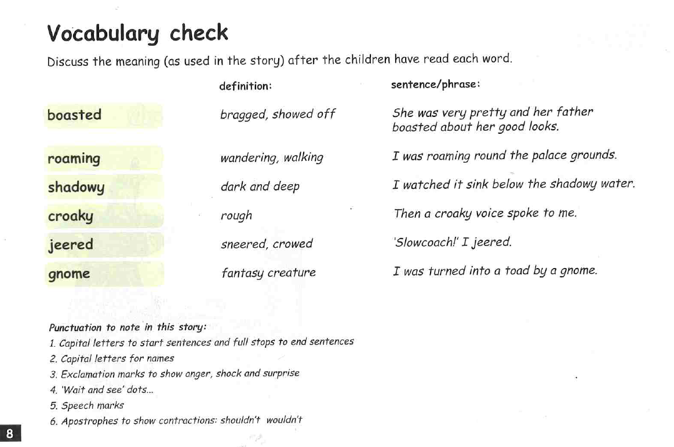

Slide 7
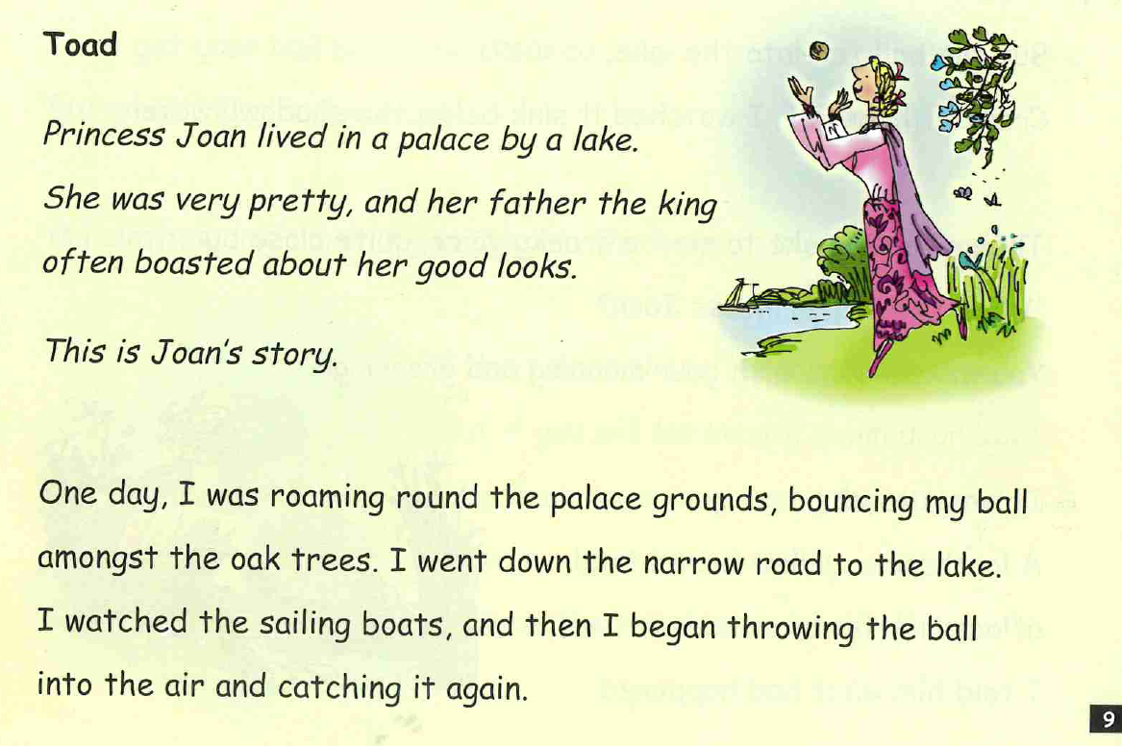

Slide 8
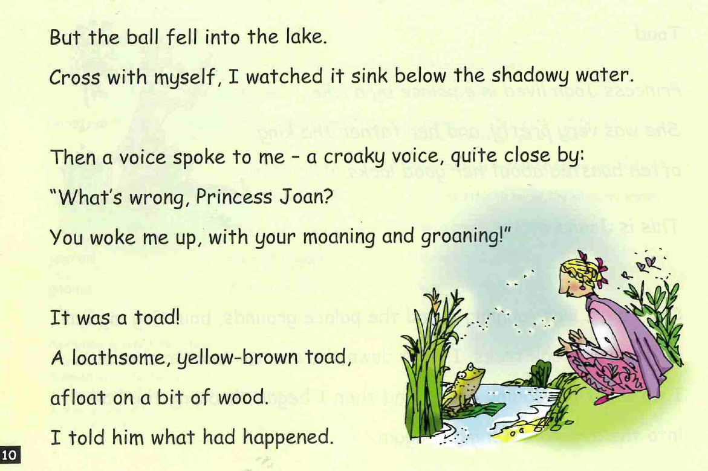

Slide 9
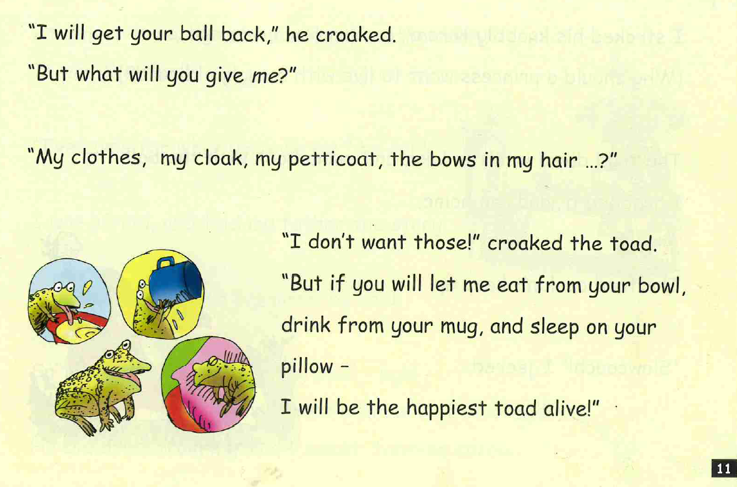

Slide 10
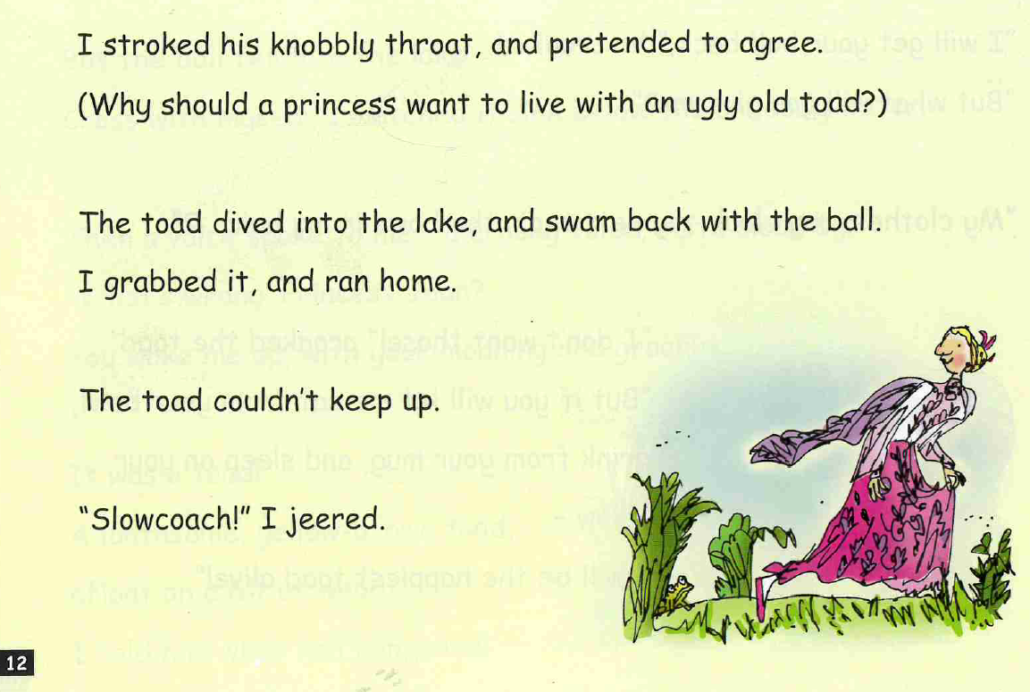

Slide 11
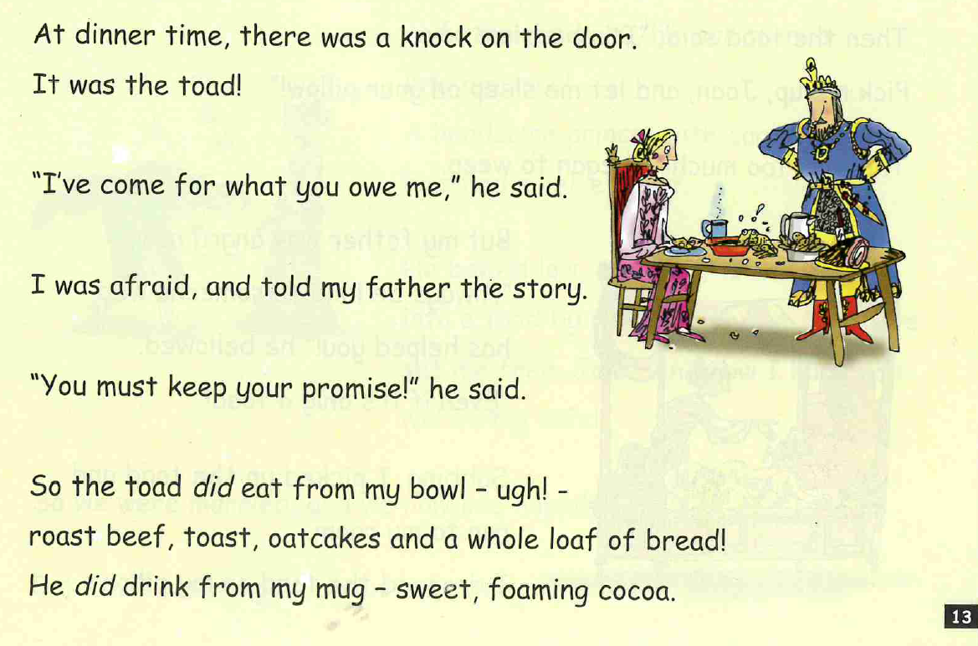

Slide 12
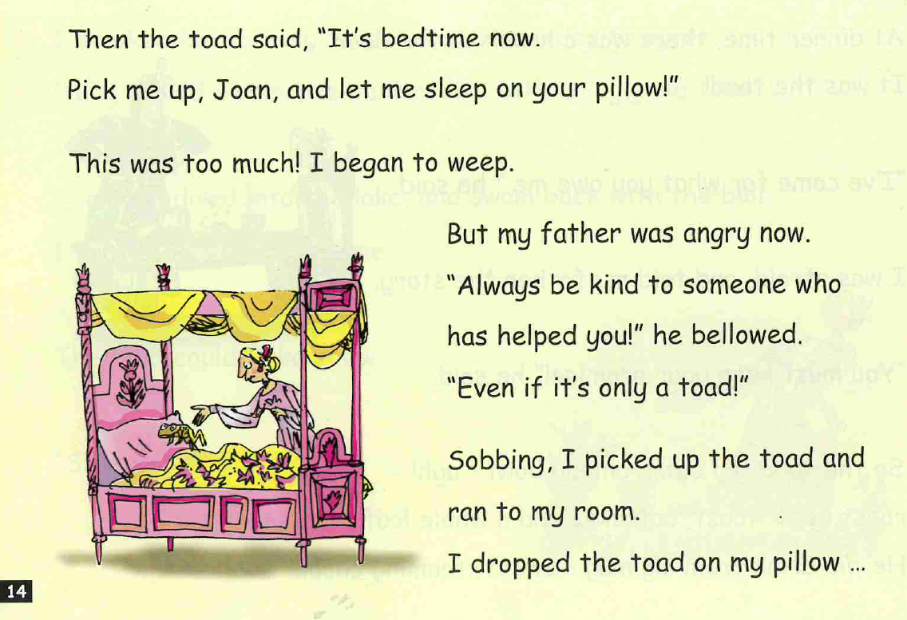

Slide 13
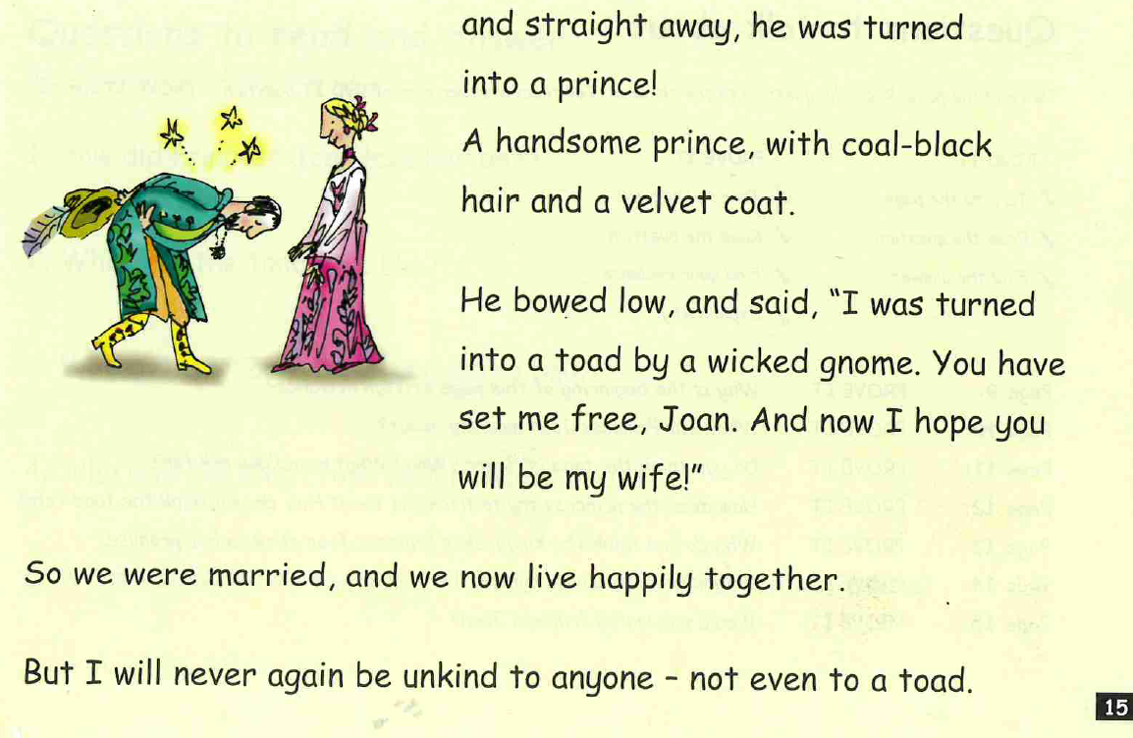

Slide 14
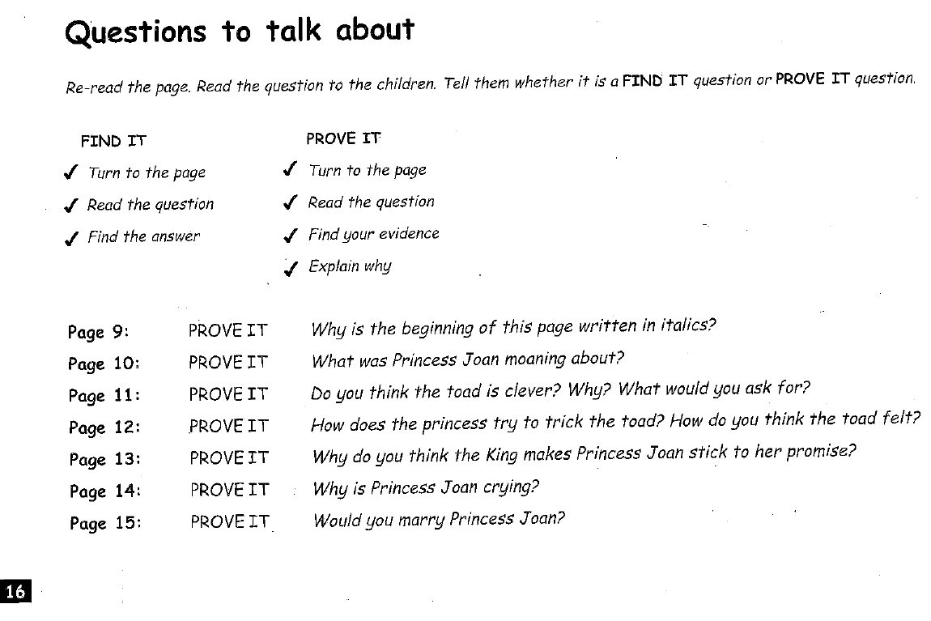

Slide 15
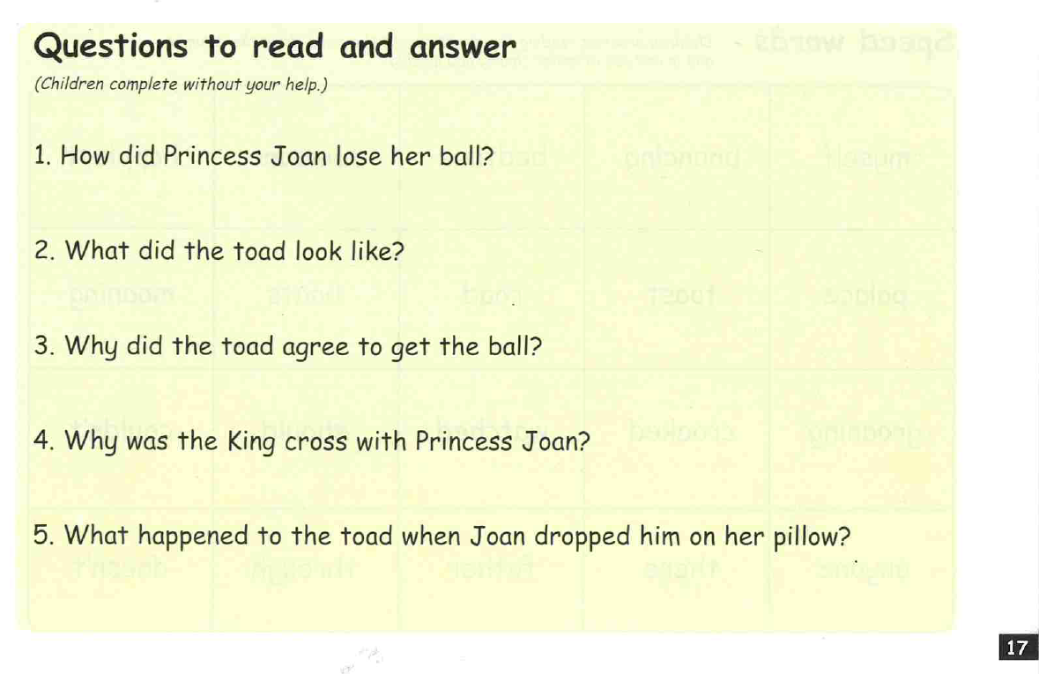

Slide 16
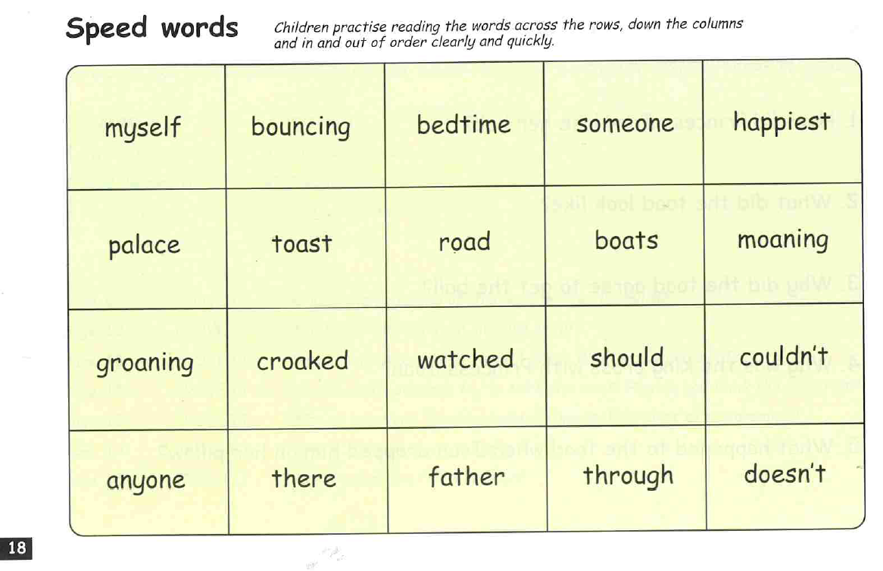

Slide 17



Edit a Sentence
2. Build a Sentence
The worksheet can be found on website or follow the PowerPoint and
write in a book or on handwriting paper.

Slide 18
Edit a sentence
Can you rewrite the below sentence for me please correcting all the mistakes. The correct sentence is on the following slide. No peaking until you have finished!
There are 7 mistakes!
it was a toad a loathsome, yello-brown toad, aflot on a bit of would
Then mark it using the correct sentence on the next slide.

Slide 19
It was a toad! A loathsome, yellow-brown toad, afloat on a bit of wood.

Slide 20

Build a sentence
Your word for today is - deceitful
What does it mean? Can you find out?
Your job is to write a really creative sentence using this power word.
Can you include:
‘wow’ vocabulary
Add a conjunction to extend your sentence – and, or, but, so, if, because, when, that
Remember the 3 golden rules – capital letters, full stops and your sentence must make sense
Don’t forget to use your headphones to say your sentence out loud before writing it down.
E.g. The deceitful witch tricked Hansel and Gretal to stay in the gingerbread house.

Slide 21


