Slide 1

Climate Change
What can we do to help?
On the following slide there are a selection of short clips to watch.
‘Twinkle Go’ Pin code: HI 0871

Slide 2
Fishing Nets
https://www.bbc.co.uk/programmes/p06m0nd5
No Plastic Straws
https://www.bbc.co.uk/programmes/p06m0n9h
Reuse coffee cups and bottles
https://www.bbc.co.uk/programmes/p06bsx6t
David Attenborough –what we can do?
https://www.bbc.co.uk/programmes/p06bsx63
Newsround
https://www.bbc.co.uk/newsround/47979998
Kids Take Action
https://www.youtube.com/watch?v=hKFV9IquMXA

Slide 3


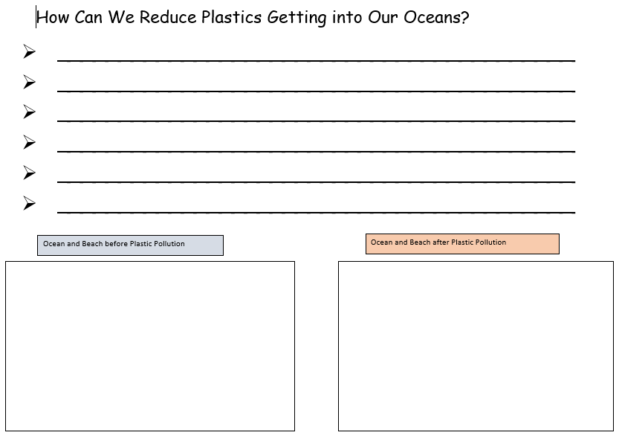
Complete the activity in the folder
Write neat sentences with correct punctuation.
Be specific eg Take Outs need to use recyclable packaging. recycle

Slide 4

Follow the link for Today’s Worship
Live on TEAMS with
Mr Debenham

Slide 5
Have a super day, give of your best and please send me an e mail this afternoon with examples of your work.
teacher@kingslandengland.hereford.sch.uk
In the subject line could you have :
Year 3 and name of your child
Please only send one email a day with either attachments or a photo of work completed.

