Slide 1

The Muslim Pilgrimage- Hajj
Below are two video clips to watch as well as PPTs and activities in the ‘Twinkle Go’ folder you could choose from.
https://www.bbc.co.uk/teach/class-clips-video/religious-education-ks2-my-life-my-religion-muslim-pilgrimage-hajj/zndfcqt
https://www.bbc.co.uk/programmes/p02mwk0y
If you login in to Twinkle Go, you will find:
PPT guide
Photo display
Twinkle Go-PIN:
MF5087

Slide 2
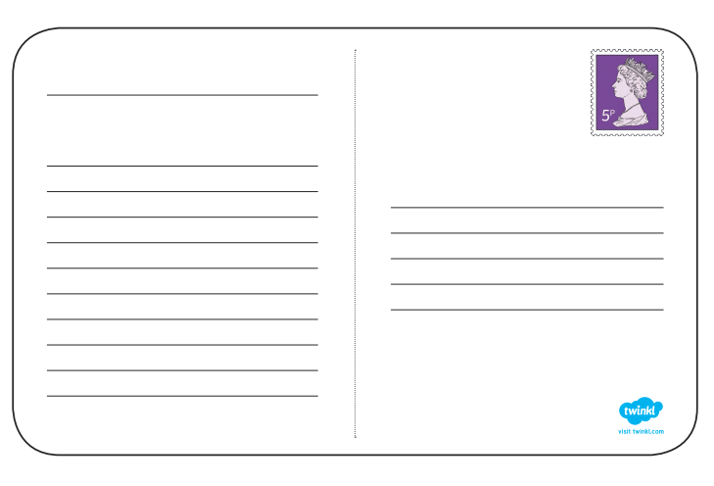
Imagine you have been to Mecca on Hajj.
Write a postcard about your experience
Address it to Class 3
Include:
Where you are
Why you are there
Something you saw
What impressed you
How it made you feel

Slide 3

Follow the link for Today’s Worship
In the Whole School Folder

