Slide 1


Slide 2

This week we are going to take a look at conjunctions.

Slide 3

An conjunction is the name given to words that allow us to extend our sentences.
Today we are going to concentrate on using the conjunctions and but and or.
For example
I walked to the shop. We can extend this sentence by using and.
I walked to the shop and bought the biggest chocolate bar they had.

Slide 4

We can add different conjunctions to the same sentence and it will change it.
Theodore’s cat ran happily across the park and climbed the biggest tree.
Theodore’s cat ran happily across the park but ran straight back because it was scared.

Slide 5
We can add different conjunctions to the same sentence and it will change it.
When Ellie-Mae goes to the playground she will play on the slide and sometimes on the swings.
When Ellie-Mae goes to the playground she likes to play on the slide or she will only play on the roundabout.

Slide 6
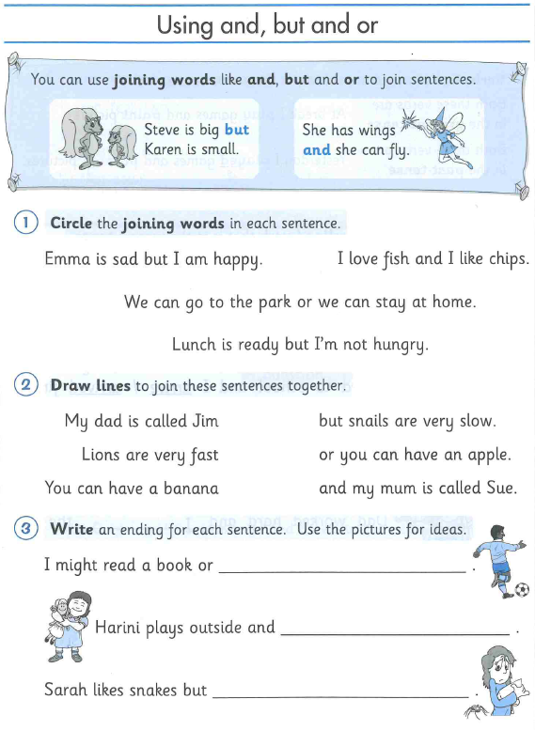
Can you complete the worksheets on conjunctions.
After you have completed it, you will need to complete the 6 sentences using either and but and or.
If you are unable to print the worksheet, completing it on a separate book or paper will be great.

