Slide 1
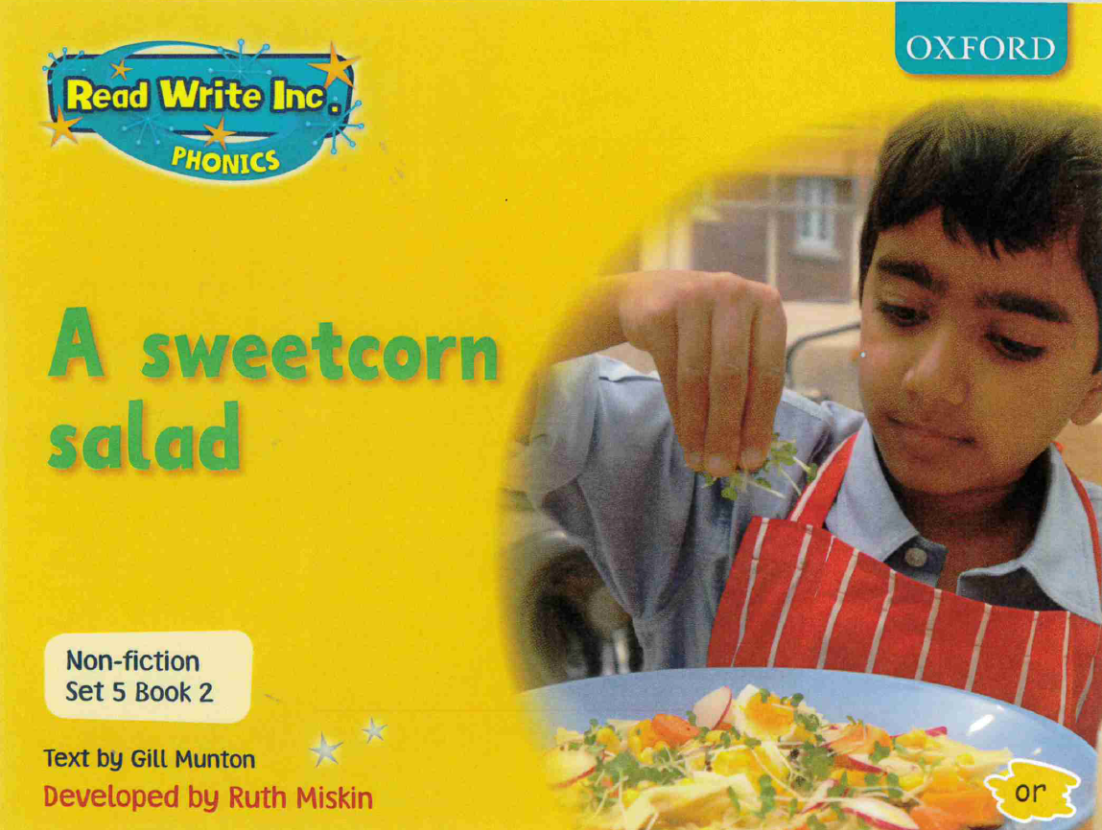

Slide 2
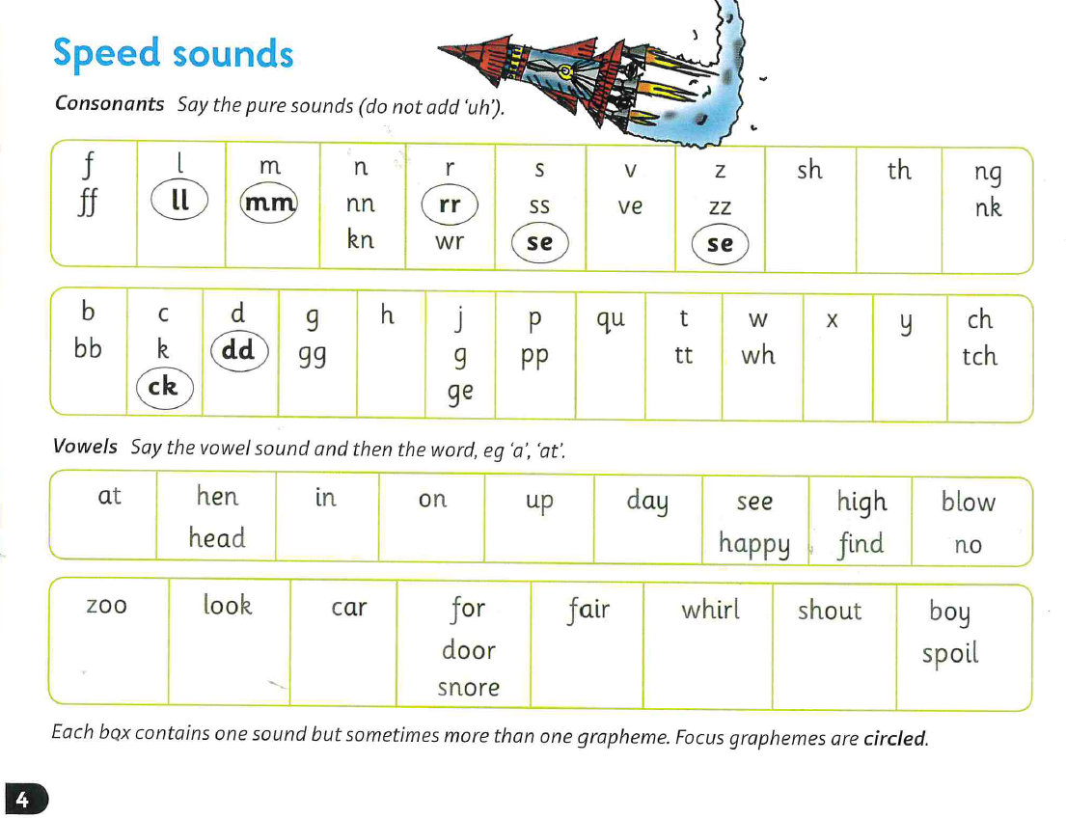

Slide 3
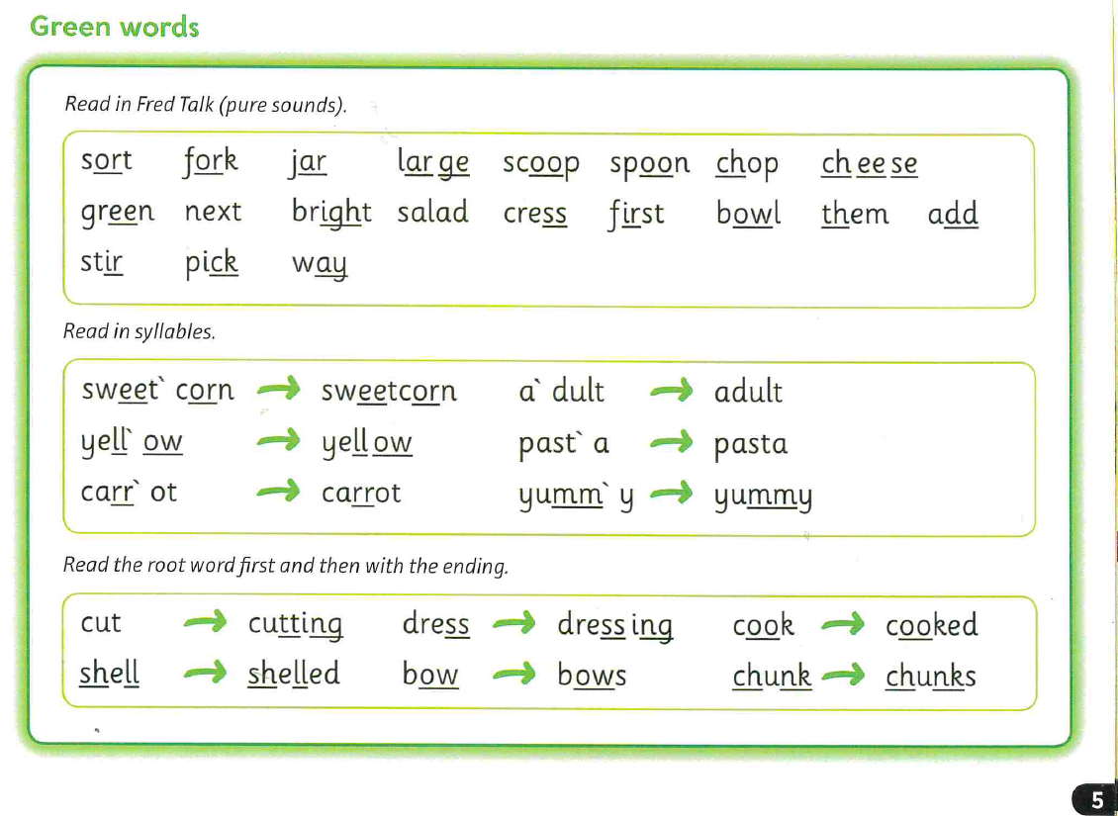

Slide 4
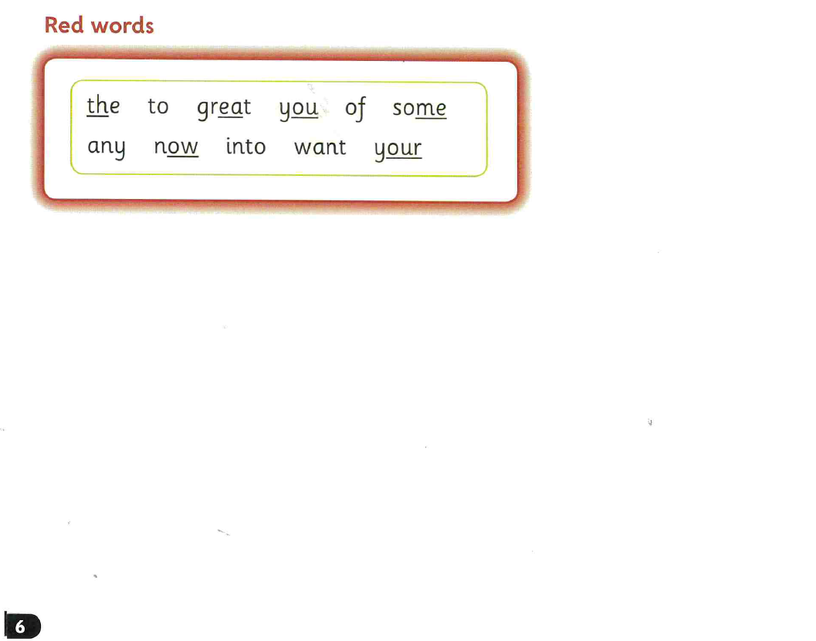

Slide 5
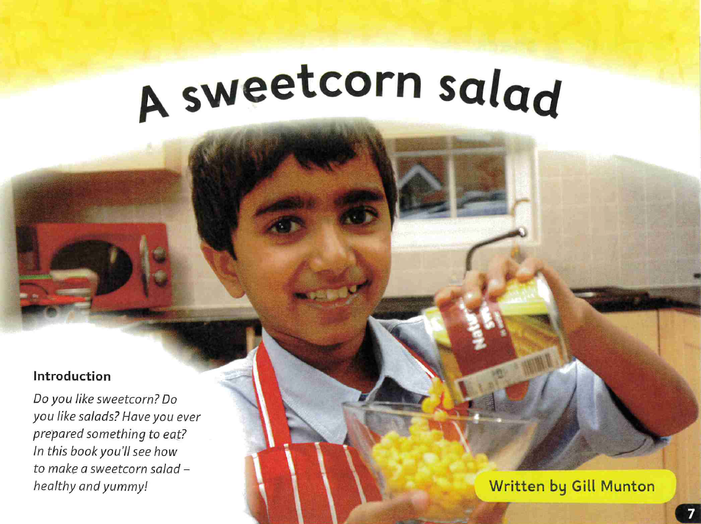

Slide 6
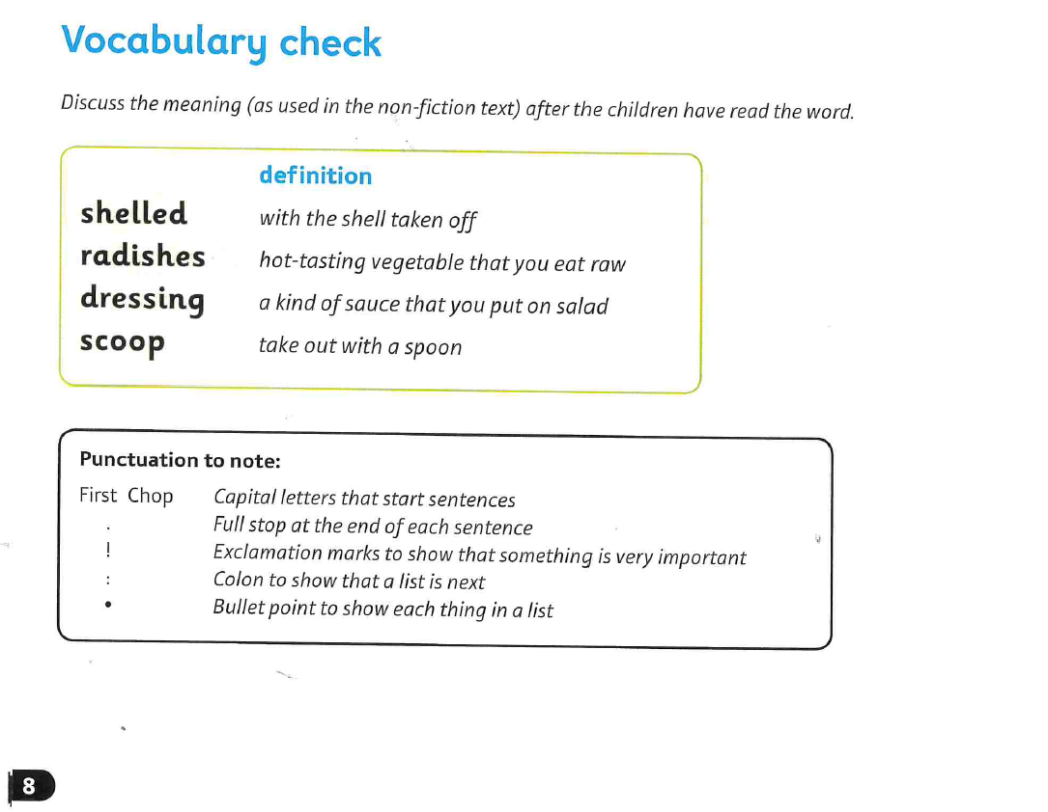

Slide 7
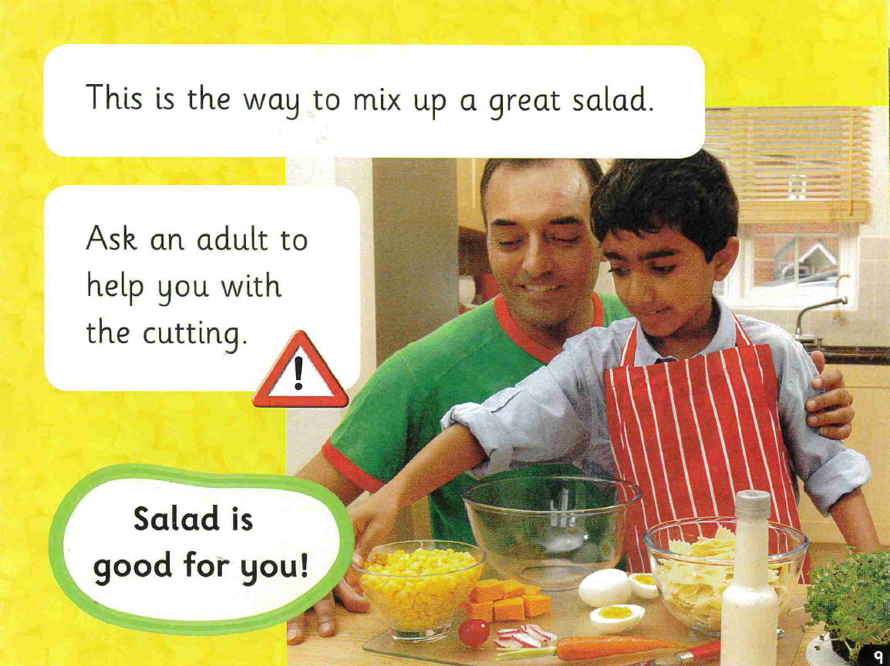

Slide 8
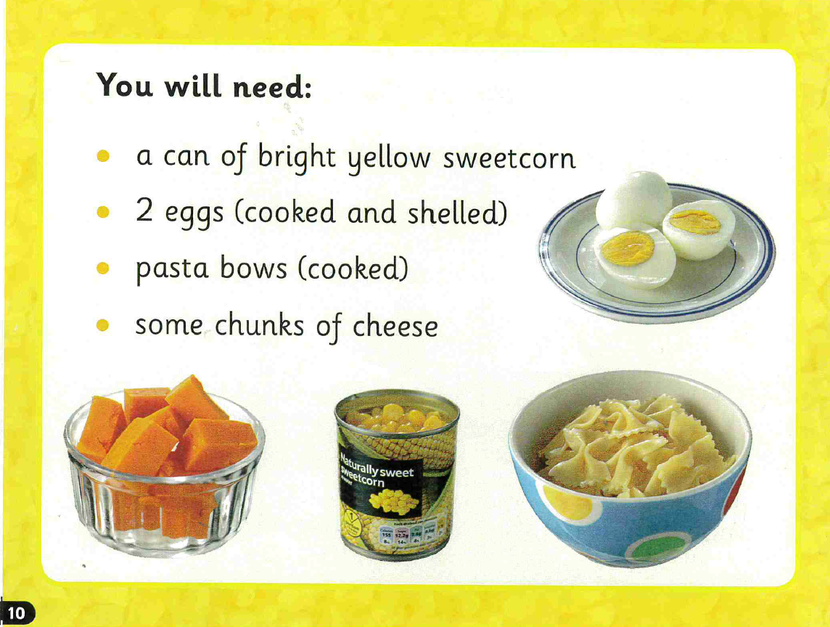

Slide 9
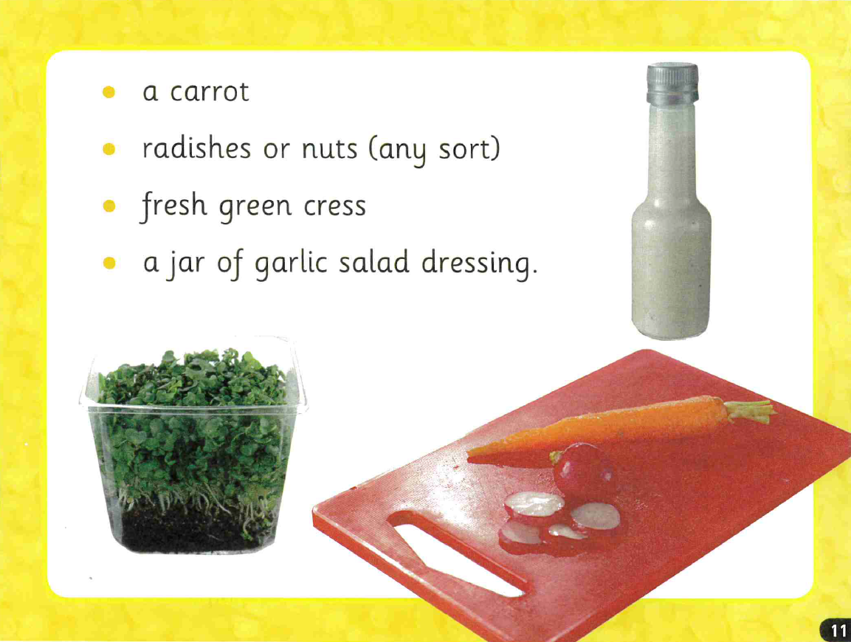

Slide 10
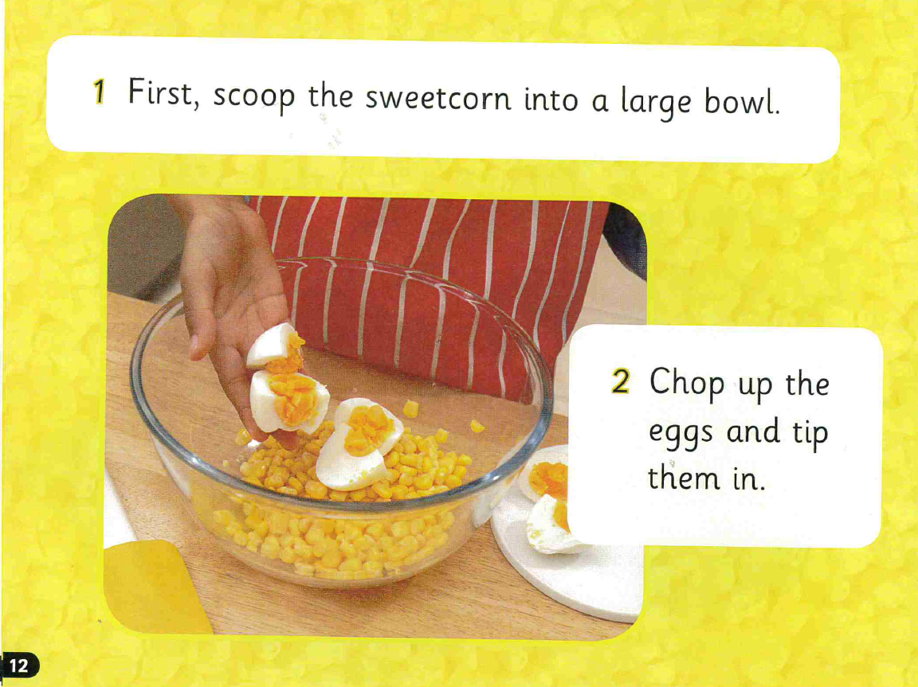

Slide 11
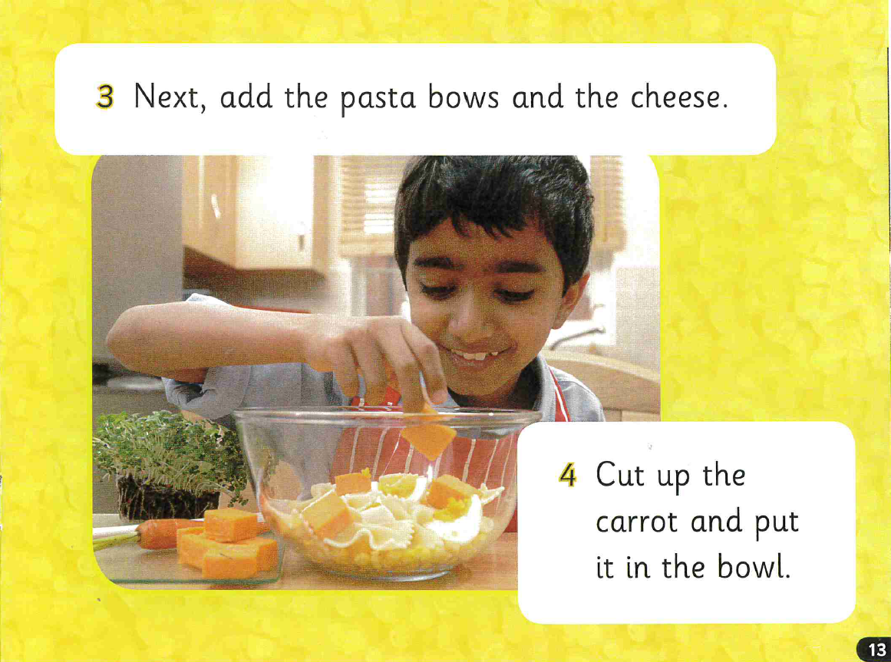

Slide 12
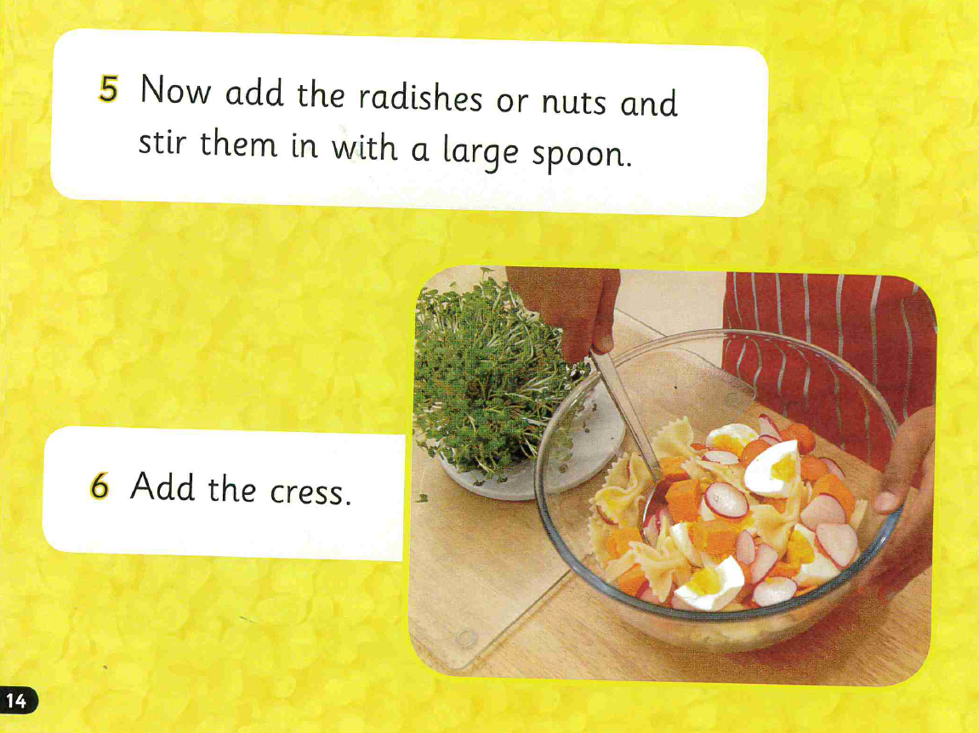

Slide 13
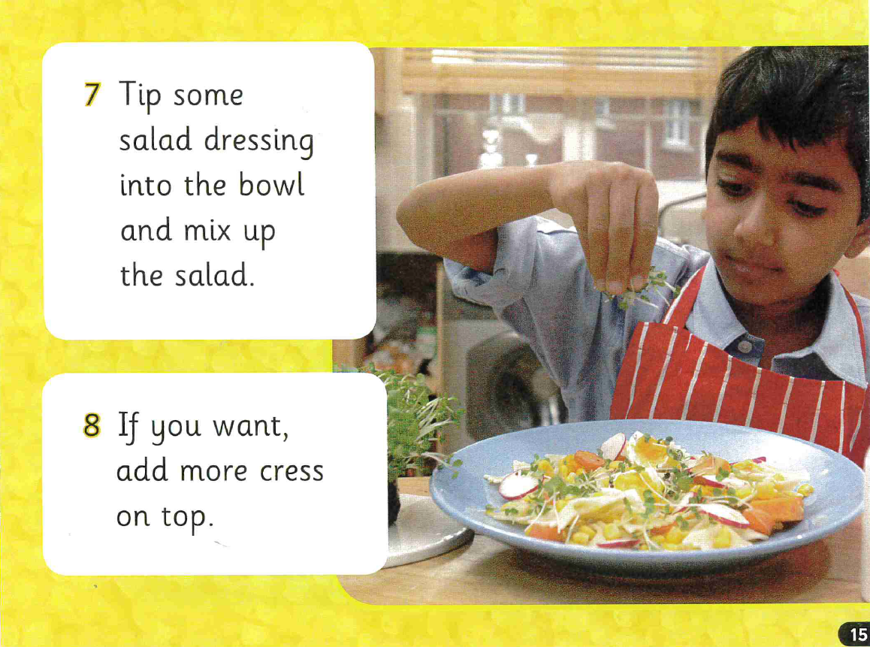

Slide 14
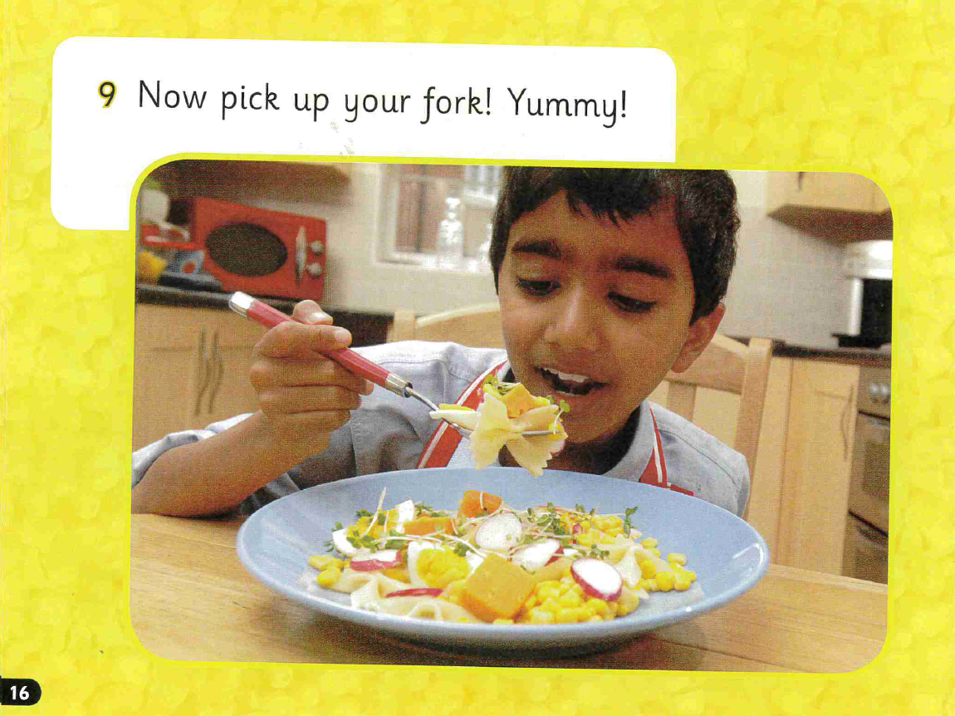

Slide 15
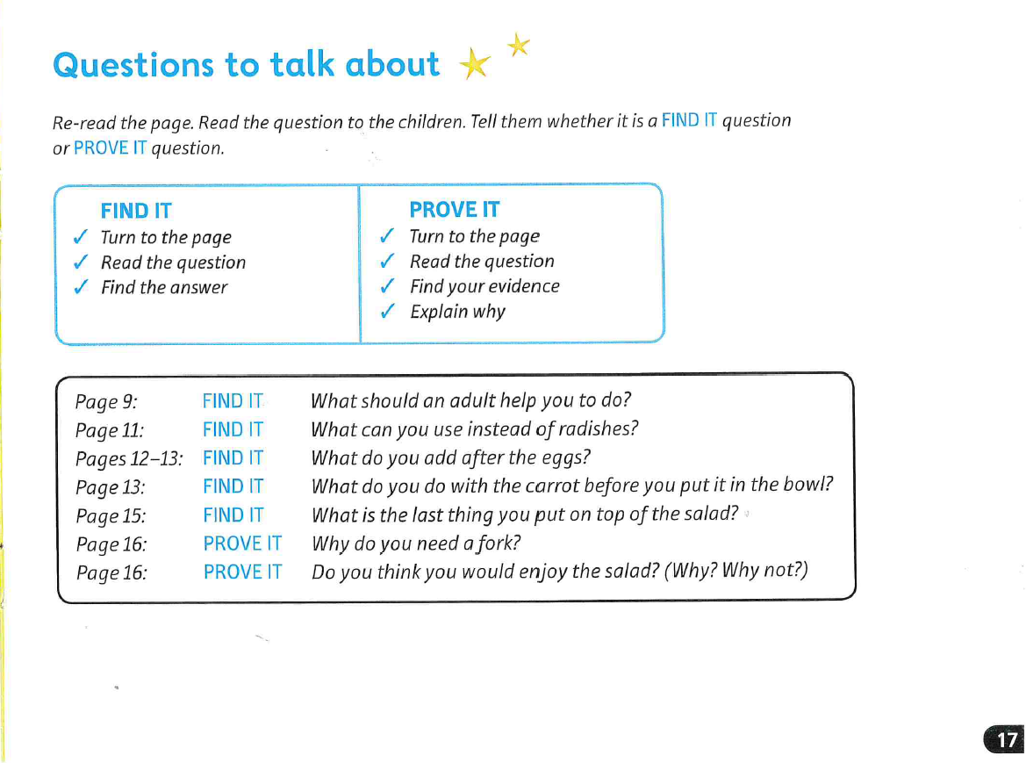

Slide 16
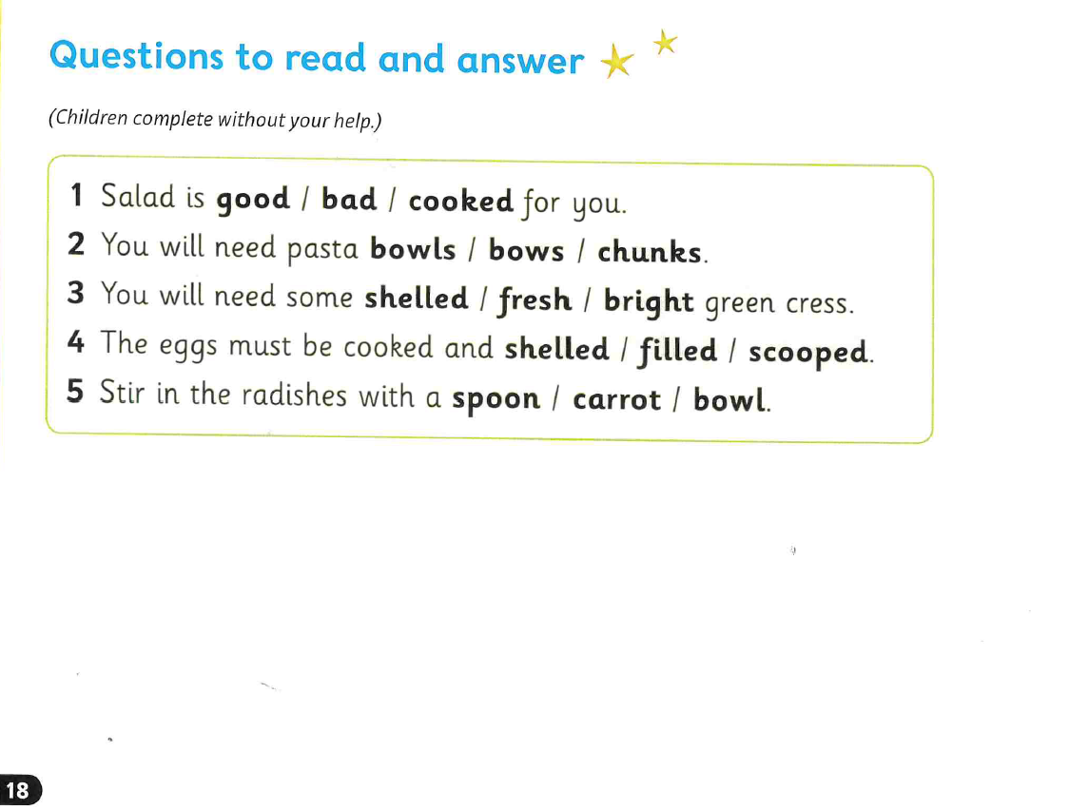

Slide 17
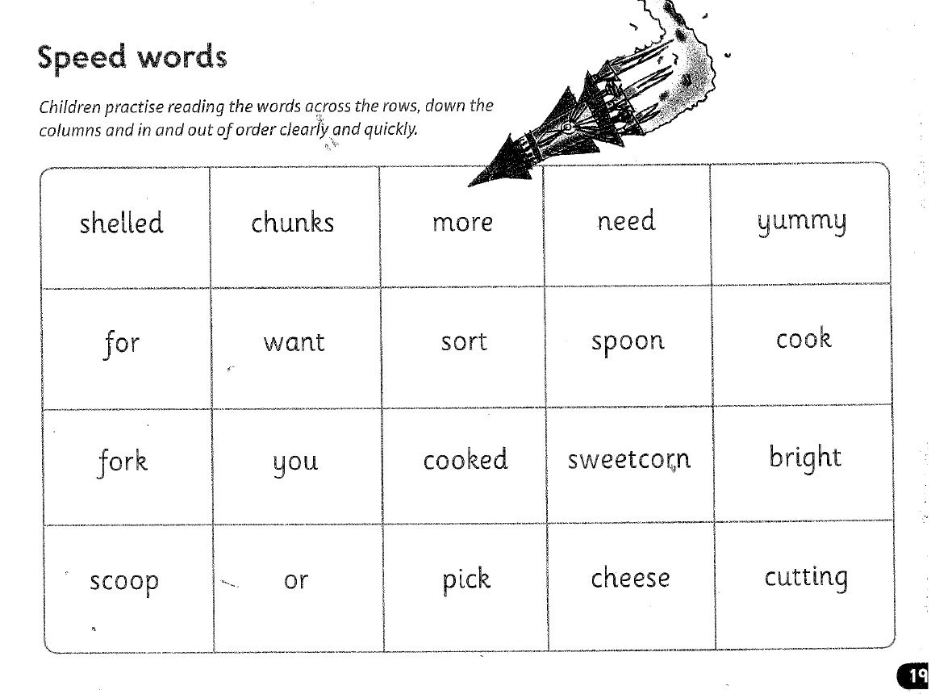

Slide 18



Edit a Sentence
2. Build a Sentence
The worksheet can be found on website or follow the PowerPoint and
write in a book or on handwriting paper.

Slide 19
Edit a sentence
Can you rewrite the below sentence for me please correcting all the mistakes. The correct sentence is on the following slide. No peaking until you have finished!
There are 2 capital letters missing
2 missing speech marks “”
2 full stops missing
tip some salad dressing into the bol and micks up the salad if you want, add more cress on top
Then mark it using the correct sentence on the next slide.

Slide 20
Tip some salad dressing into the bowl and mix up the salad. If you want, add more cress on top.

Slide 21

Build a sentence
Your word for today is - scooped
What does it mean? Can you find out?
Your job is to write a really creative sentence using this power word.
Can you include:
‘wow’ vocabulary
Add a conjunction to extend your sentence – and, or, but, so, if, because, when, that
Remember the 3 golden rules – capital letters, full stops and your sentence must make sense
Don’t forget to use your headphones to say your sentence out loud before writing it down.
E.g. Daisy scooped up the rounders ball and threw it into the backstop.

Slide 22


