Slide 1
Science: Types of Rocks
Watch the following short clips and then go through the PPT in the folder.
Types of rocks and how they are used. (no narration-35 seconds)
https://www.bbc.co.uk/bitesize/clips/zvrb4wx
Rocks in Daily Life
https://www.youtube.com/watch?v=60wmyyCaUgQ
Stonemason ( 30 seconds)
https://www.bbc.co.uk/bitesize/clips/z2cg9j6
Limestone and its uses ( 1min 24 sec)
https://www.bbc.co.uk/bitesize/clips/z3ynvcw

Slide 2
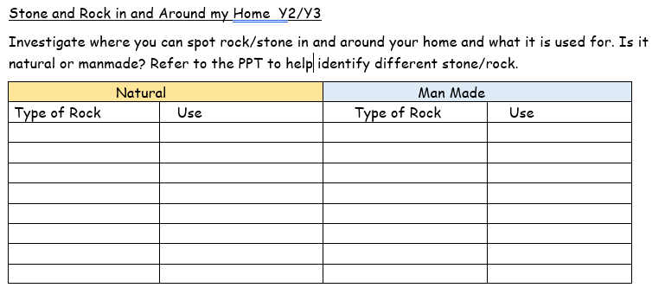
Use the worksheet to record different rocks/ stone you can find in your home or outside in your garden.

Slide 3

Follow the link for Today’s Worship
This can be found in the
‘Whole School’ folder.

