Slide 1
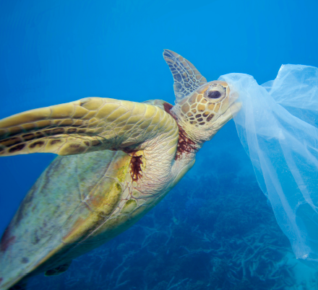
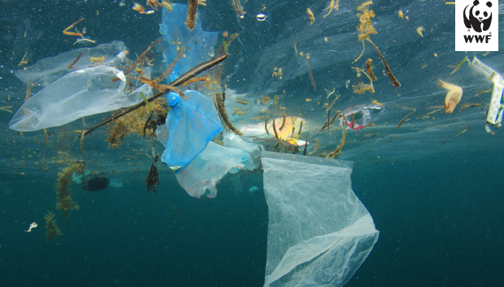
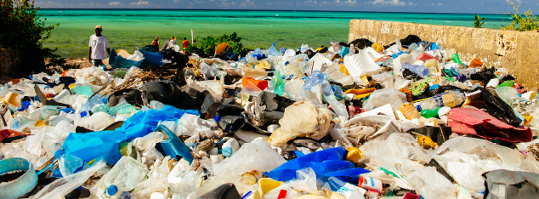
Plastic in Our Oceans

Slide 2
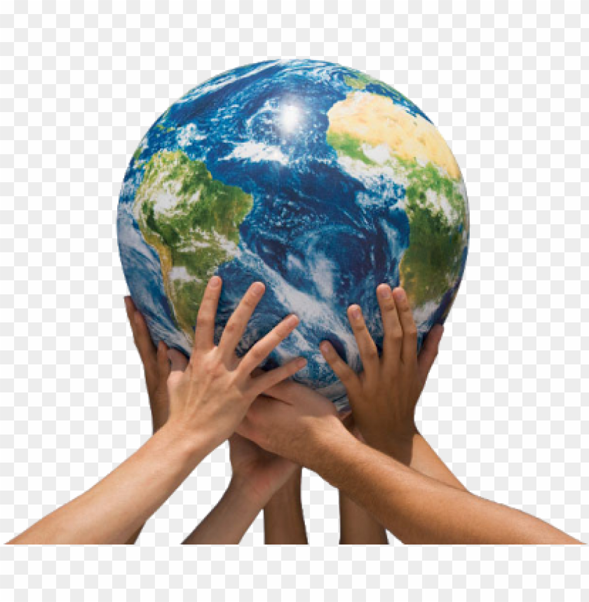
Climate Change
Plastic in Our Oceans
Have your worksheet ( in the folder) with you to pause and take notes on the information in the videos and PPTs
Watch the following Video clips
David Attenborough- plastic in our oceans (2min)
https://www.bbc.co.uk/programmes/p05q49hq
Newsround (3min)
https://www.bbc.co.uk/newsround/42810179
Plastic in Our Oceans
https://www.greenpeace.org.uk/news/why-is-there-so-much-plastic-in-the-ocean/
‘Twinkle Go’ Pin code: SQ1078
For more resources

Slide 3
Climate Change
Plastic in Our Oceans
Have your worksheet with you to pause and take notes on the information in the videos and PPTs
Use your Twinkle Go logins emailed previously and the ‘Twinkle Go’ Pin code: SQ1078 for the resources you will need:
PPTS
Interactive resources
e book story
Blue Planet PPT

Slide 4

Follow the link for Today’s Worship
Live on TEAMS with
Mr Debenham

