Slide 1


Slide 2
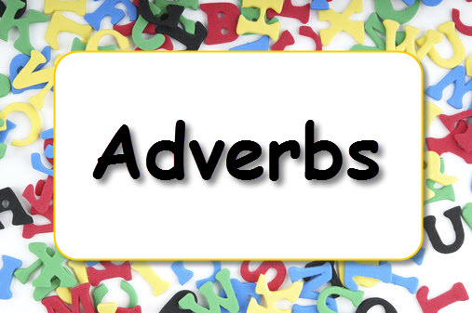
This week we are going to take a look at adverbs.

Slide 3
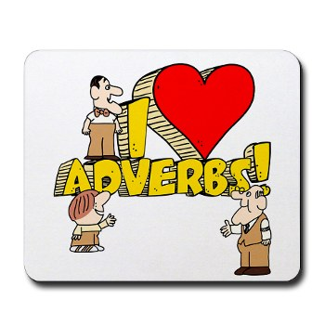
An adverb is simply a word that describes a verb (an action or a doing word).
It is important to use in our writing as it makes it more interesting.
For example
He ate his breakfast.
He quickly ate his breakfast.

Slide 4
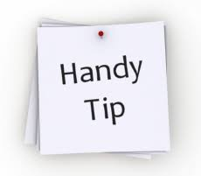
Adverbs often end in ‘ly’
Eli’s dog ran happily across the park.
Theo noisily played the drums.
Ebony safely climbed the ladder.
Connie spilt the milk accidentally.

Slide 5
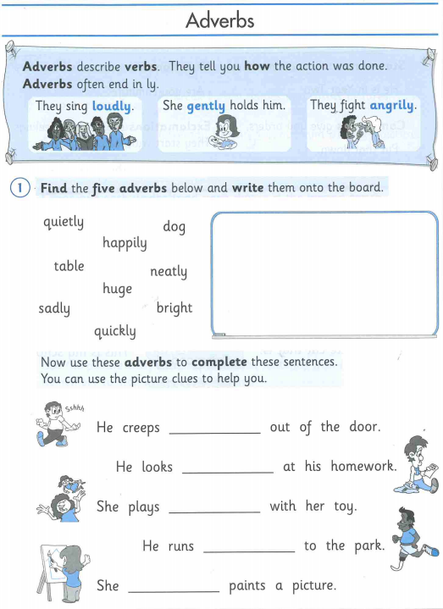
Can you complete the worksheets on adverbs.
After you have completed it, you will need to write 5 sentences with an adverb in and underline them.
If you are unable to print the worksheet, completing it on a separate book or paper will be great.

Slide 6


