Slide 1
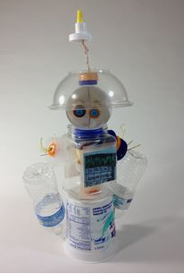
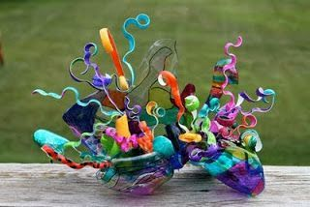
I would like you to create a sculpture using the plastic you have collected.
The main part of your sculpture needs to be plastic but you may
use a few other materials if necessary.
It can be abstract or a model of something.

Slide 2
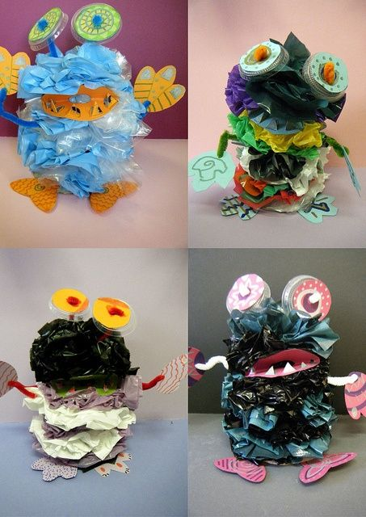
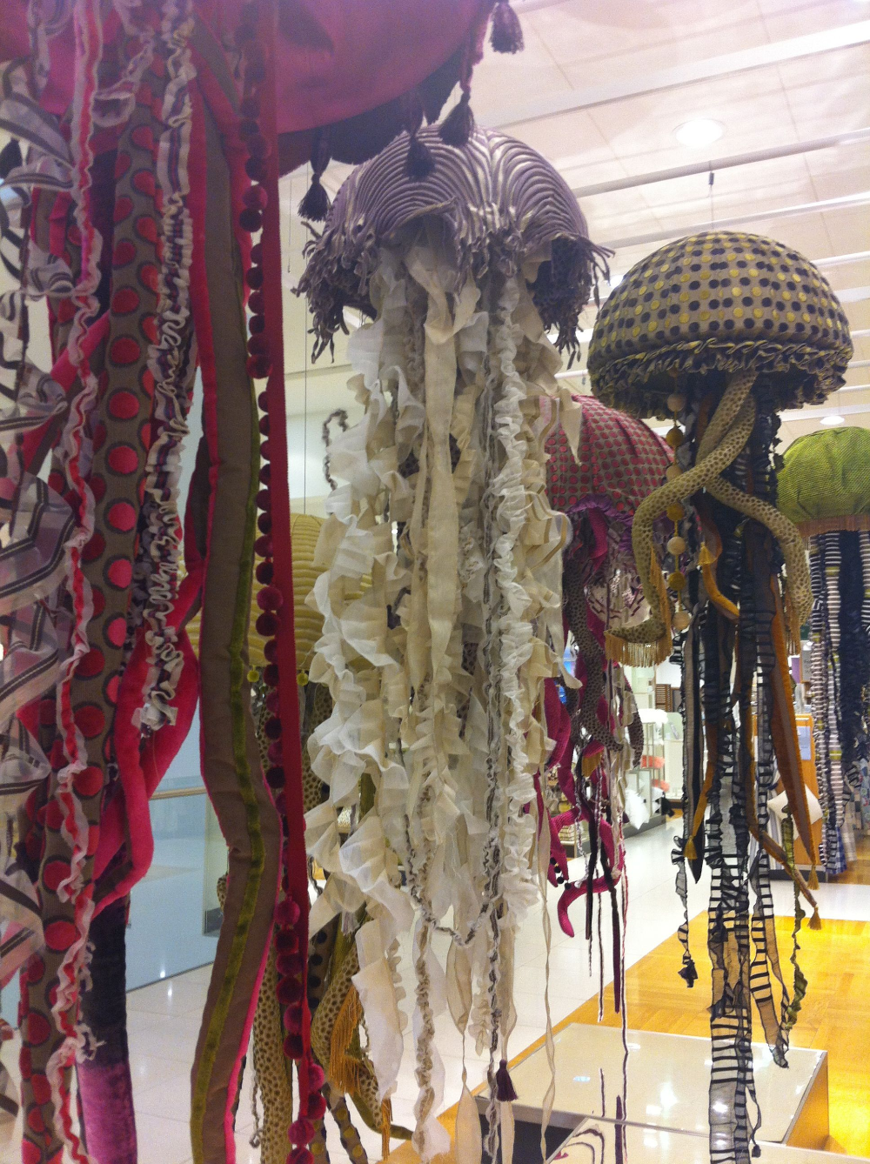
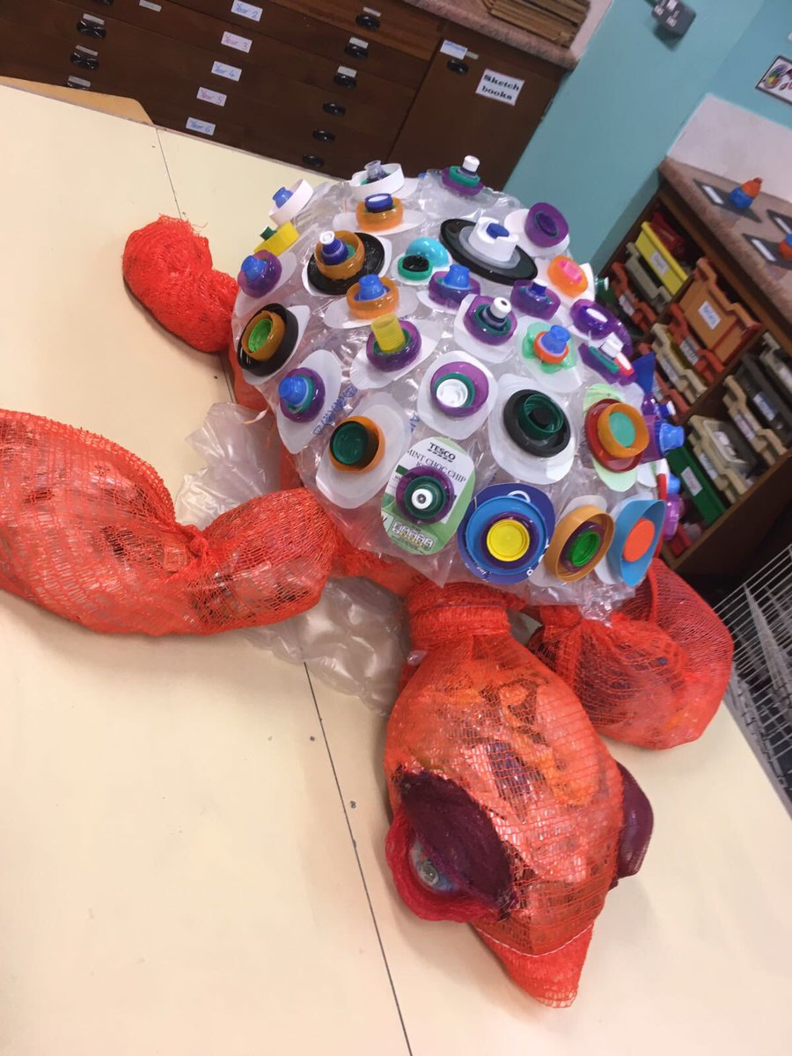
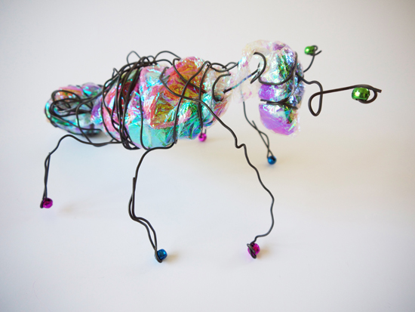
Some ideas to think about.
Be creative!

Slide 3


Music
Click on the link below and follow the lesson .
The lesson looks at clapping 4 beats in a bar.
https://classroom.thenational.academy/lessons/exploring-4-beats-in-a-bar-cgwk2t?activity=video&step=1

