Slide 1


Slide 2
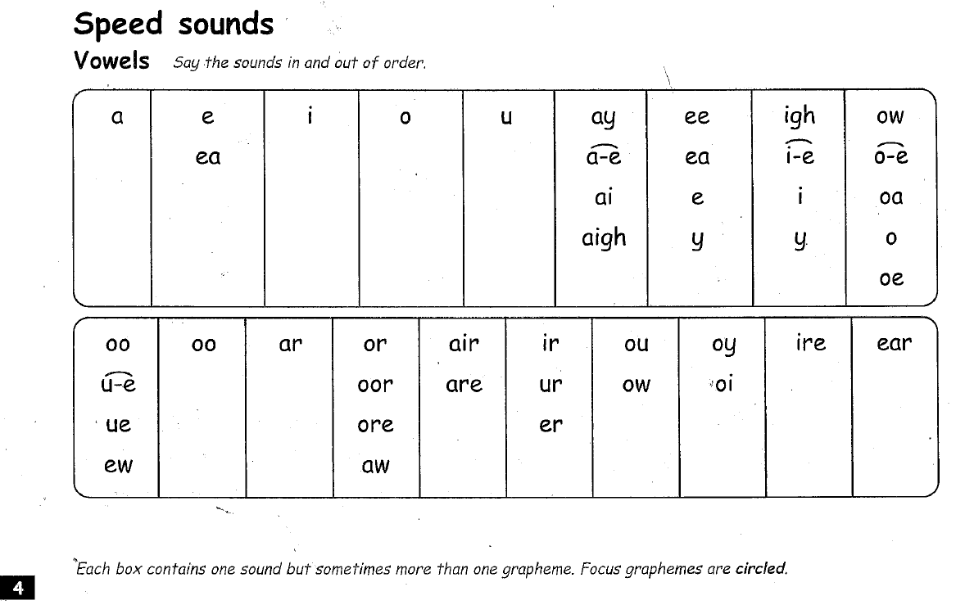

Slide 3
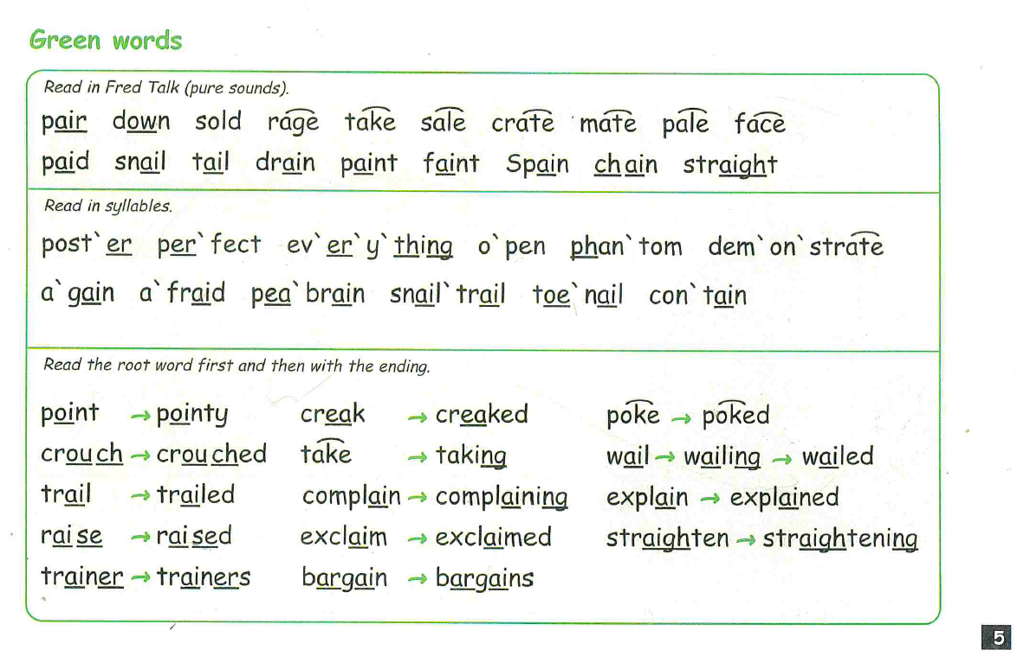

Slide 4
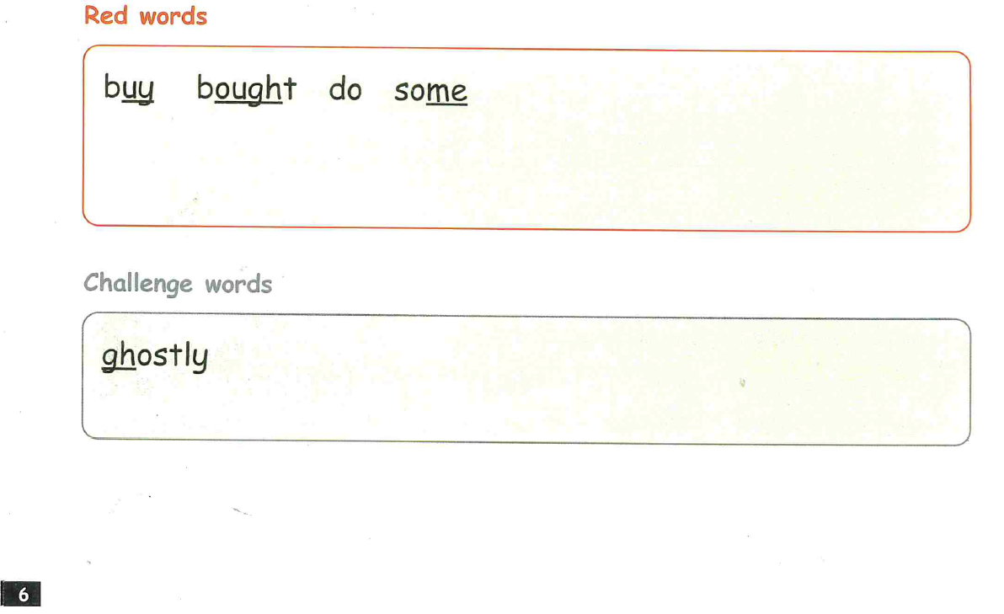

Slide 5
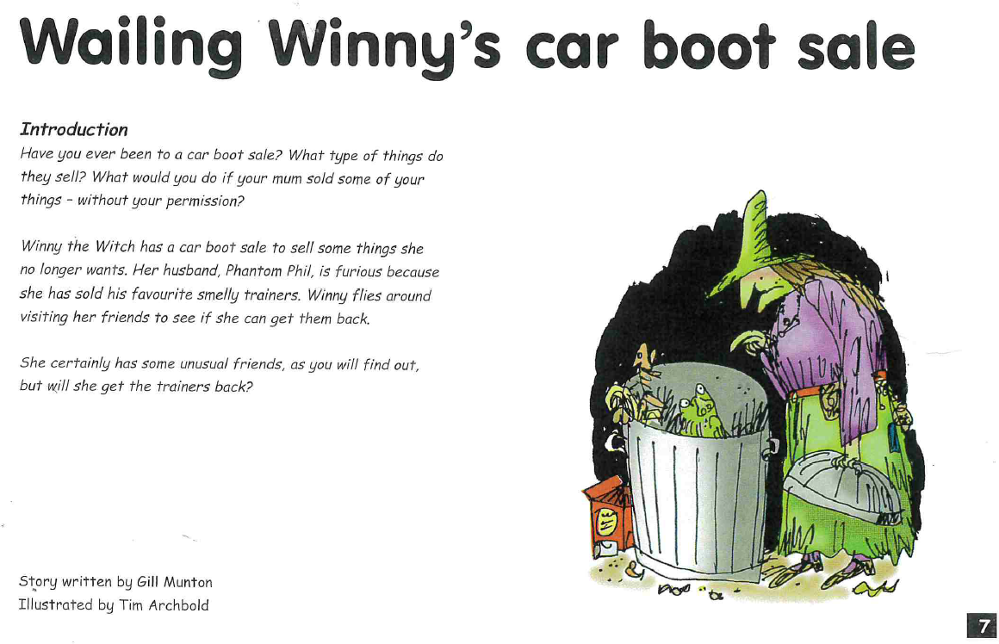

Slide 6
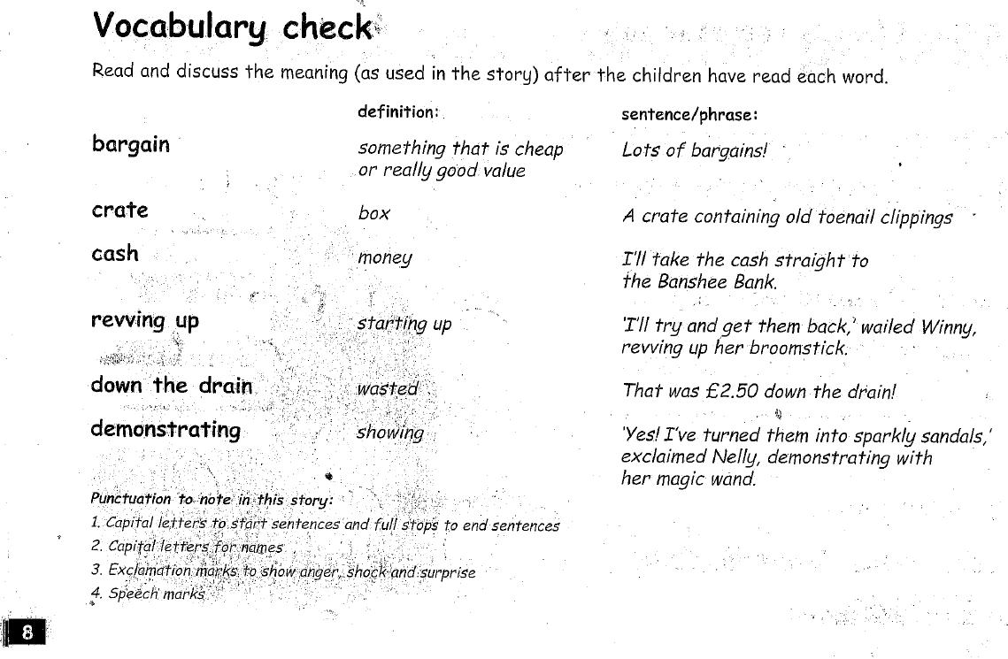

Slide 7
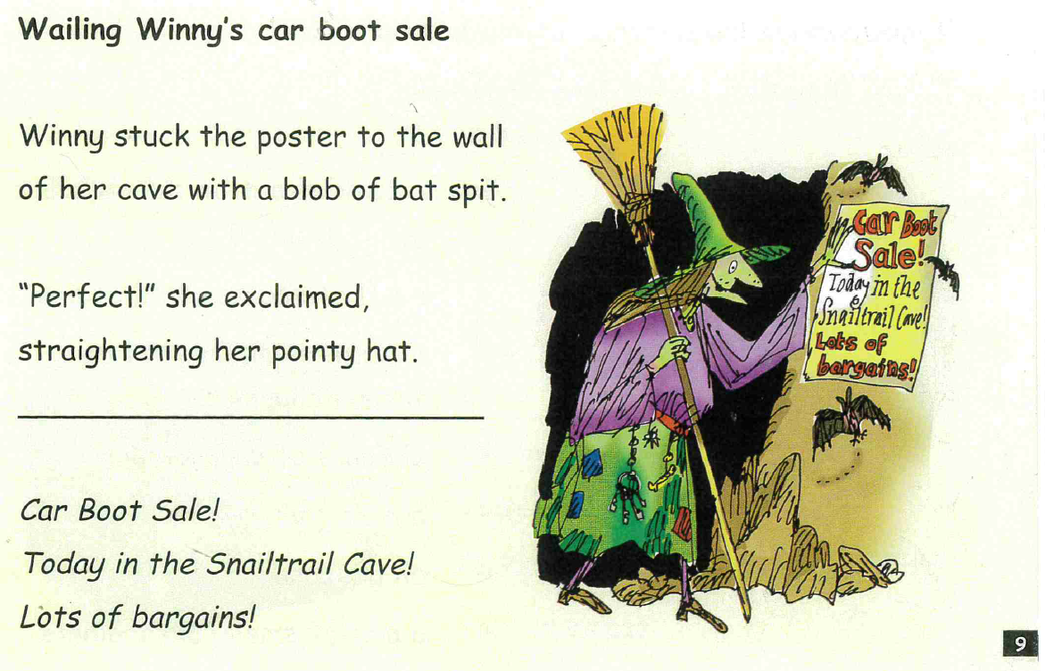

Slide 8
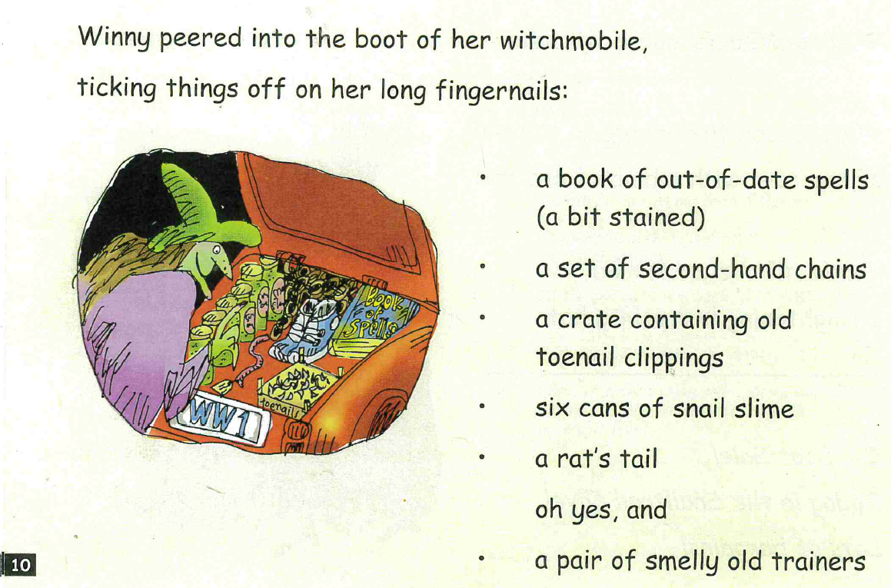

Slide 9
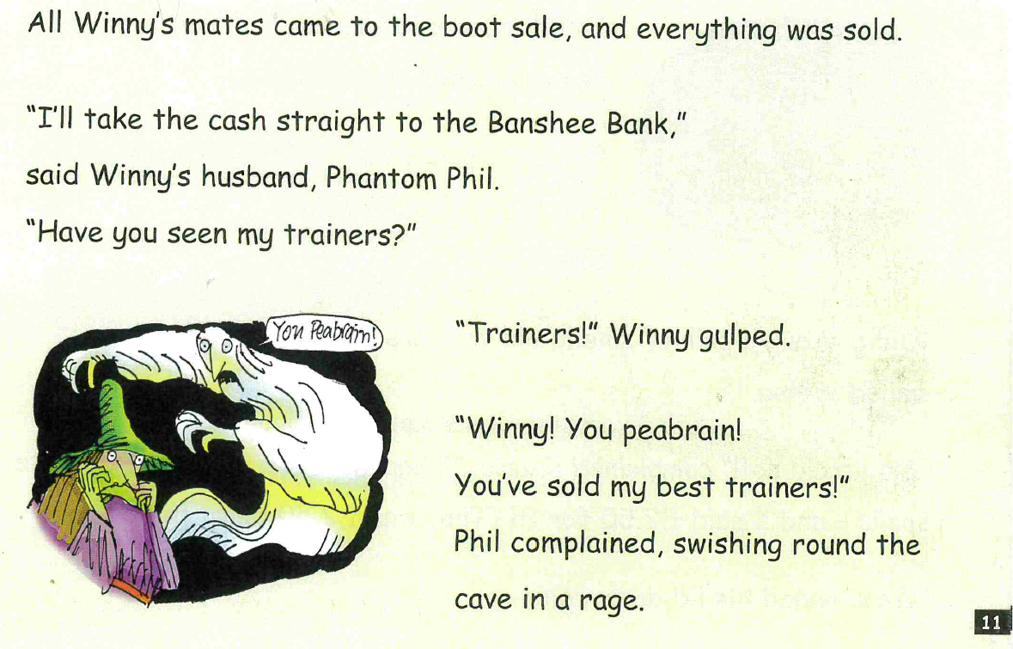

Slide 10
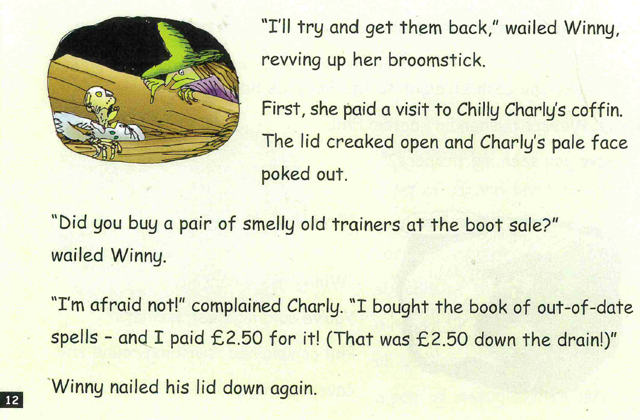

Slide 11
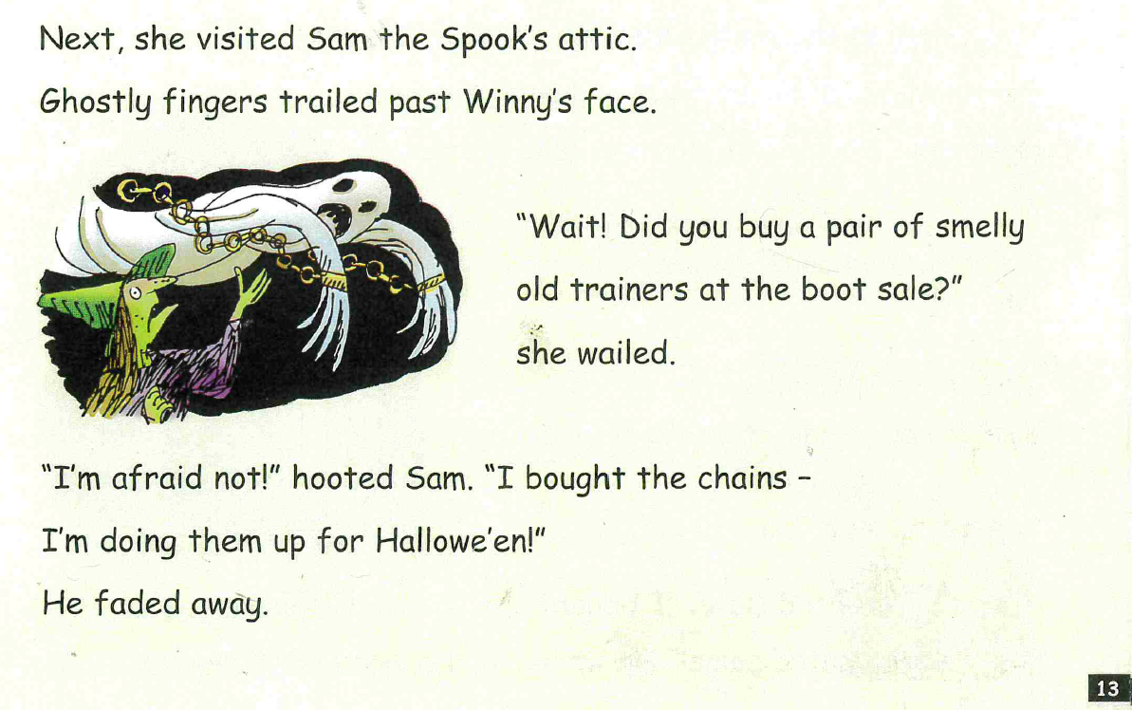

Slide 12
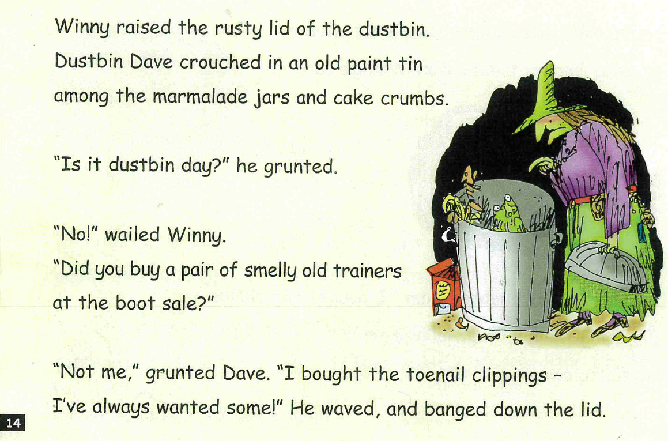

Slide 13
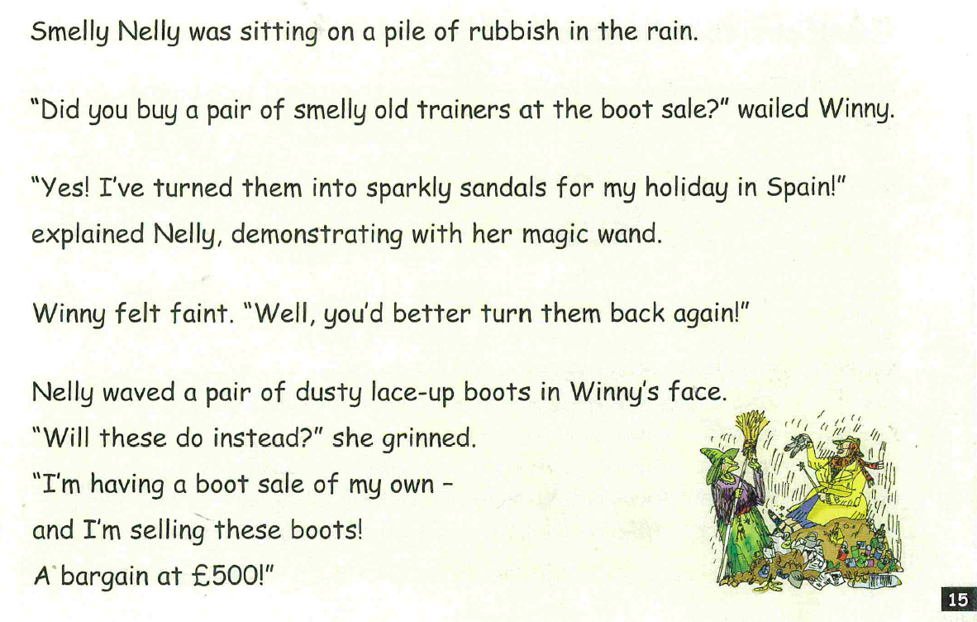

Slide 14
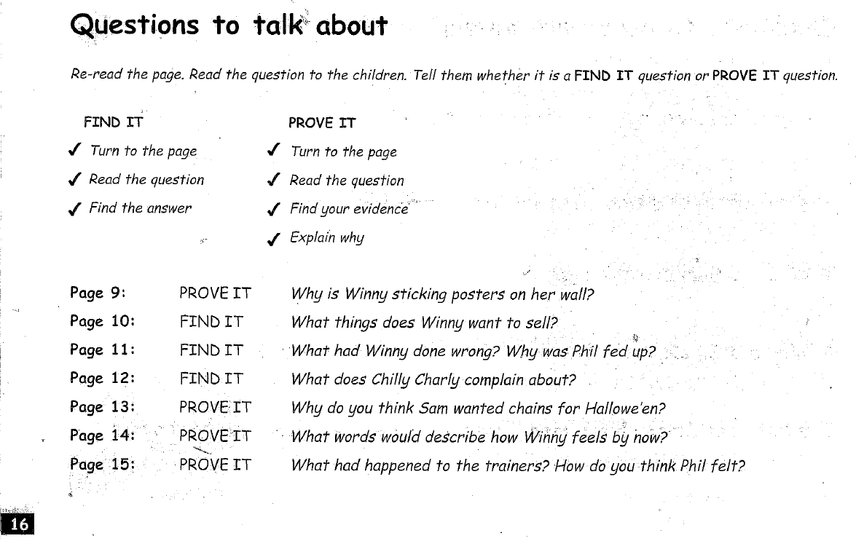

Slide 15
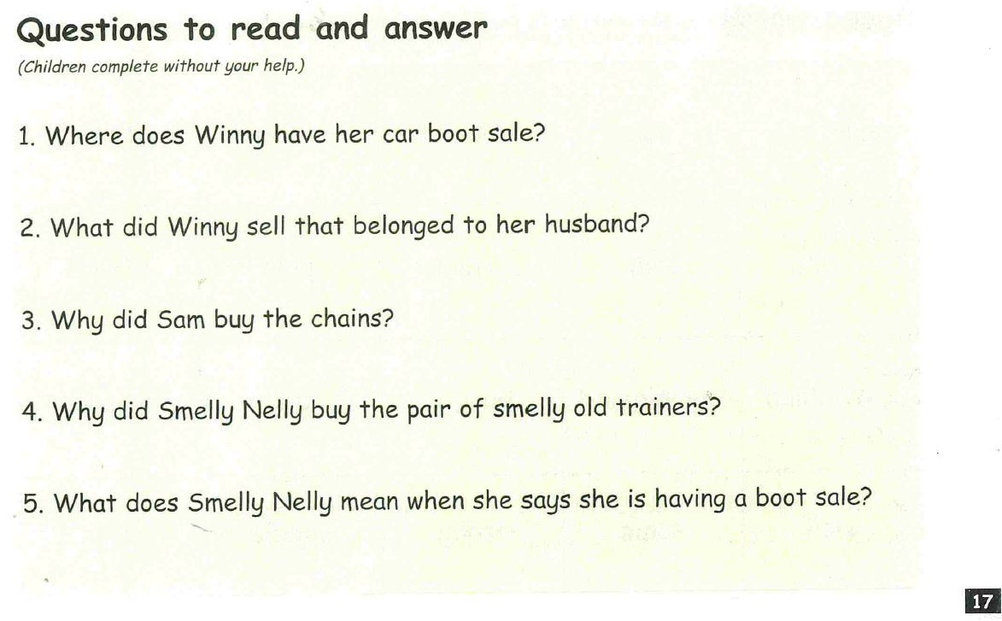

Slide 16
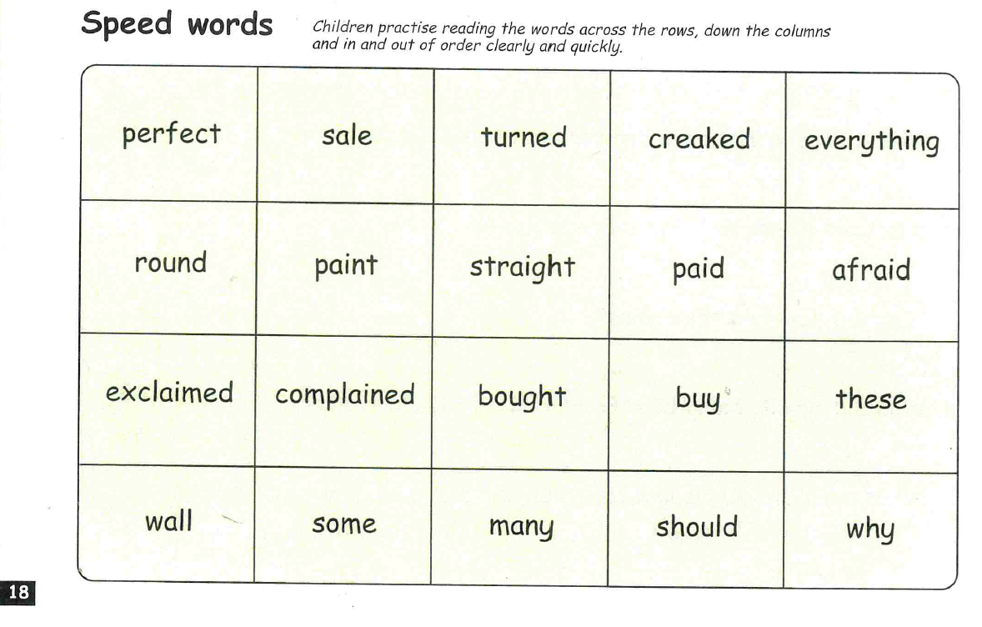

Slide 17



Edit a Sentence
2. Build a Sentence
The worksheet can be found on website or follow the PowerPoint and
write in a book or on handwriting paper.

Slide 18
Edit a sentence
Can you rewrite the below sentence for me please correcting all the mistakes. The correct sentence is on the following slide. No peaking until you have finished!
There are 2 capital letters missing
2 missing speech marks “”
2 full stops missing
I’m afraid not! hooted sam “i bought the chains for Hallowe’en ”
Then mark it using the correct sentence on the next slide.

Slide 19
“I’m afraid not!” hooted Sam. “I bought the chains for Hallowe’en.”

Slide 20

Build a sentence
Your word for today is - disgusting
What does it mean? Can you find out?
Your job is to write a really creative sentence using this power word.
Can you include:
‘wow’ vocabulary
Add a conjunction to extend your sentence – and, or, but, so, if, because, when, that
Remember the 3 golden rules – capital letters, full stops and your sentence must make sense
Don’t forget to use your headphones to say your sentence out loud before writing it down.
E.g. What a disgusting idea, I will not go swimming in the foul murky pond.

Slide 21


