Slide 1

What is Ramadan and why do Muslims fast?
Below are two video clips to watch as well as PPTs and activities in the ‘Tinkle Go’ folder you could choose from.
What is Ramadan
https://www.bbc.co.uk/programmes/p02mwdxf
Why Muslims Fast:
https://www.bbc.co.uk/bitesize/clips/z434wmn
If you login in to Twinkle Go, you will find: information PPT
wordsearch
interactive comprehension
audio book
Twinkle Go-PIN:
Y14726

Slide 2
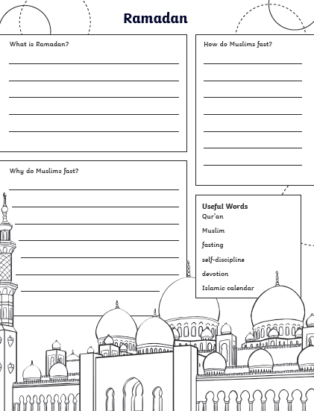


After you have watched the video clips and accessed the resources, complete the following activities:
Follow the instructions to make a Ramadan Lantern or a Ramadan Moon and Star symbol
Complete the worksheet in the folder

Slide 3

Follow the link for Today’s Worship
In the Whole School Folder

