Slide 1
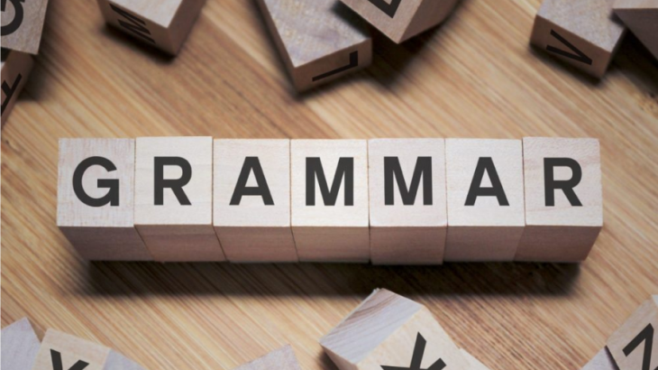

Slide 2

This week we are going to take a look at adjectives.

Slide 3
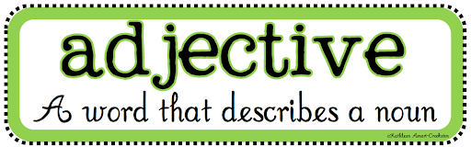
An adjective describes a noun.
It gives us more information about a noun and makes our writing more interesting.
For example
They live in a beautiful house.
The dress you wore was very pretty.
The shiny boat bobbed up and down on the sparkling water.

Slide 4
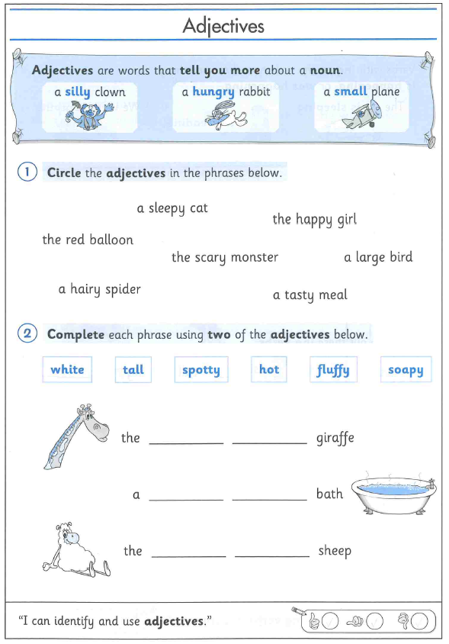
Can you complete the worksheets on adjectives.
After you have completed it you will need to write 5 sentences with an adjective in and underline the adjective.
If you are unable to print the worksheet, completing it on a separate book or paper will be great.

