Slide 1


Slide 2
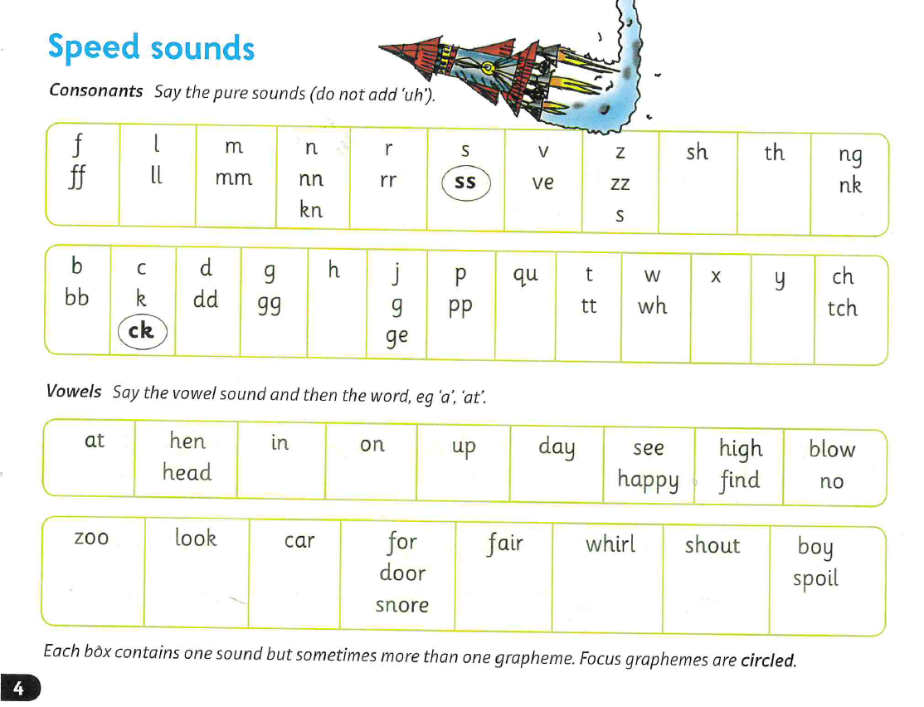

Slide 3
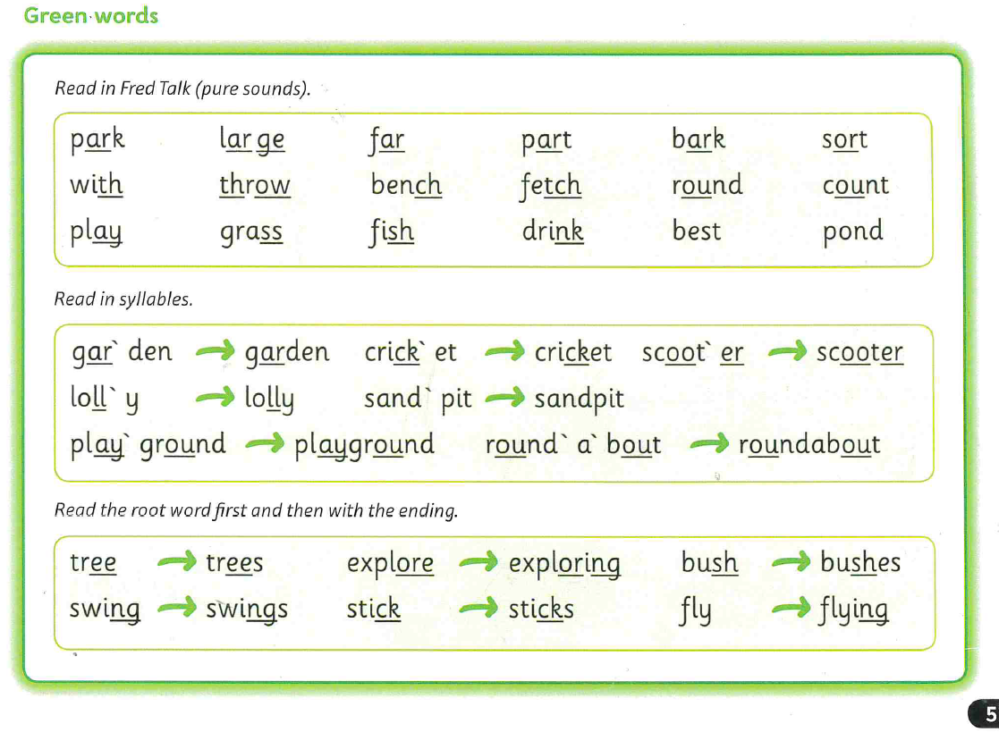

Slide 4
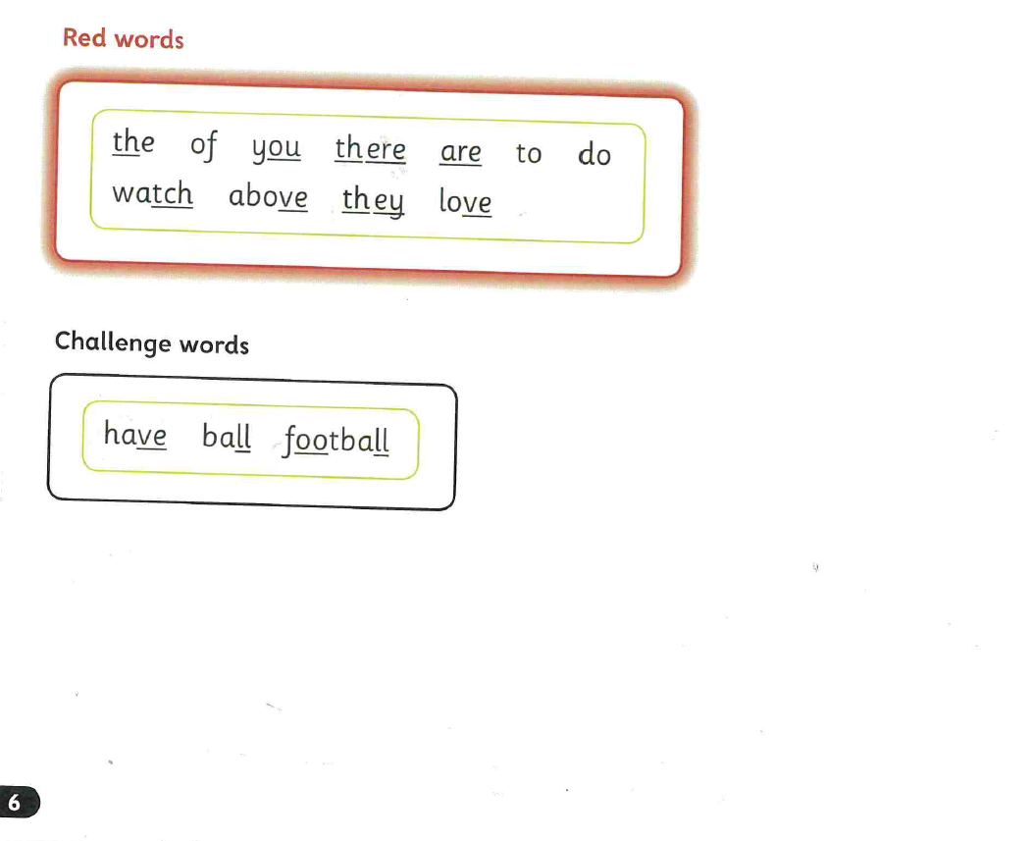

Slide 5


Slide 6
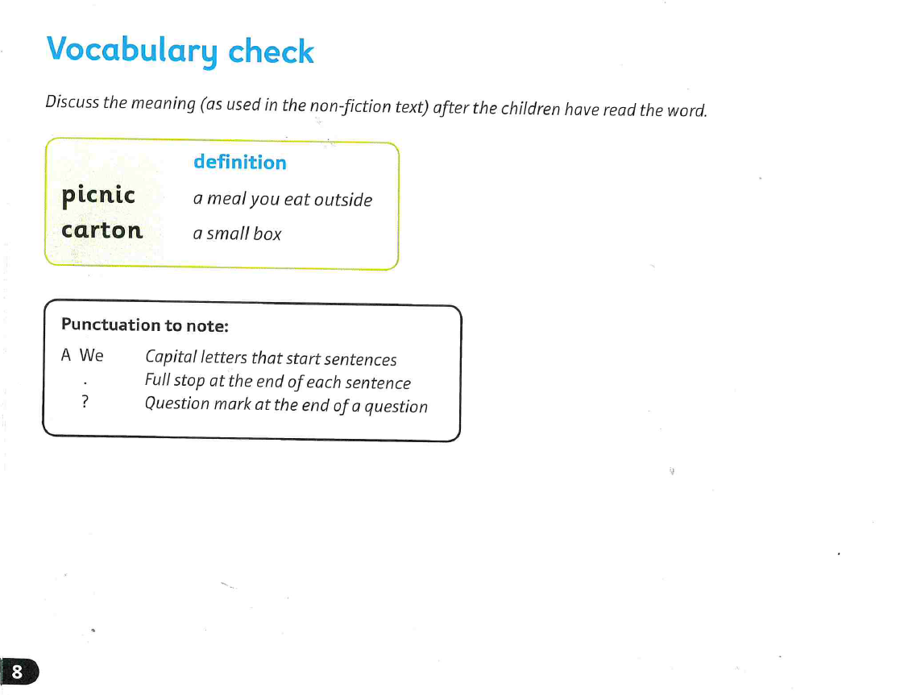

Slide 7
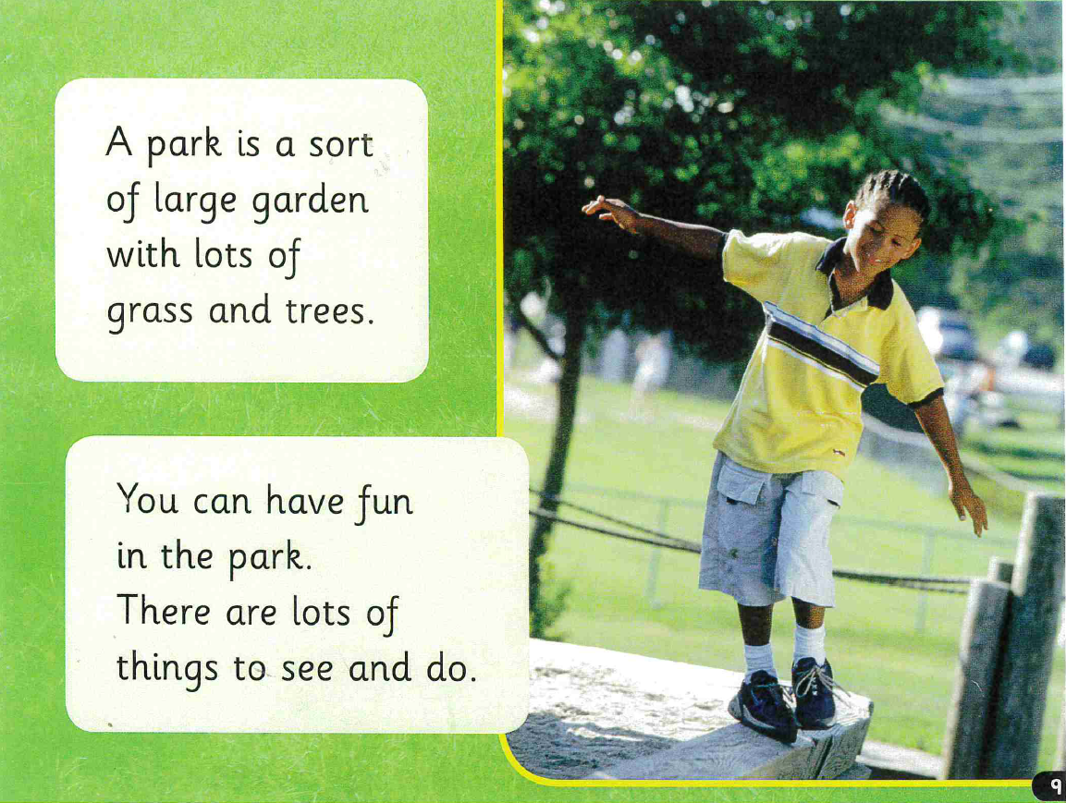

Slide 8
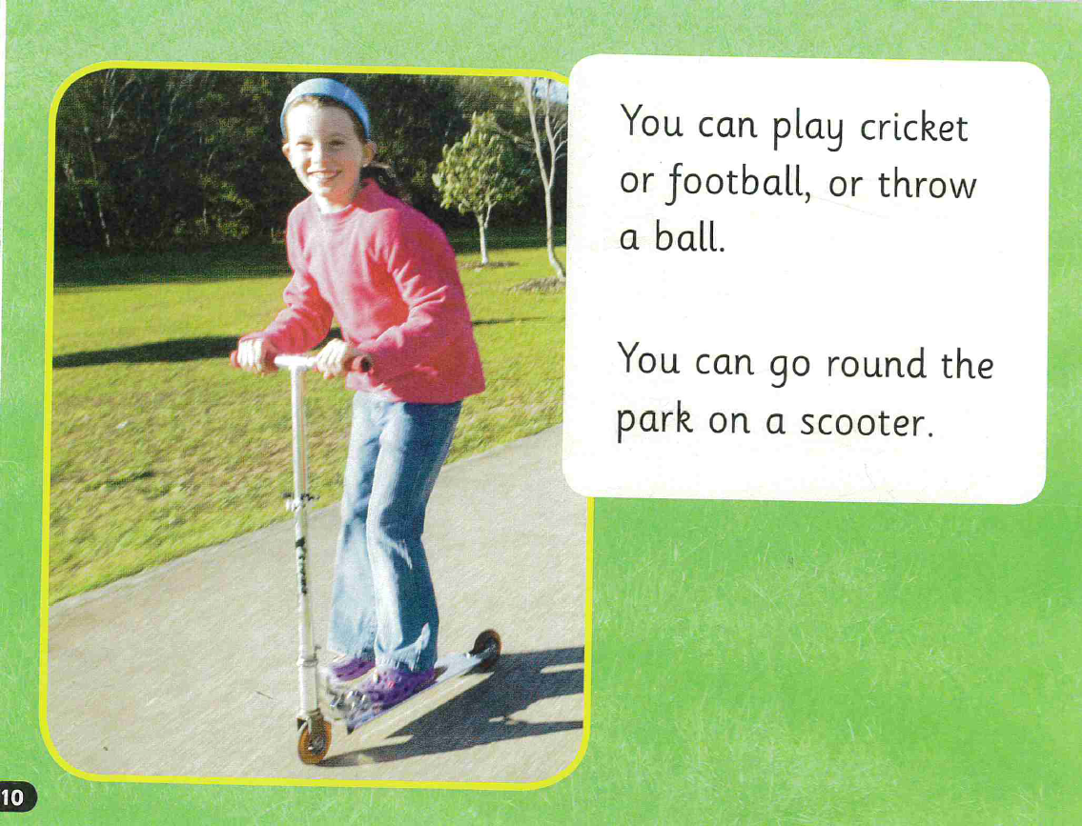

Slide 9


Slide 10
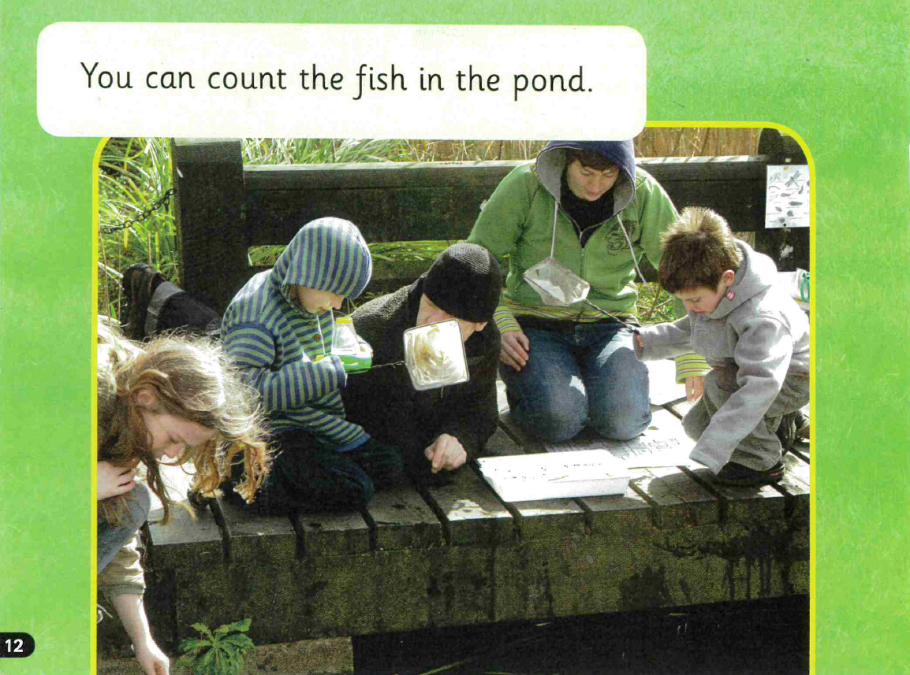

Slide 11


Slide 12
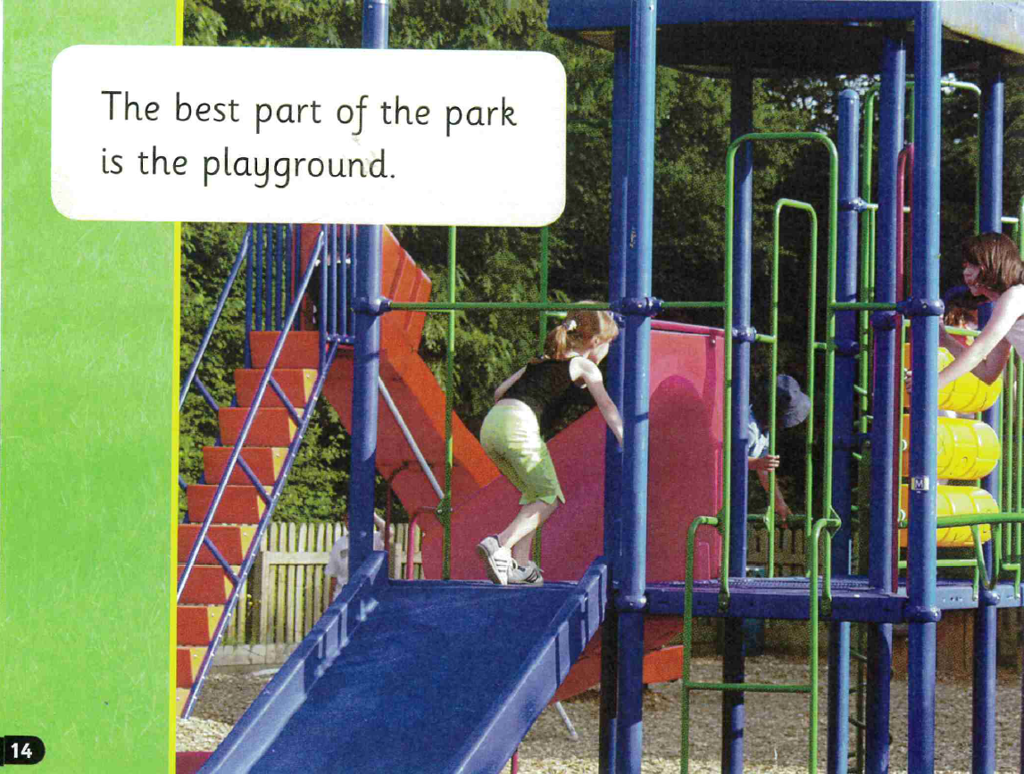

Slide 13
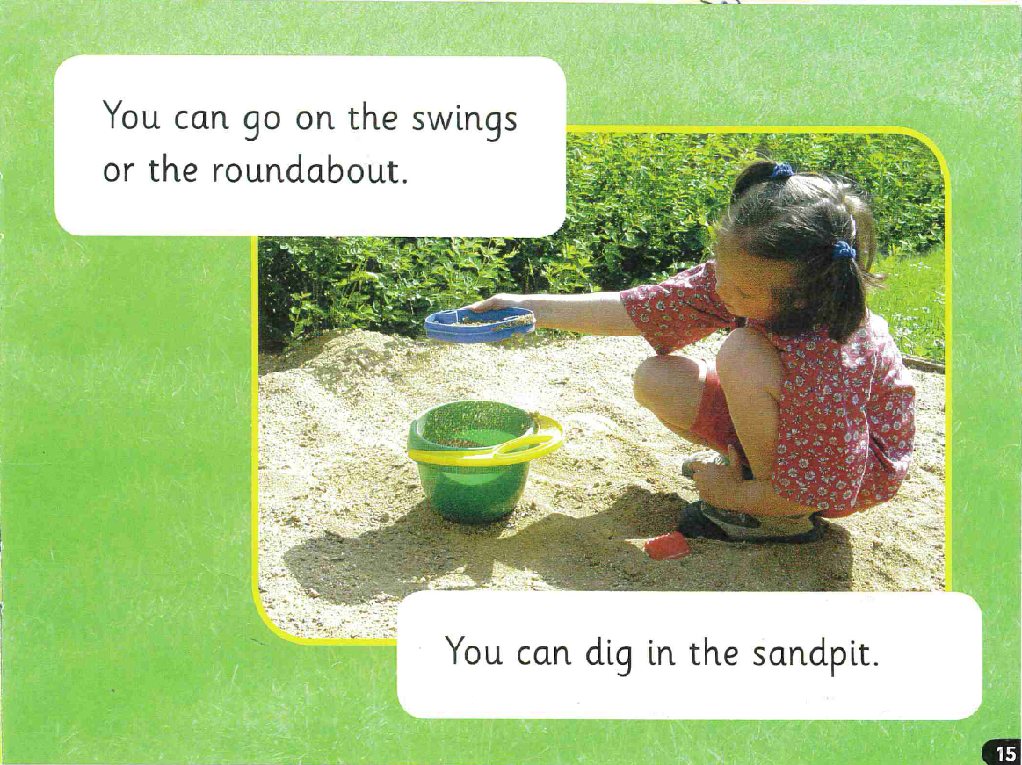

Slide 14


Slide 15
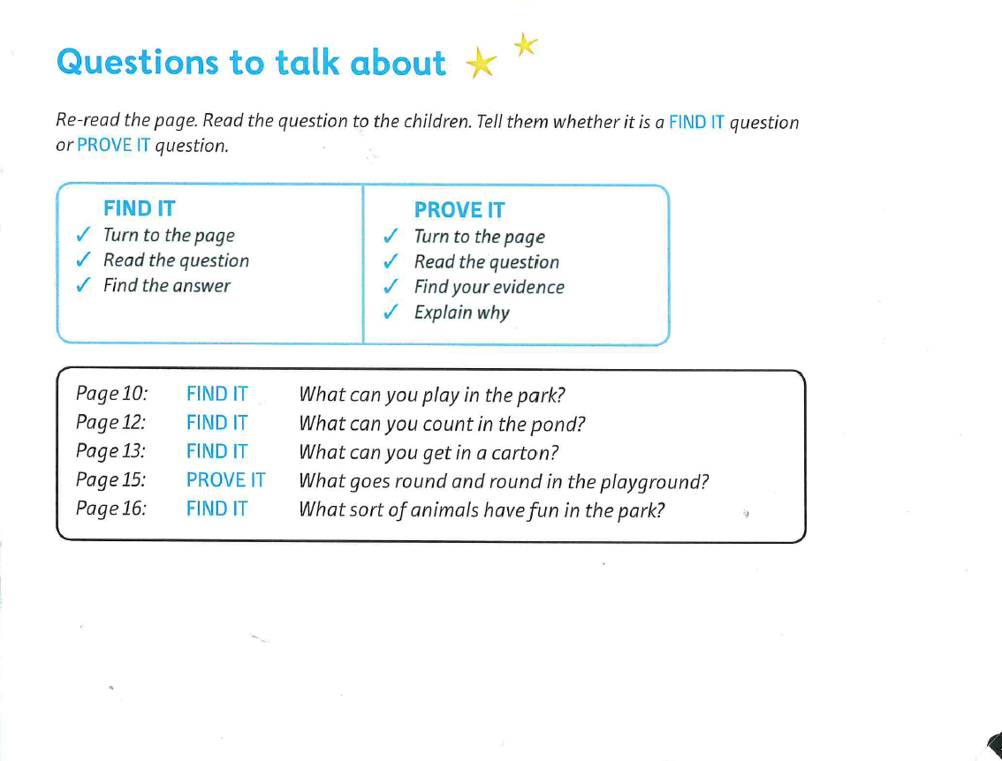

Slide 16
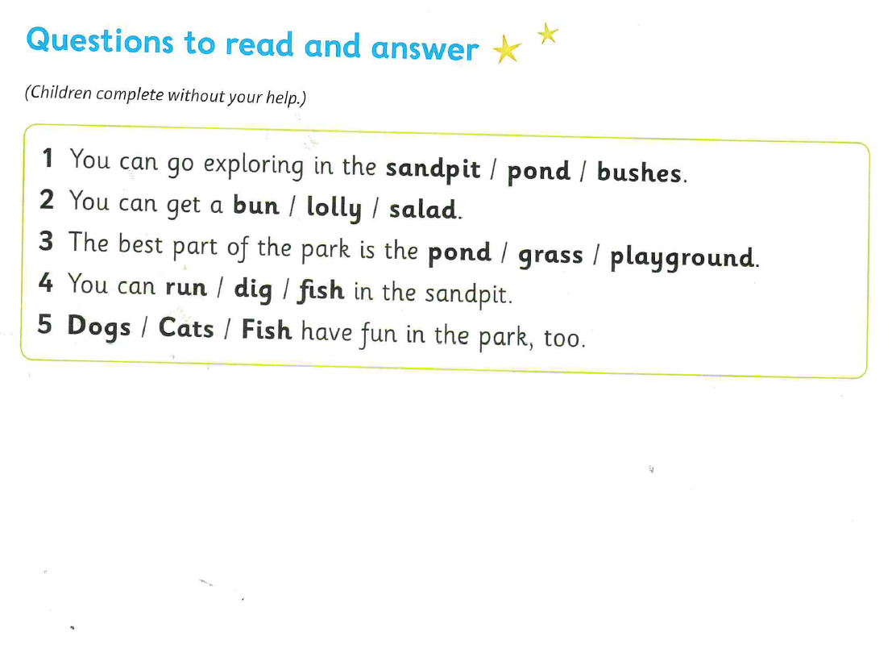

Slide 17
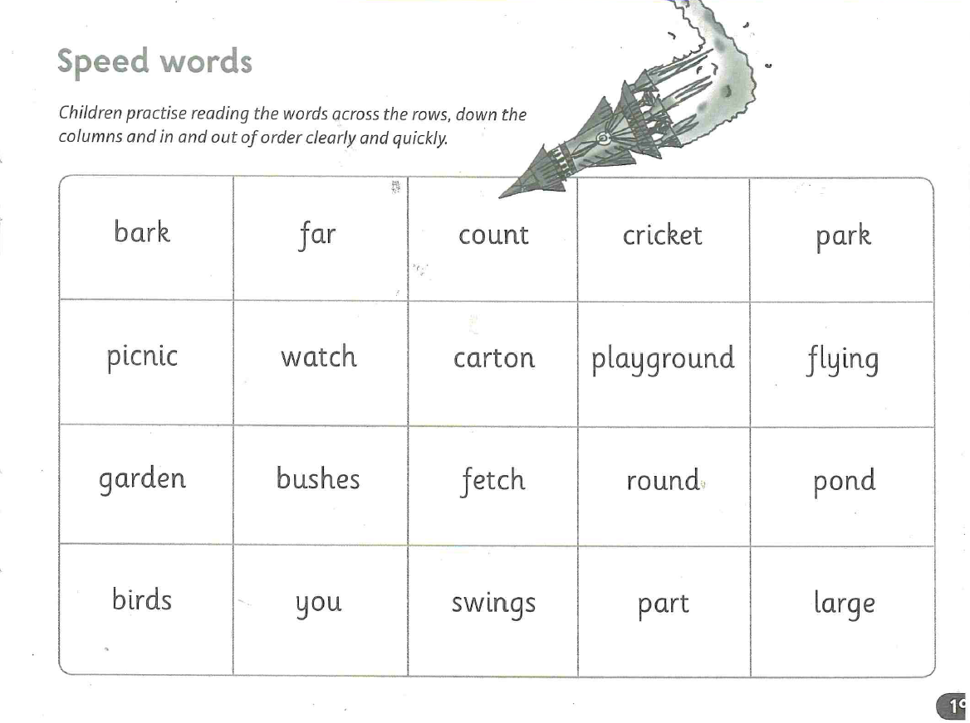

Slide 18

You have been given the opportunity to design your very own park. What 5 things / pieces of equipment would you choose to put in your park?
An example and a guide to the big write can be found on the website.

Slide 19


