Slide 1
Layers of the Earth
Watch the following Video Clips:
https://www.youtube.com/watch?v=2Kku4Ifcl7w
https://www.youtube.com/watch?v=bXdFBAk6MBM
Twinkle Go: Use your login details and the pincode: CK2387
to view the PPTs

Slide 2
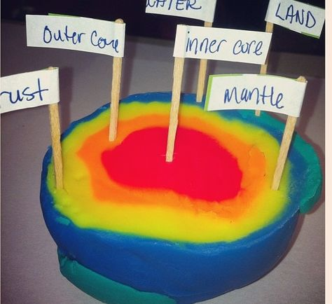
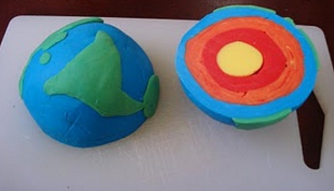
Activities
There are 2 activities in the folder. Choose one or both to complete.
Use different colours of plasticine or playdough to demonstrate the layers of the earth. See the link below .
*There is a playdough recipe on the next slide.
https://www.youtube.com/watch?v=zmx-r2wU6-M

Slide 3
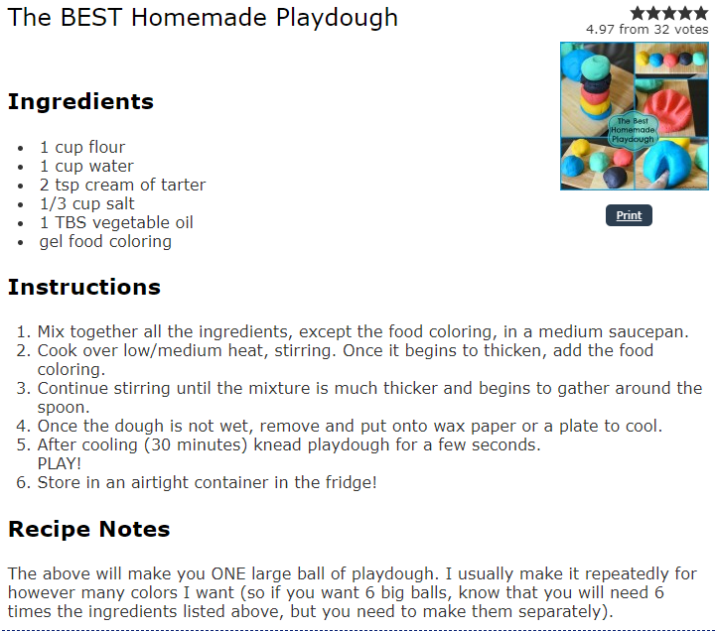

Slide 4

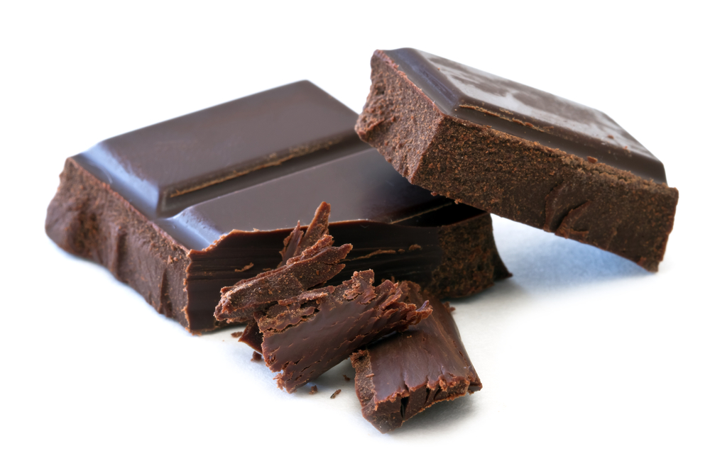
Next Week you will need the following if you want to follow the science experiments.
Starburst Sweets (about different colours)
Plain chocolate (about 50g)

Slide 5
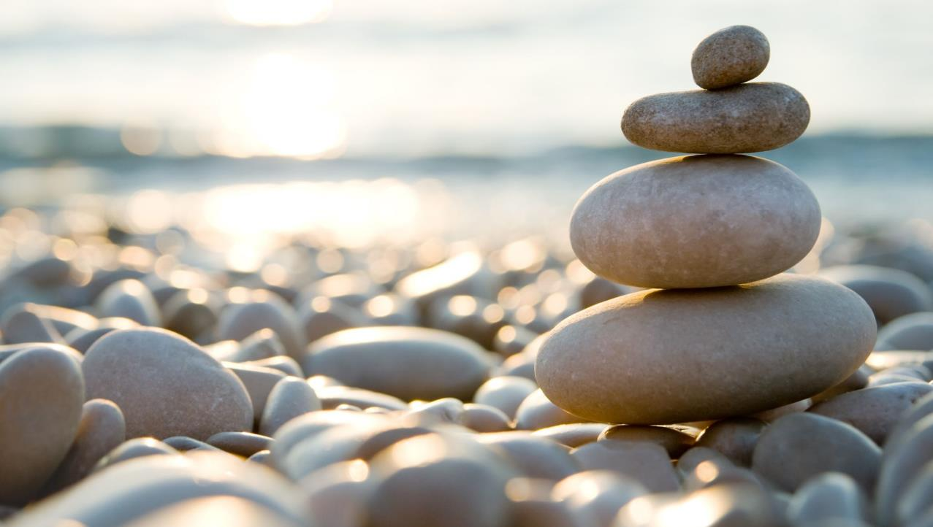
Follow the link for Today’s Worship
This can be found in the
‘Whole School’ folder.

