Slide 1

Pollution!

Slide 2
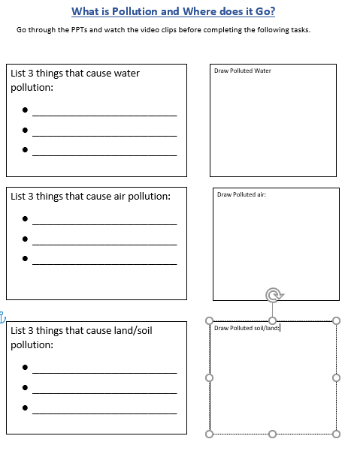
It may be useful to have your worksheet instructions with you while watching the PPT and Video clips. You could then fill in a section as each topic is covered.

Slide 3
Climate Change
What is waste and where does it go?
Use the Tinkle Go pin code to access the ppts:
YR8279
Watch the following Video clip
You may want to pause after each section to fill in your worksheet:
Air , Water and Land Pollution
https://www.youtube.com/watch?v=OqHp03RRTDs

Slide 4
If you are interested and would like to watch a few extra clips:
Rubbish in the River Thames
https://www.bbc.co.uk/bitesize/clips/zr2jmp3
Human impact on the environment.
https://www.bbc.co.uk/teach/class-clips-video/science-ks2--ks3-human-impact-on-the-environment/zf9nvk7

Slide 5

Follow the link for Today’s Worship
Live on TEAMS with
Mr Debenham

